Slide 2
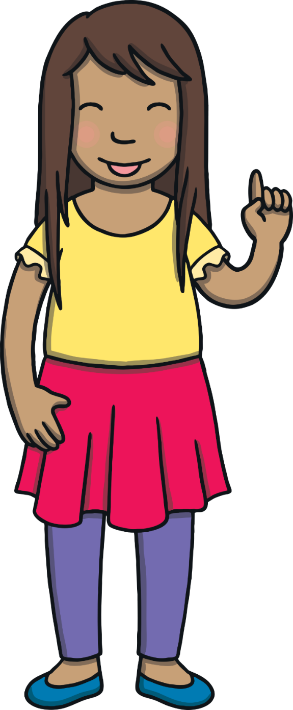
Today, we are learning to read words that contain u_e saying /yoo/.

Slide 3
Teach
u and e are cheeky partners. When u and e work together, they say /yoo/.
u and e are too cheeky to sit together so they have to have a letter sit between them.
u
_
e

Slide 4
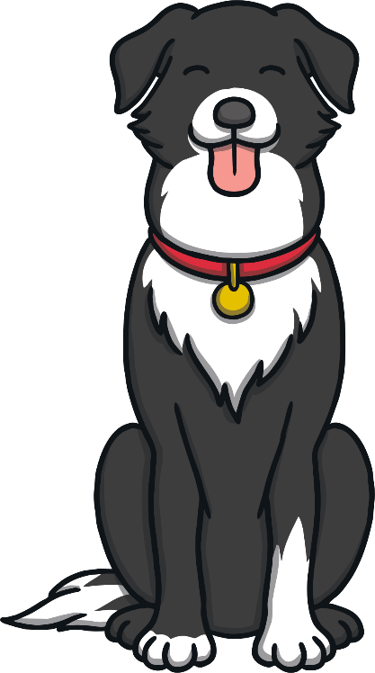
Teach
Let’s read these words.
use
tune
X
cute
refuse

Slide 5
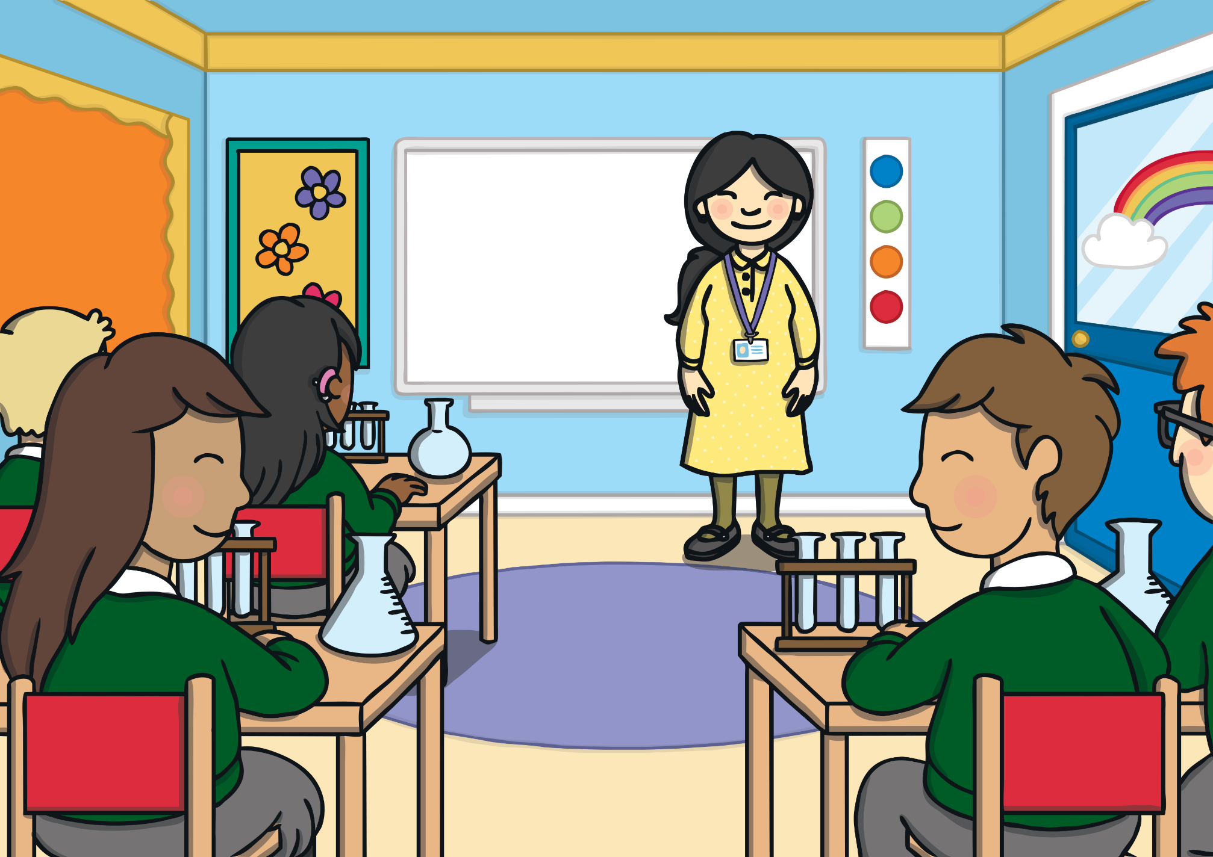
Teach
Kit and Sam were in a school science lesson. “Today, we will use a test tube to do an experiment,” said their tea ch er, Mrs Tan. “Then, you will all complete a science project for your homework. Take a test tube home as you will need to use one for your project.”

Slide 6
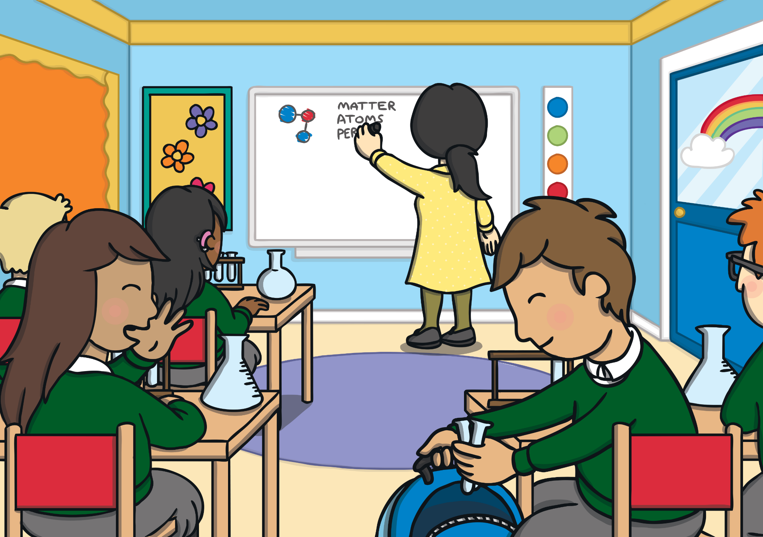
Teach
“Cool!” said Kit. “I feel just like Albert Einstein.”
“Who is he?” asked Sam. “He was a very famous scientist,” said Kit. “The world would be a diff erent place without his discoveries.”

Slide 7
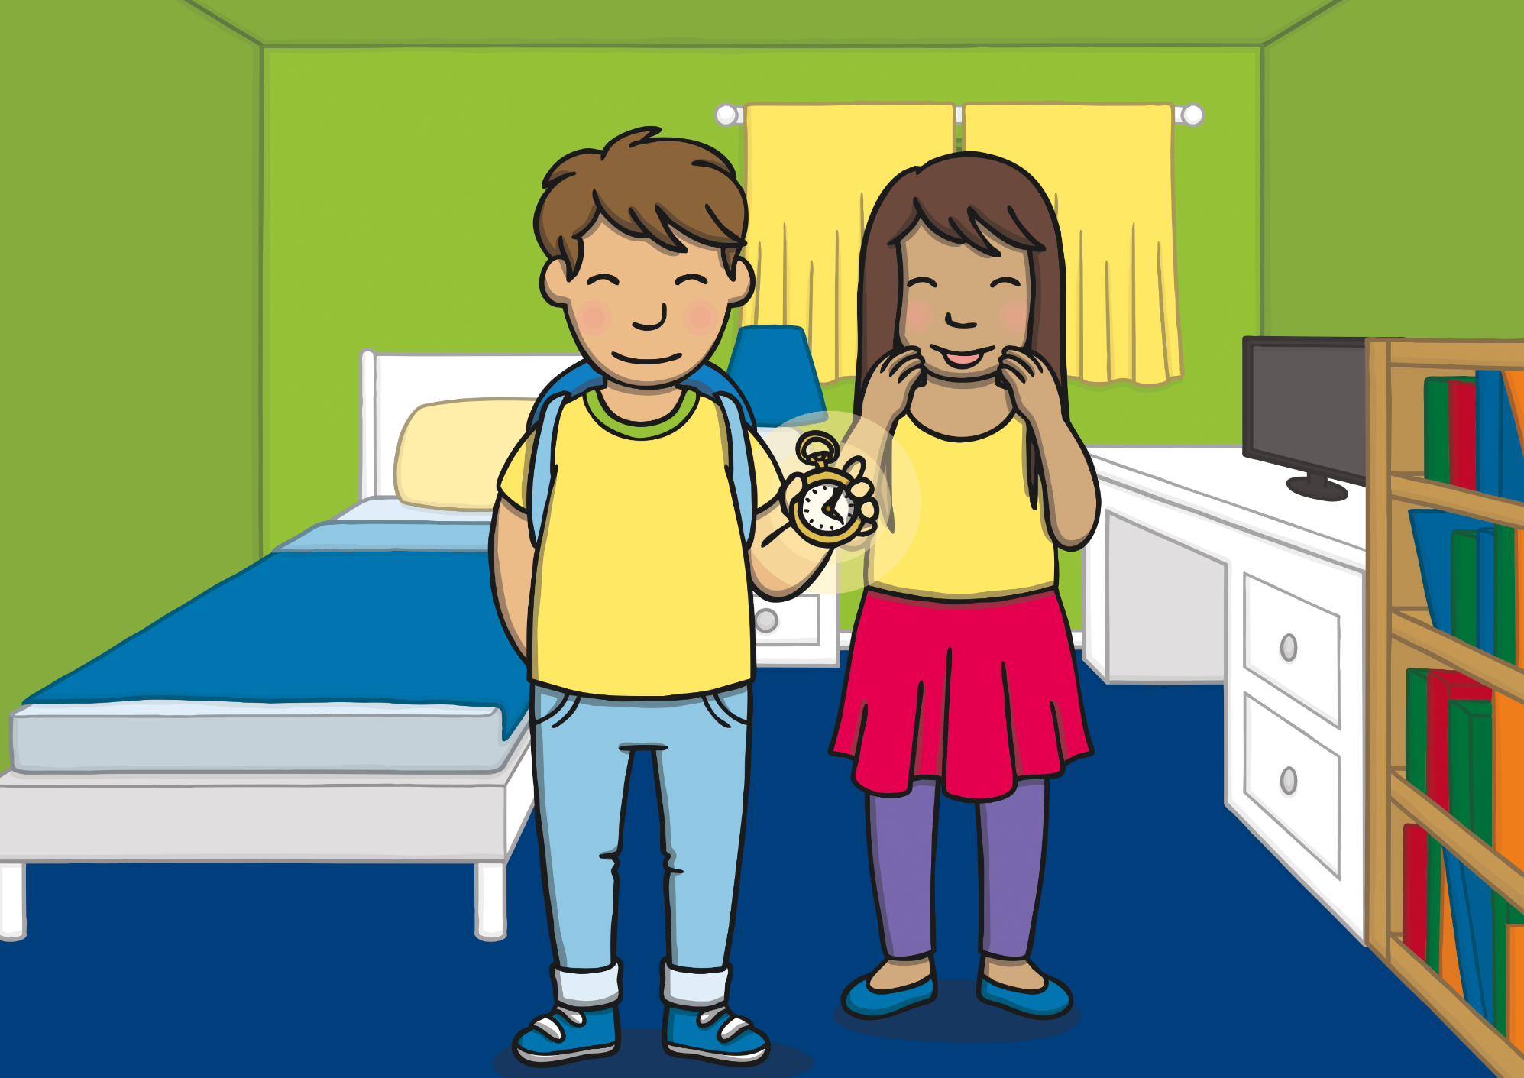
Teach
Sam wanted to find out more about Albert Einstein. “I have an idea,” said Kit and he took out the magic watch. “Let’s go and meet him…he could even help with our science projects!” The room began to fade…

Slide 8
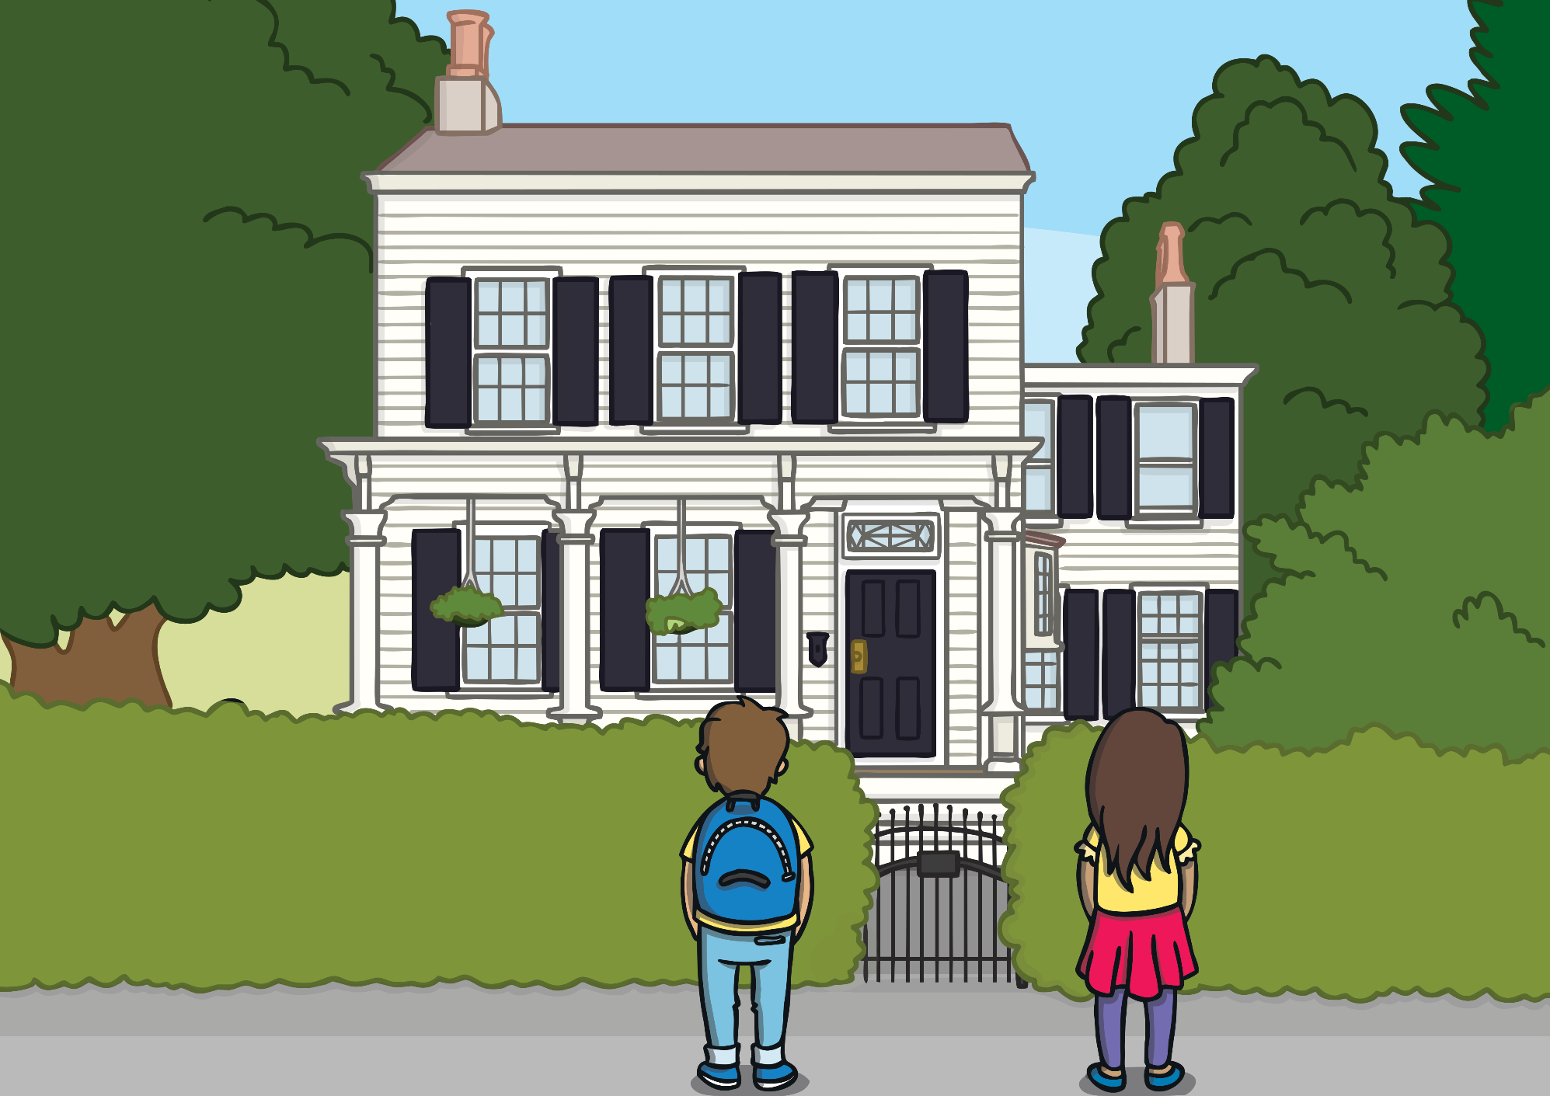
Practise
Kit and Sam found themselves outside a huge white house. “Where are we?” asked Sam.
“This is Albert Einstein’s home in America. We must be in about the year 1935. That is when he moved to this house.”

Slide 9
Apply
Sam looked around as Kit put away the magic watch. “Do you think we should have called and asked whether we could visit first?” asked Sam nervously.

Slide 10
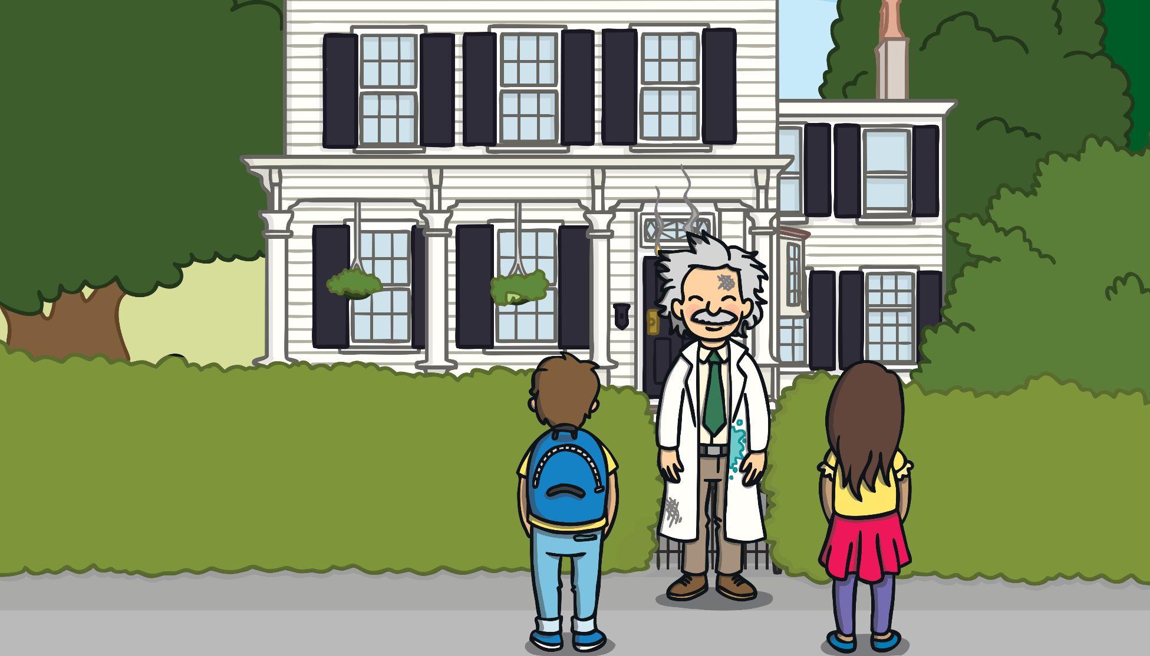
Apply
Sentence Time
Suddenly, a grumpy-looking man appears from the house and looks up and down the road. What does he say?

Slide 11
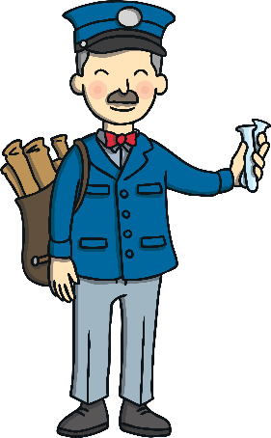
Apply
Apply
“I asked for a test tube but the mailman has not called yet!”
Sound Buttons On/Off
Show

Slide 12
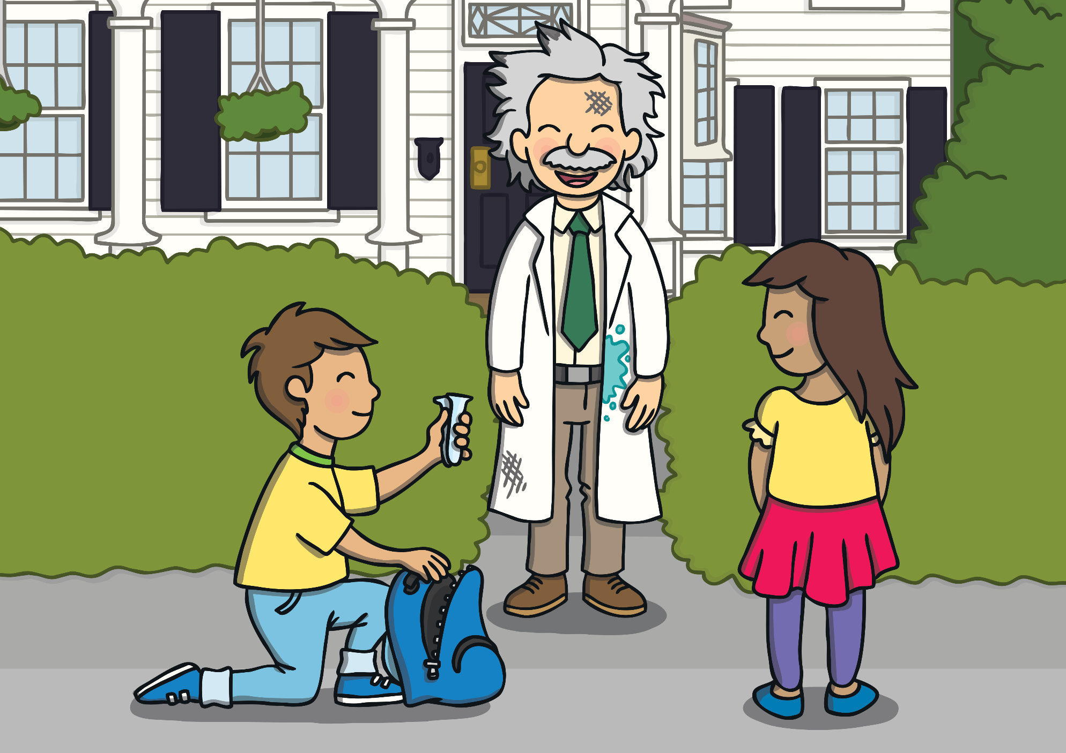
Apply
The man saw Kit and Sam standing outside his house. “Are you the mailman with the test tube I need to use?” he asked Kit.
“No,” replied Kit. “But I might be able to help you…”

Slide 13
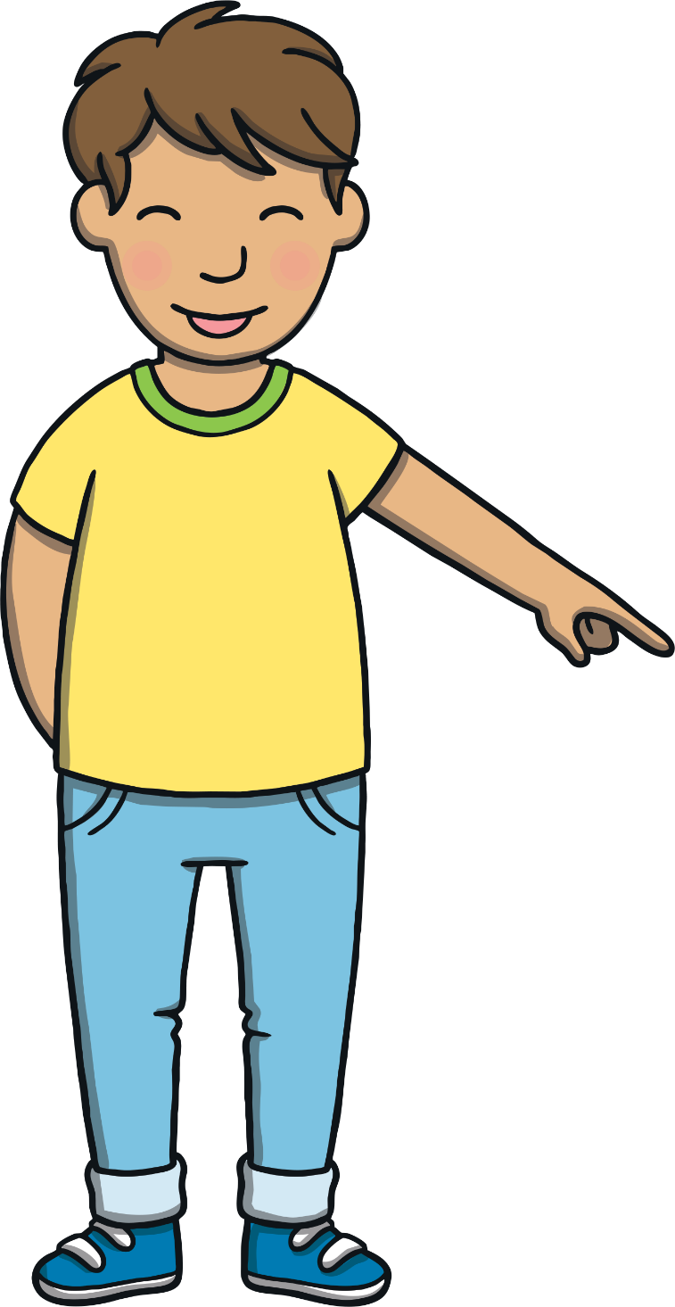
Apply
Today, we have learnt…
u_e
saying /yoo/
The adventure continues next lesson!

