Slide 2
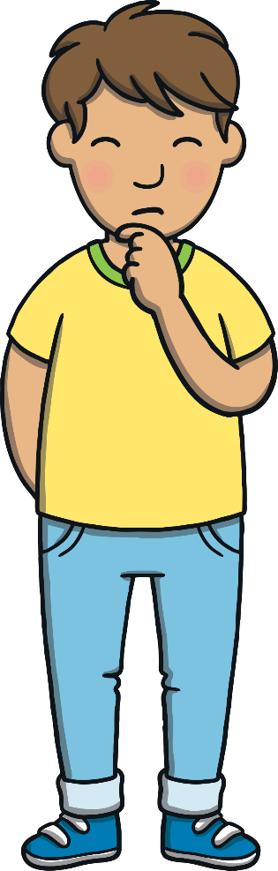
Teach
Here are this week’s focus words for reading…
water
where

Slide 3

Teach
Today, we are learning to write words that contain ou saying /ow/.

Slide 4
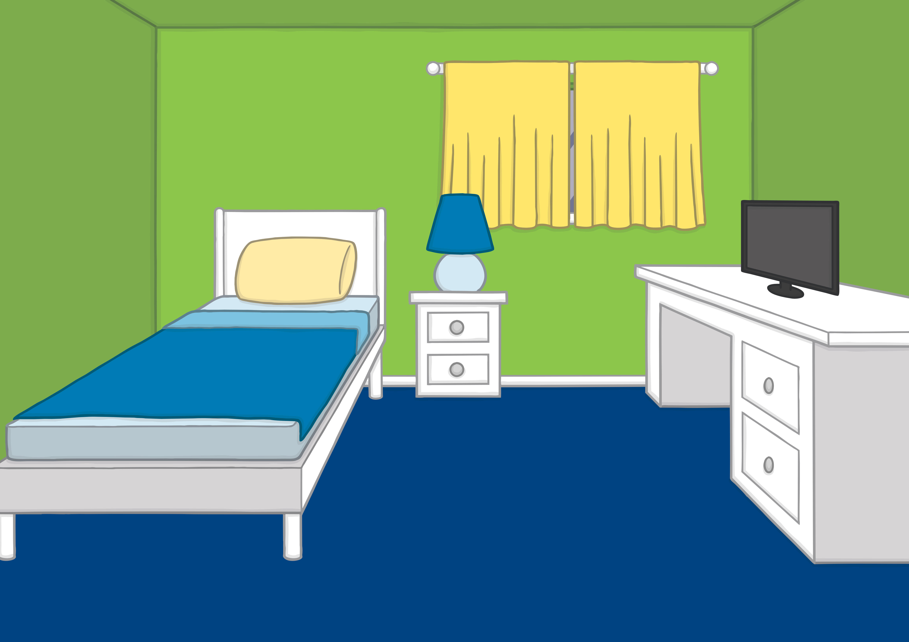
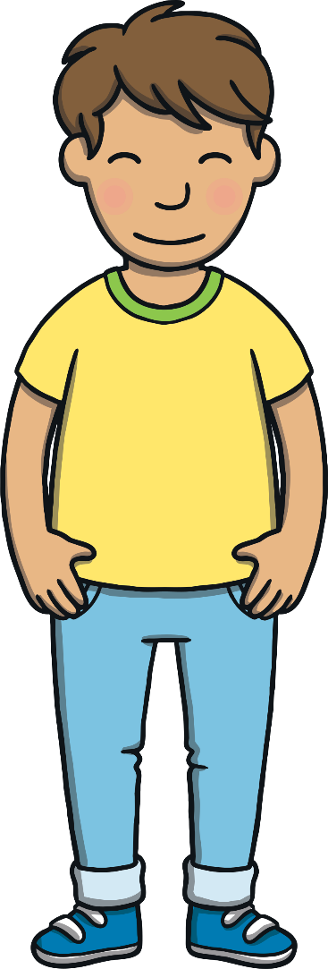

Teach
Kit and Sam were very excited because tonight they were going on their first ever Beaver sleepover. They were going to camp in the woods with some of their friends!

Slide 5

Teach
Mum helped Kit and Sam pack their rucksacks for the trip. They had a long list of things to bring! “Do not forget to pack these,” said Mum as she handed Kit and Sam a water flask each.

Slide 6


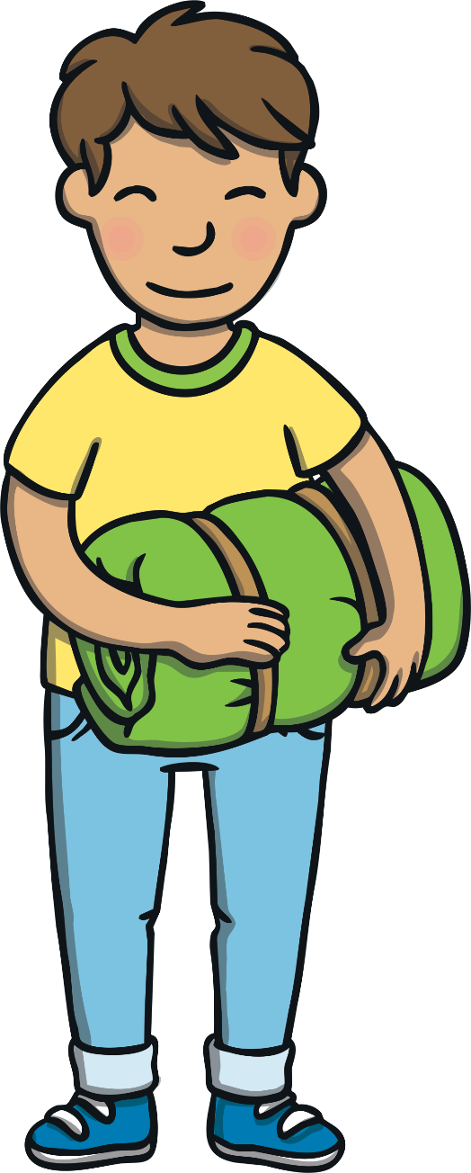
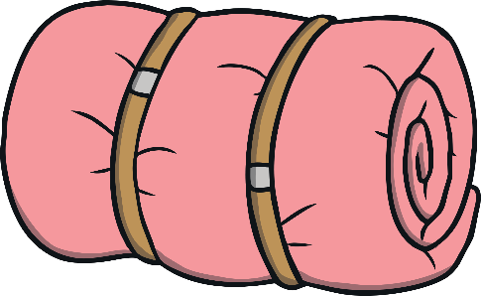
Teach
“Do we have to bring a sleeping bag?” asked Kit. “I want to sleep out under the stars!”
Mum replied, “A sleeping bag is on the kit list. I think you might be glad of it when it gets cold in the night.”

Slide 7

Teach
Sometimes the /ow/ sound can be spelt with an o and a u. Together they make ou.
d
u
cl
o

Slide 8


Teach
‘ou’ Sleeping Bag
Kit and Sam need a sleeping bag. Click on the sleeping bag to reveal the words. Can you read them?

Slide 9

Practise
shout

Slide 10
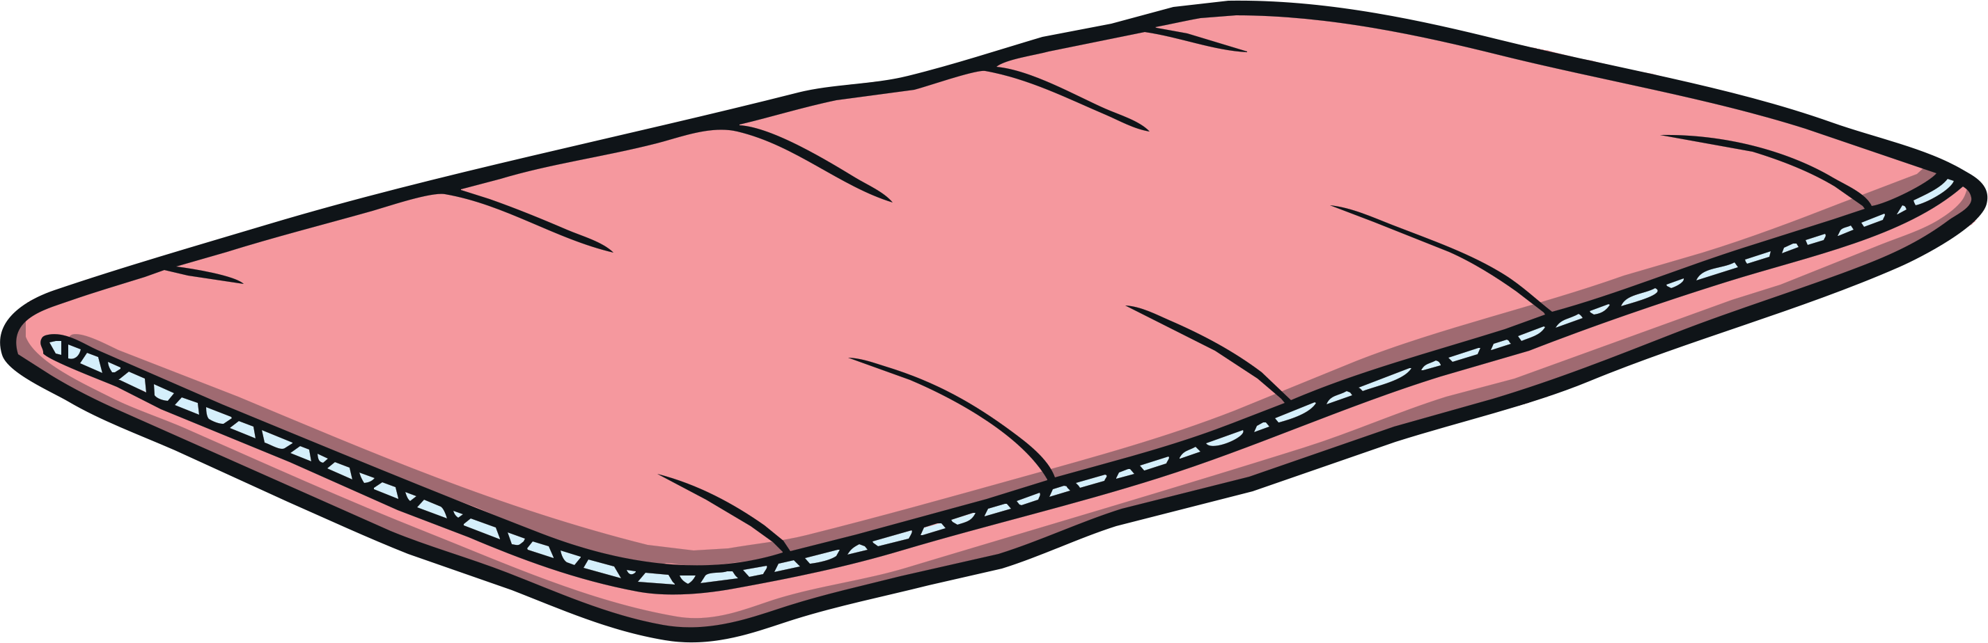
Practise
ground

Slide 11
Practise
pound

Slide 12
Practise
mouth

Slide 13
Practise
found

Slide 14

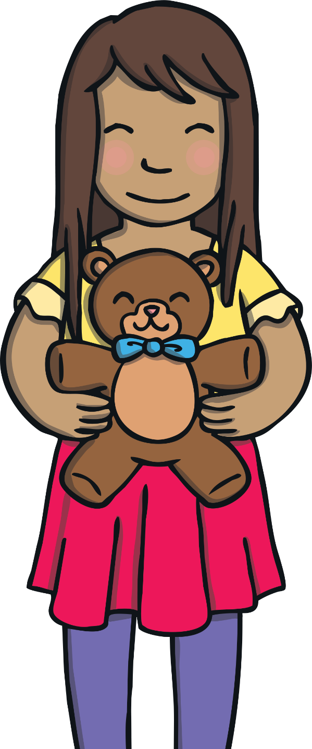
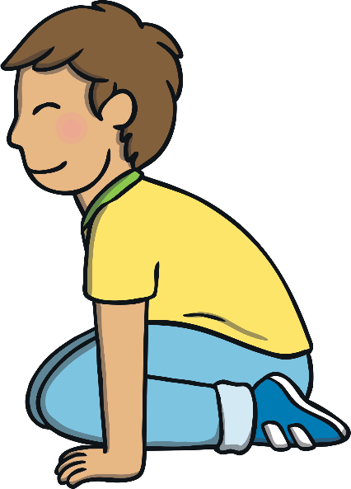
Apply
“I am going to bring my favourite teddy,” Sam said to Kit and Mum. Mum smiled but Kit did not hear Sam because he was crouched down on the floor by the bed.

Slide 15

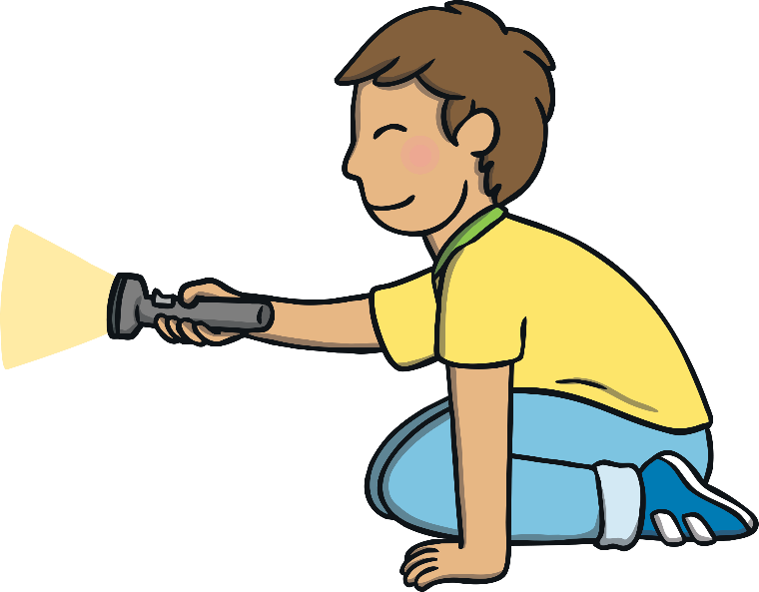
Apply
Kit was busy playing with the torch his Dad had given him. He needed to bring it with him on the camping trip. Mum had not noticed what Kit was up to.

Slide 16

Apply
Sentence Time
As Mum reads down the kit list, she suddenly realises one item is missing from Kit’s rucksack. What is Mum going to ask Kit?

Slide 17

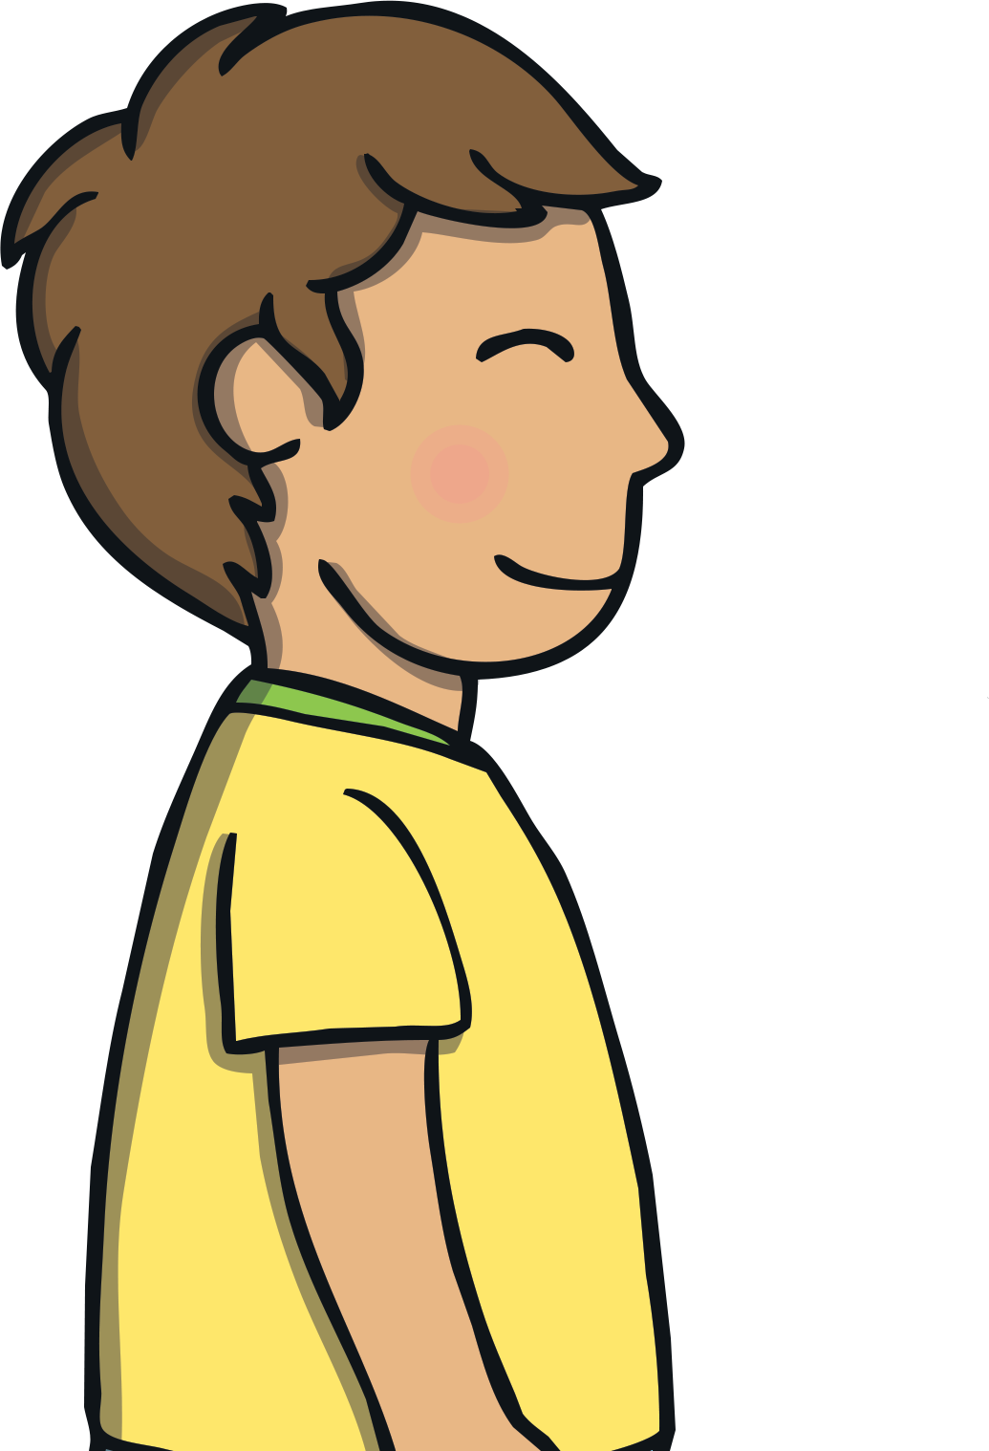
Where is the torch that Dad lent you?

Slide 18

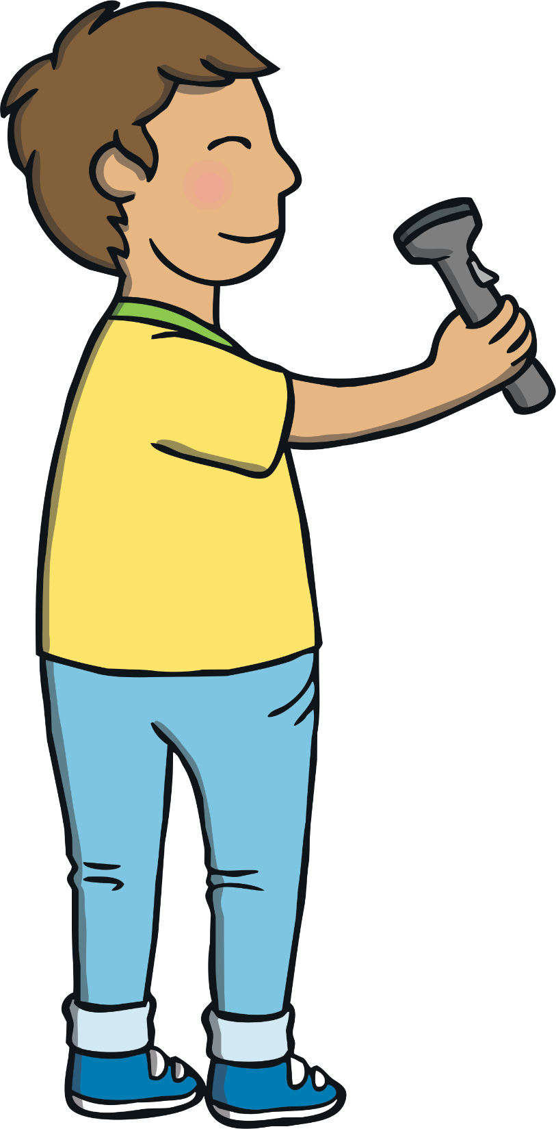
Apply
Kit took a moment to respond. Then, he shouted from under the bed, “it is here! I was just testing the torch out.” He stood back up and smiled.
“OK, pop it into your rucksack. It is time to go,” said Mum.
Sam smiled, “I am super excited for our camping trip!”

Slide 19
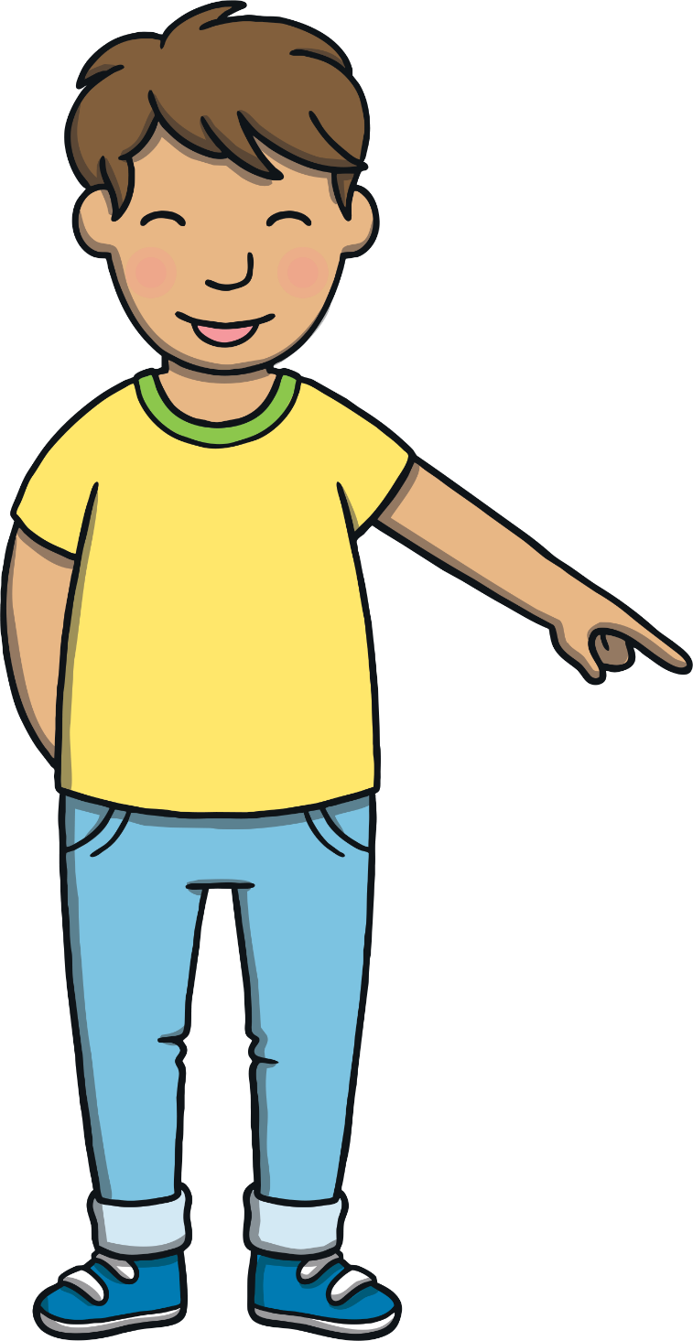
Today, we have learnt…
ou
saying /ow/
The adventure continues next lesson!

