Slide 2
Teach
a and e are cheeky partners. When a and e work together, they say /ai/.
a and e are too cheeky to sit together so they have to have a letter sit between them.
_
a
e

Slide 3

Teach
Let’s read these words.
ape
ate
make
X
tape
game

Slide 4
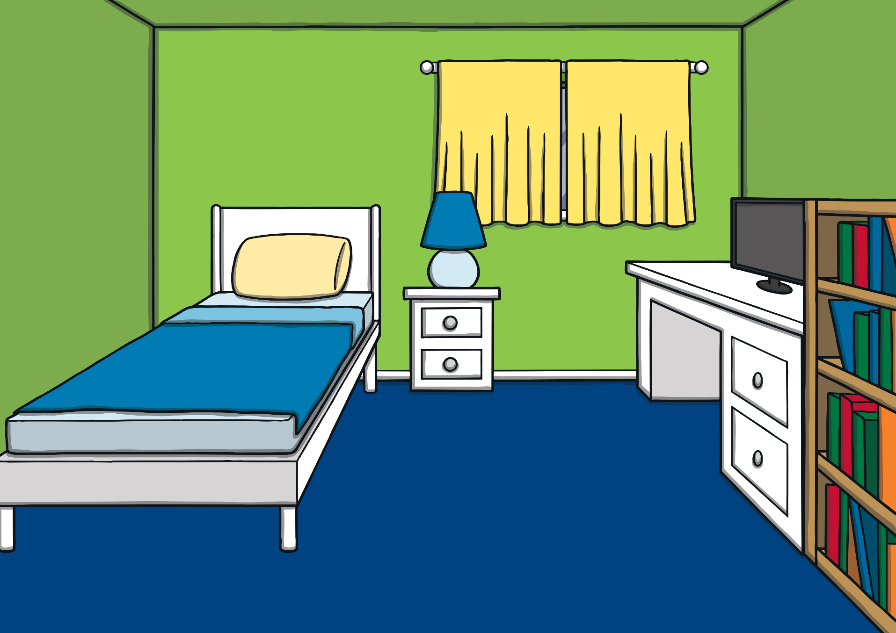


Teach
It was nearly Kit and Sam’s birthday. The twins were very excited. They were going to have a joint party!

Slide 5
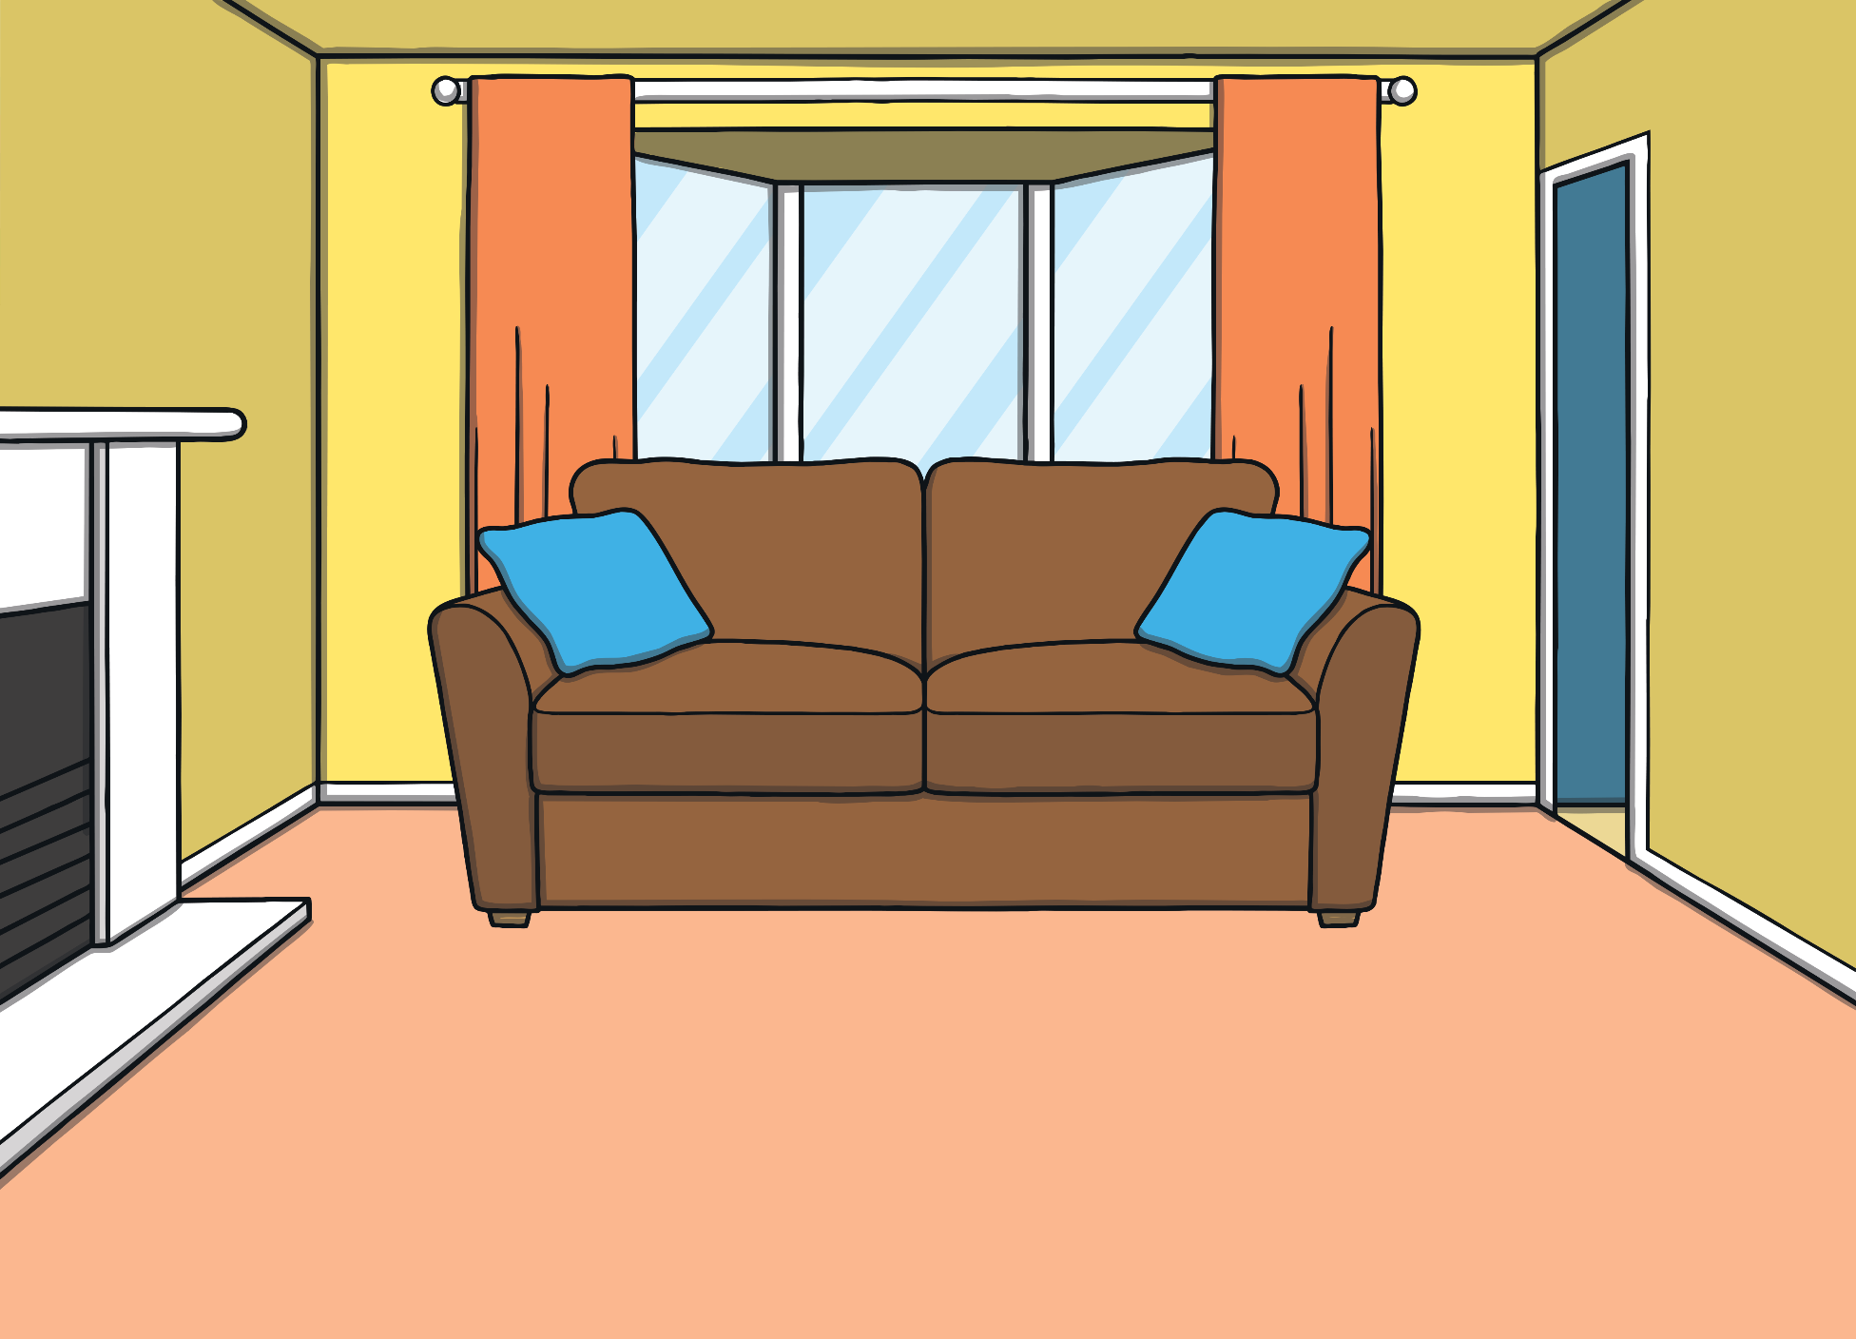




Teach
Sam asked, “What would you like as a present?”
“Hmm, maybe a fluffy toy? How about you?” asked Kit.
“I think I would like a race car,” replied Sam.

Slide 6





Teach
While Kit was licking his lips and thinking of birthday cake, Mum shouted from the kitchen, “Sam! Kit! Can you please help me?”

Slide 7
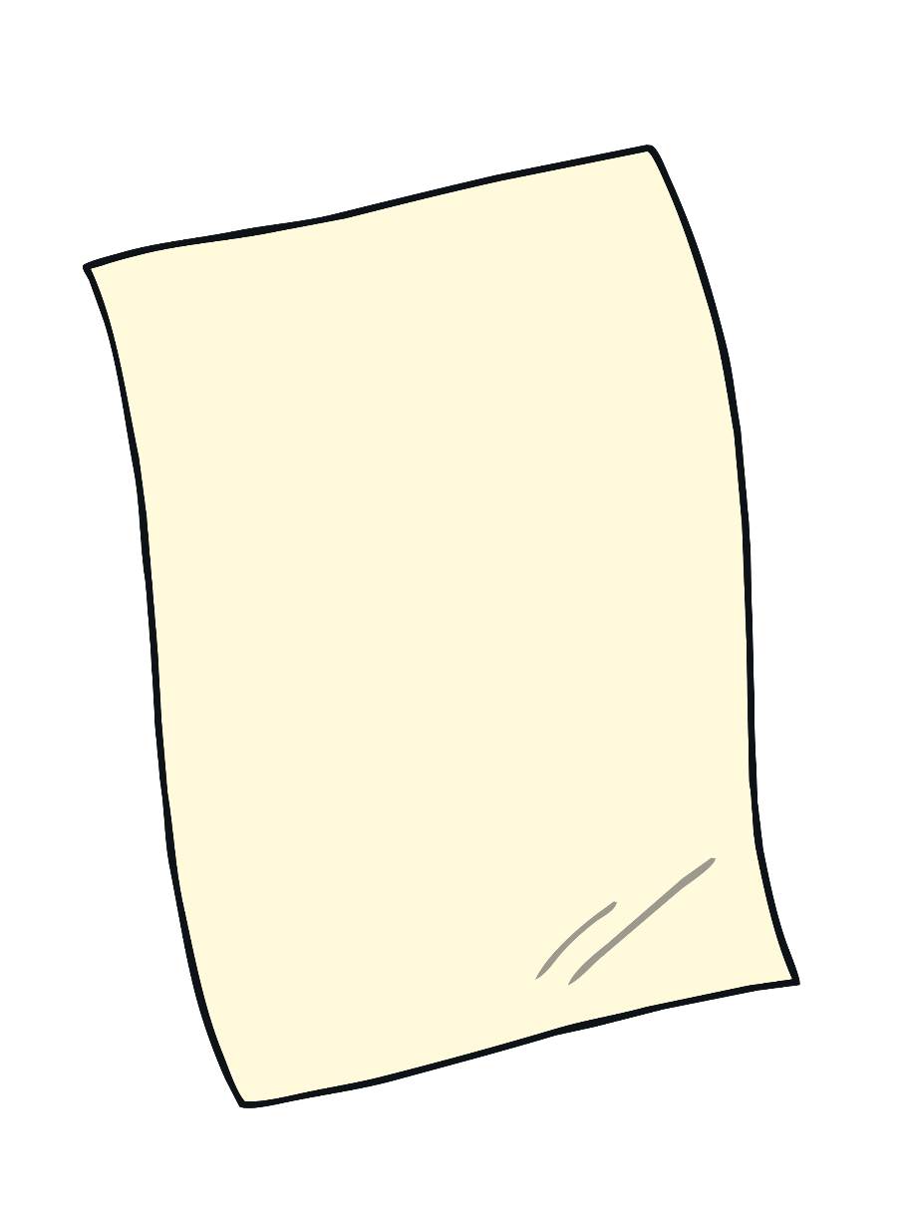
Teach
Mum needs Kit and Sam to check the party list. The cheeky partners a and e make the /ai/ sound. Can you read the a_e words on Mum’s list?

Slide 8


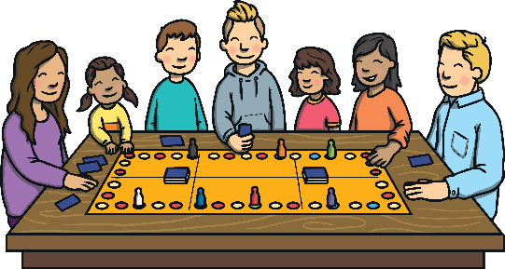

Teach
game
cake
shake
grapes

Slide 9
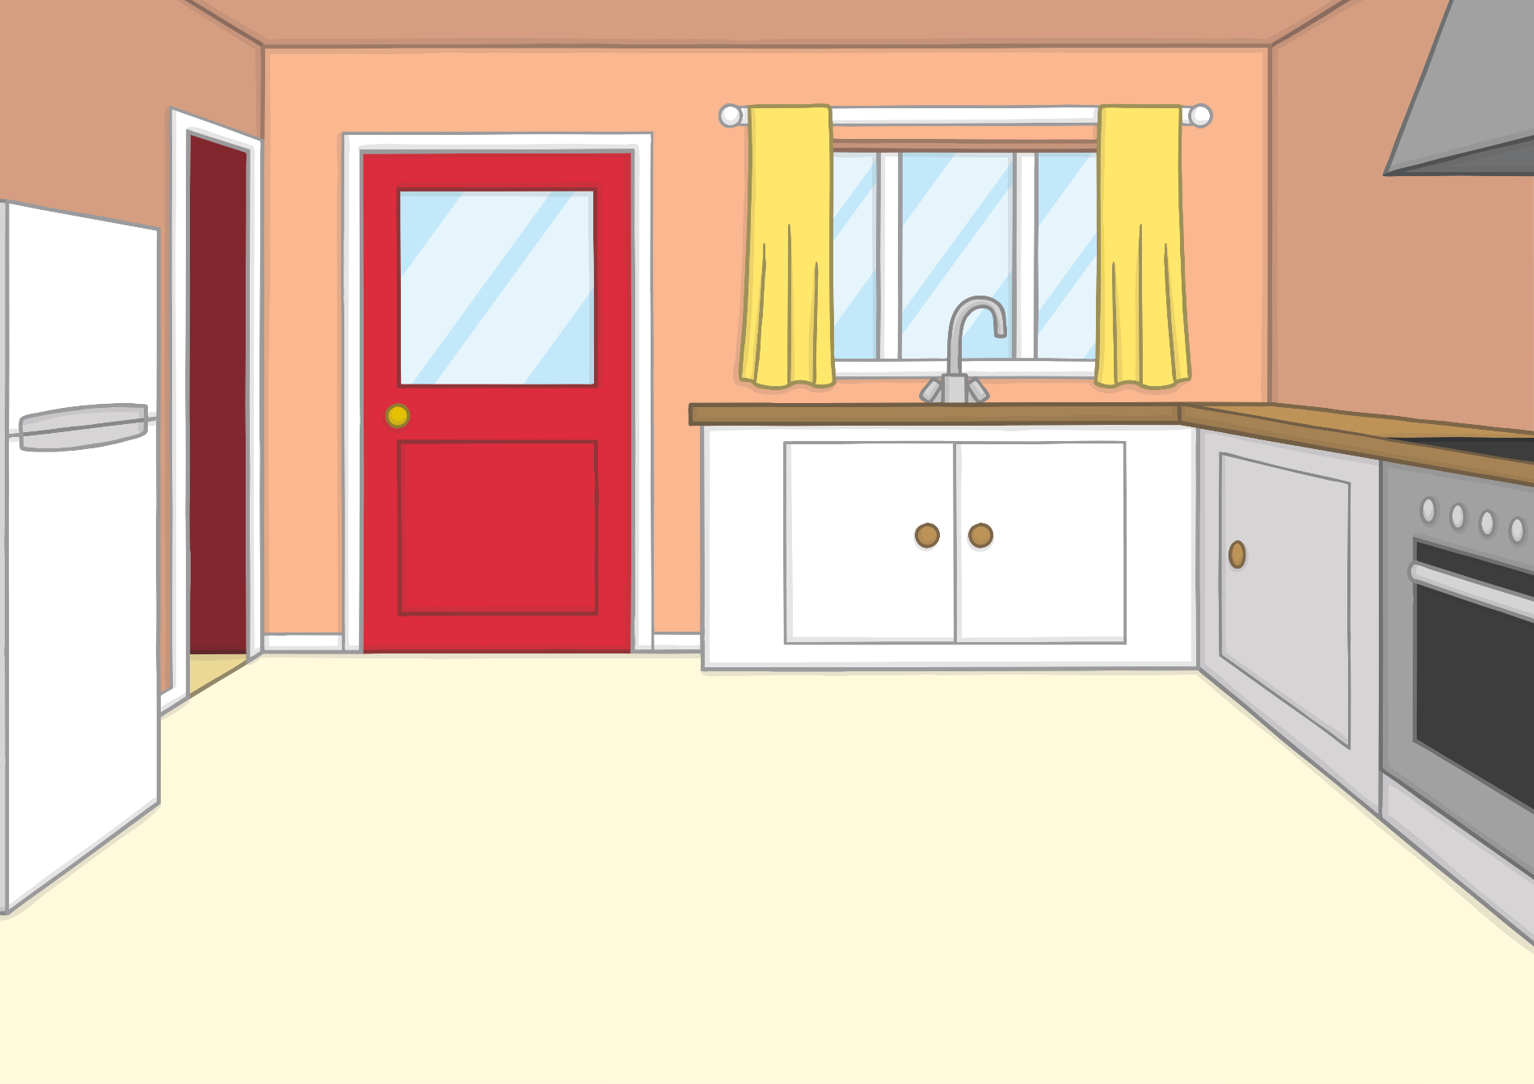



Teach
“I want to make plenty of food for the party,” said Mum.
“Can we help?” shouted Kit. “I can bake the cake! That’s the most important job!” he said, licking his lips again.

Slide 10

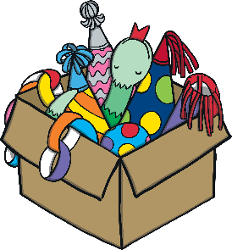
Teach
“I could do with some help too!” said Dad, who stumbled in carrying a box of decorations.
“I’ll help you with those,” said Sam.

Slide 11


Apply
Is your snake game from last year in that box?
Sound Buttons On/Off
Show

Slide 12
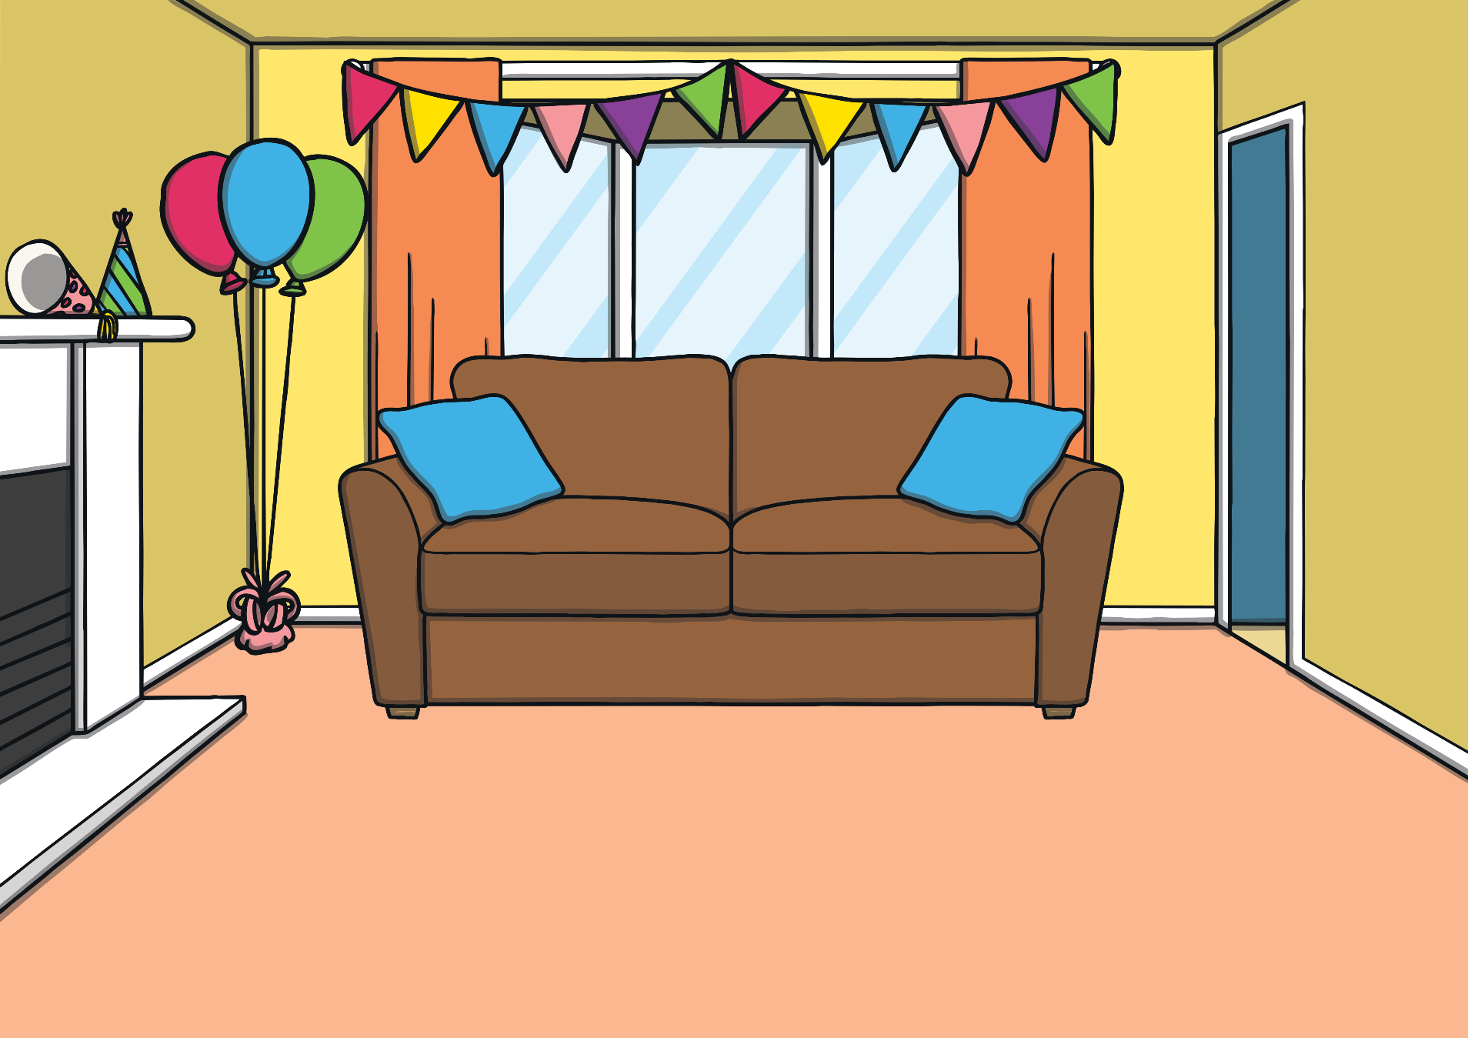



Teach
“I think so,” said Dad as he pulled out a stripy snake.
“Yay, I love to play the snake game!” cried Sam.

Slide 13


Today, we have learnt…
a_e
saying /ai/
The adventure continues next lesson!

