Slide 2
Teach
Here are this week’s focus words for reading…
water
where

Slide 3
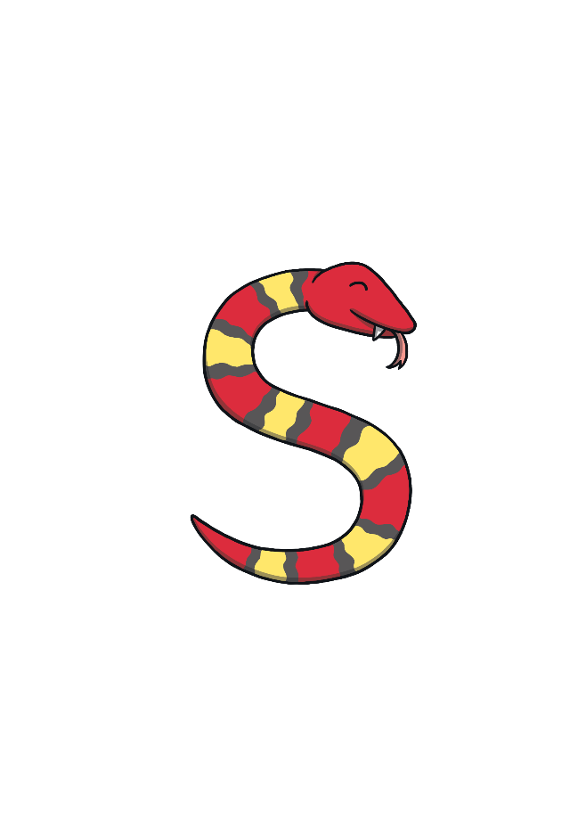
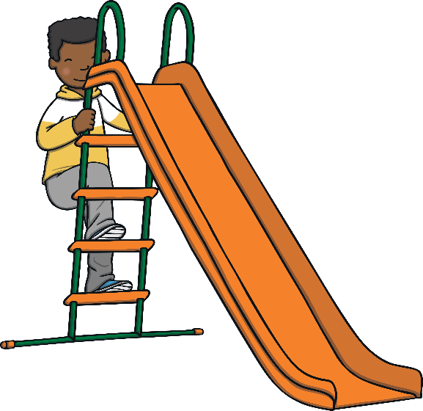
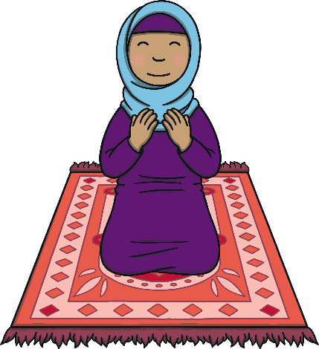
Revisit and Review
Let’s practise Sam’s Sounds and Common Exception Words!
oy
e_e
i_e
o_e
ay
u_e
a_e
ie
ea
oh
would
should
your
their
two
Mr
people
could
Mrs
love
looked
asked
called

Slide 4
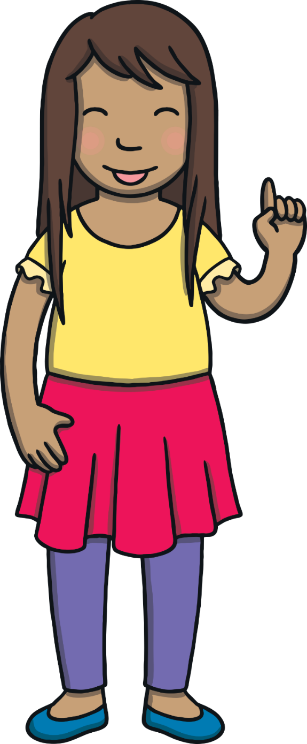
Teach
Today, we are learning to write words that contain ou saying /ow/.

Slide 5
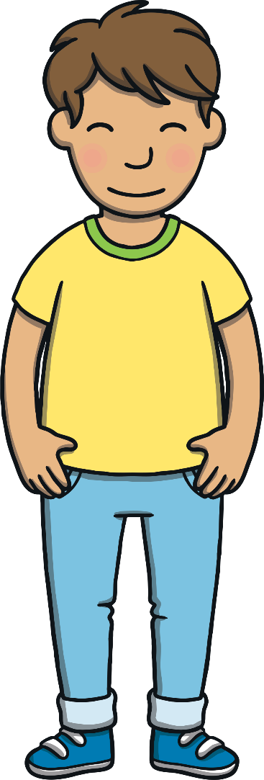
Teach
Kit and Sam were very excited because tonight they were going on their first ever Beaver sleepover. They were going to camp in the woods with some of their friends!

Slide 6
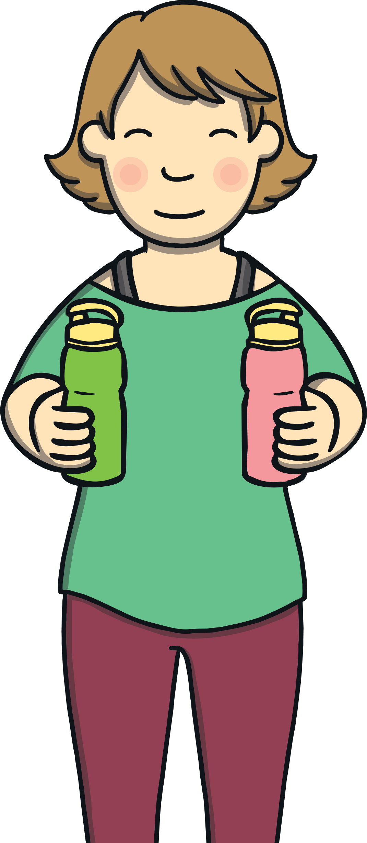
Teach
Mum helped Kit and Sam pack their rucksacks for the trip. They had a long list of things to bring! “Do not forget to pack these,” said Mum as she handed Kit and Sam a water flask each.

Slide 7
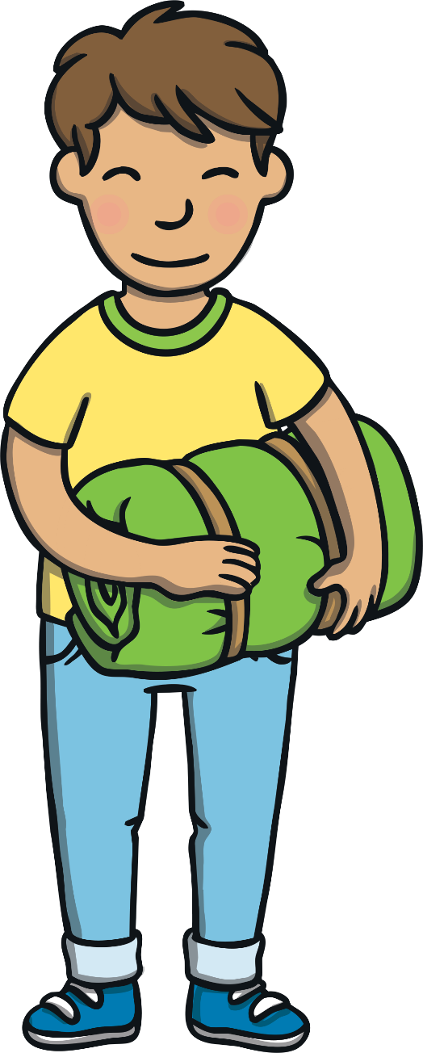
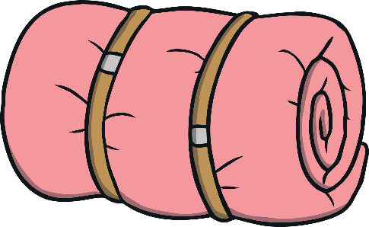
Teach
“Do we have to bring a sleeping bag?” asked Kit. “I want to sleep out under the stars!”
Mum replied, “A sleeping bag is on the kit list. I think you might be glad of it when it gets cold in the night.”

Slide 8
Teach
Sometimes the /ow/ sound can be spelt with an o and a u. Together they make ou.
d
u
cl
o

Slide 9
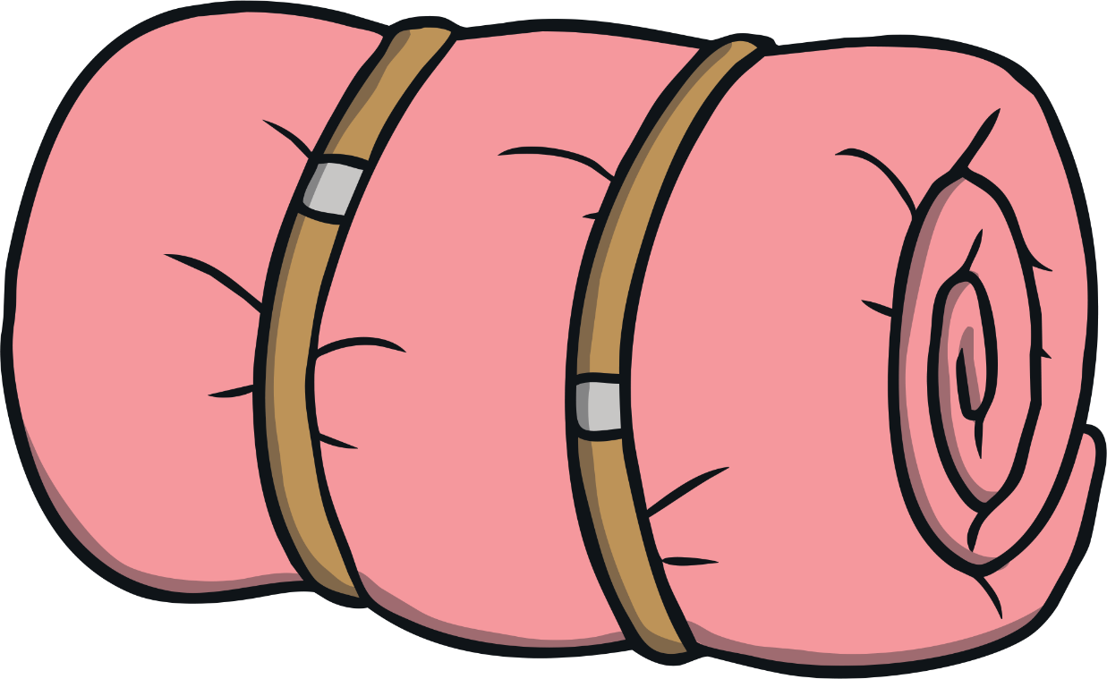
Teach
‘ou’ Sleeping Bag
Kit and Sam need a sleeping bag. Click on the sleeping bag to reveal the words. Can you read them?

Slide 10
Practise
shout

Slide 11
Practise
ground

Slide 12
Practise
pound

Slide 13
Practise
mouth

Slide 14
Practise
found

Slide 15
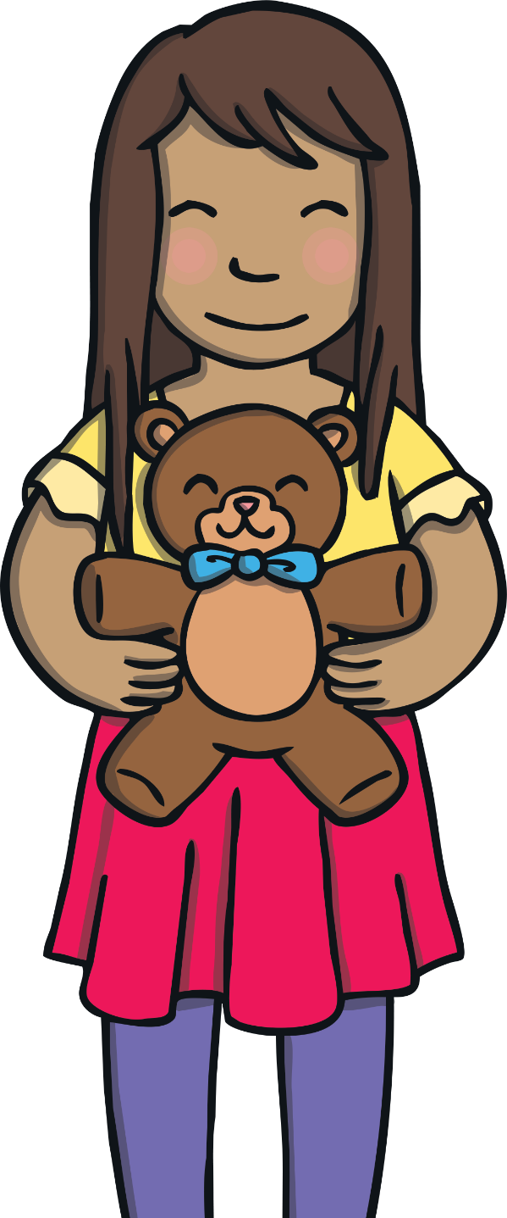
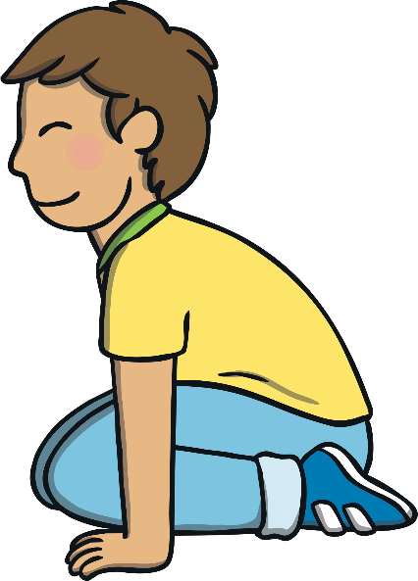
Apply
“I am going to bring my favourite teddy,” Sam said to Kit and Mum. Mum smiled but Kit did not hear Sam because he was crouched down on the floor by the bed.

Slide 16
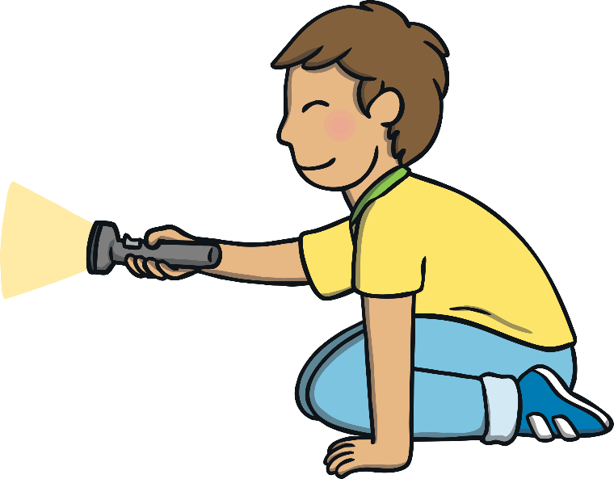
Apply
Kit was busy playing with the torch his Dad had given him. He needed to bring it with him on the camping trip. Mum had not noticed what Kit was up to.

Slide 17
Apply
Sentence Time
As Mum reads down the kit list, she suddenly realises one item is missing from Kit’s rucksack. What is Mum going to ask Kit?

Slide 18
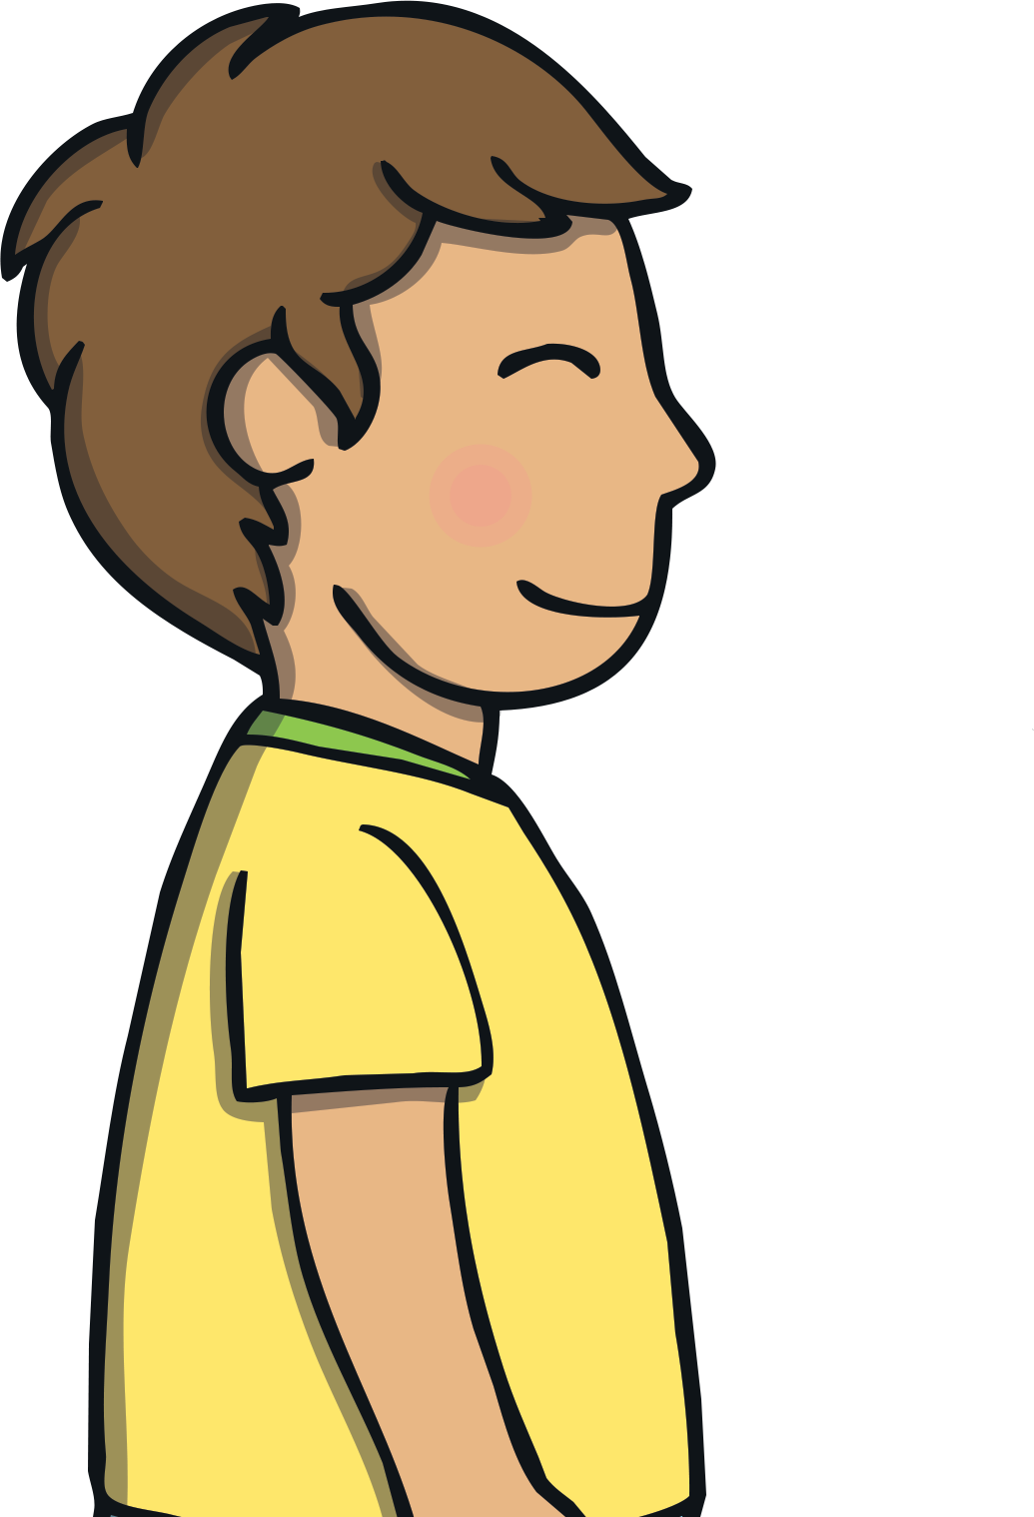
Where is the torch that Dad lent you?

Slide 19
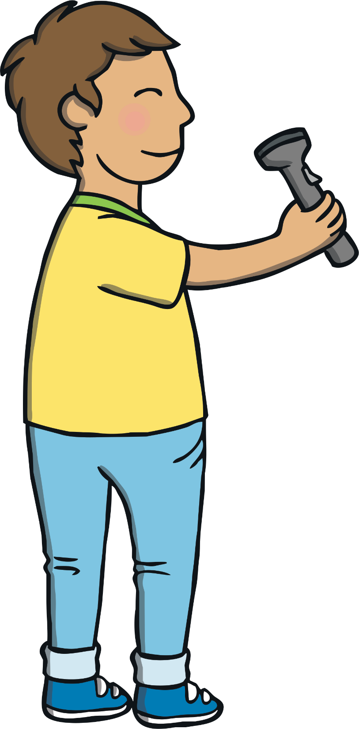
Apply
Kit took a moment to respond. Then, he shouted from under the bed, “it is here! I was just testing the torch out.” He stood back up and smiled.
“OK, pop it into your rucksack. It is time to go,” said Mum. Sam smiled, “I am super excited for our camping trip!”

Slide 20
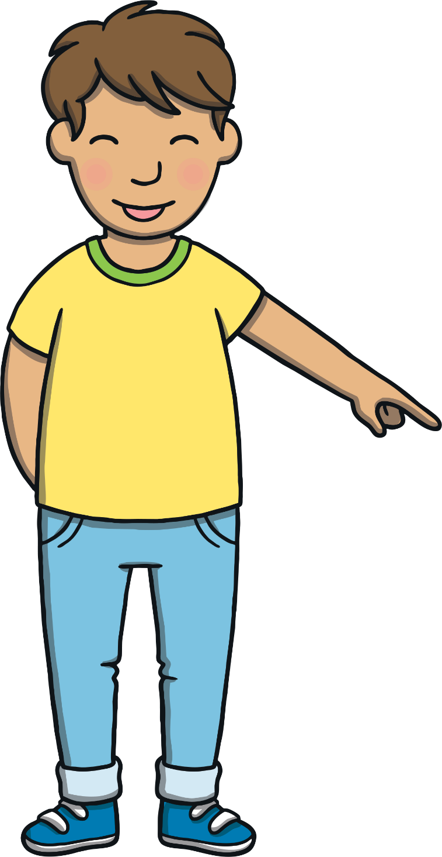
Today, we have learnt…
ou
saying /ow/
The adventure continues next lesson!

