Slide 2
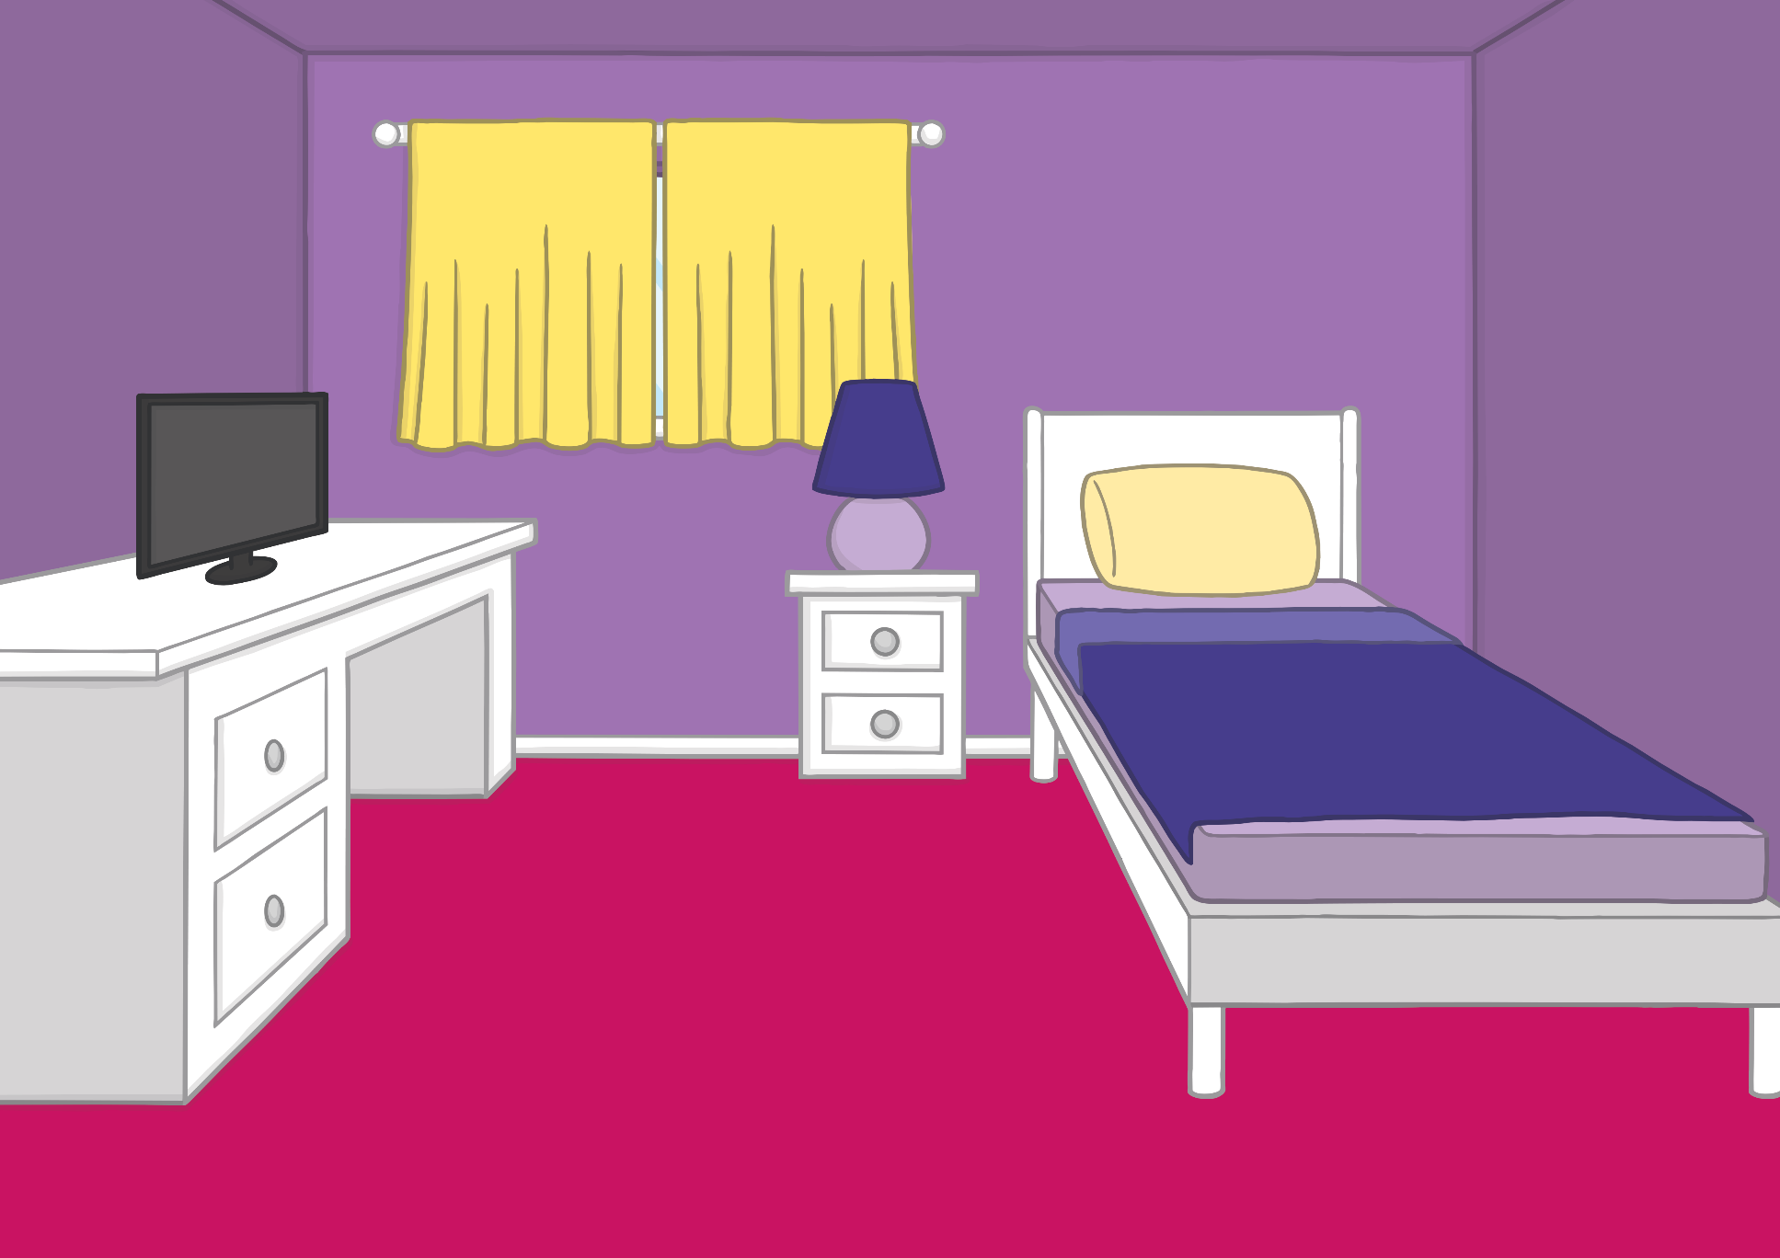
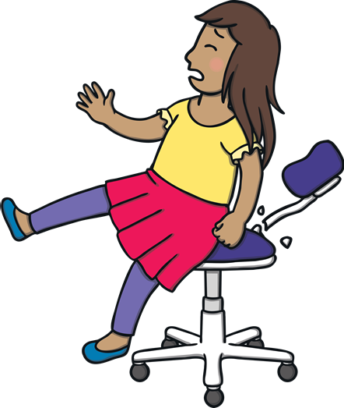
Teach
Sam had a chair in her room that had been there for a long time. One day, she sat on it and it broke.

Slide 3
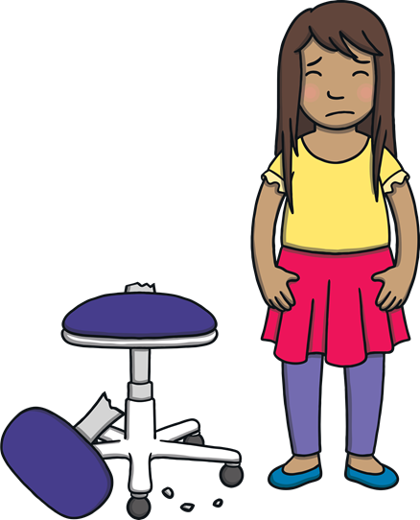
Teach
“You are Goldilocks!” laughed Dad. Sam did not find Dad’s joke funny. “Never mind,” said Dad, “it was getting very small for you anyway. We will get you a new one.”

Slide 4
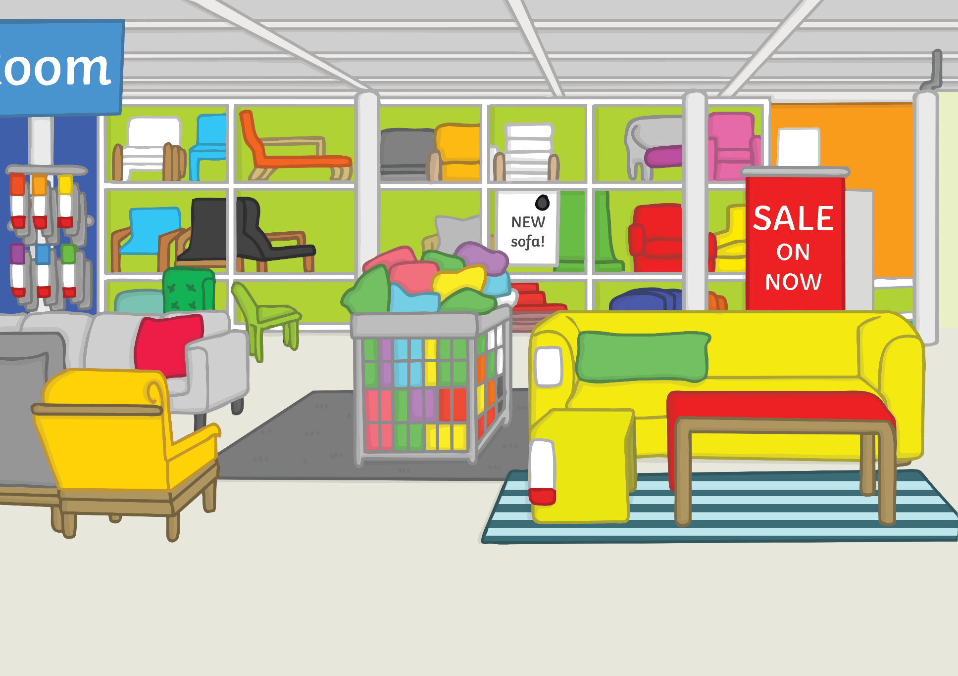
Teach
Sam was delighted when they went to the shop the next day. Dad bought her a brand new chair and a desk to match! She felt very grown up!

Slide 5
i
a
Teach
r
a, i and r are a team. They say air.

Slide 6
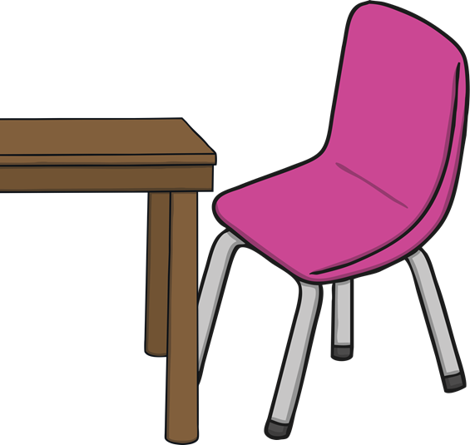
Action
Teach
Hold a chair, move it in and out from a desk.
Say ‘air, air, air’.

Slide 7
Write the Letters
Teach
Around the apple, up the stalk and down the leaf.
Down the body and tail, dot the head.
Down the robot's body, up and over its arm.
air

Slide 8
Practise
h
air
Check

Slide 9
Practise
p
air
Check

Slide 10
Practise
air
Check

Slide 11
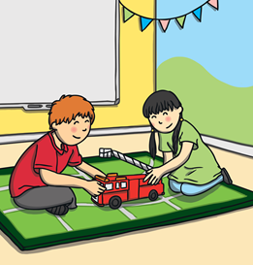
Practise
f
air
Check

Slide 12
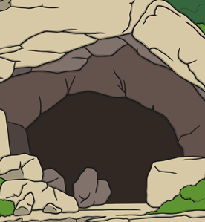
Practise
l
air
Check

Slide 13
Apply
When Sam arrived home with her new desk and chair, Kit came to admire it too. “It’s very comfy.” said Kit, as he sat down. “Look what happened while you and Dad were at the shop…”

Slide 14
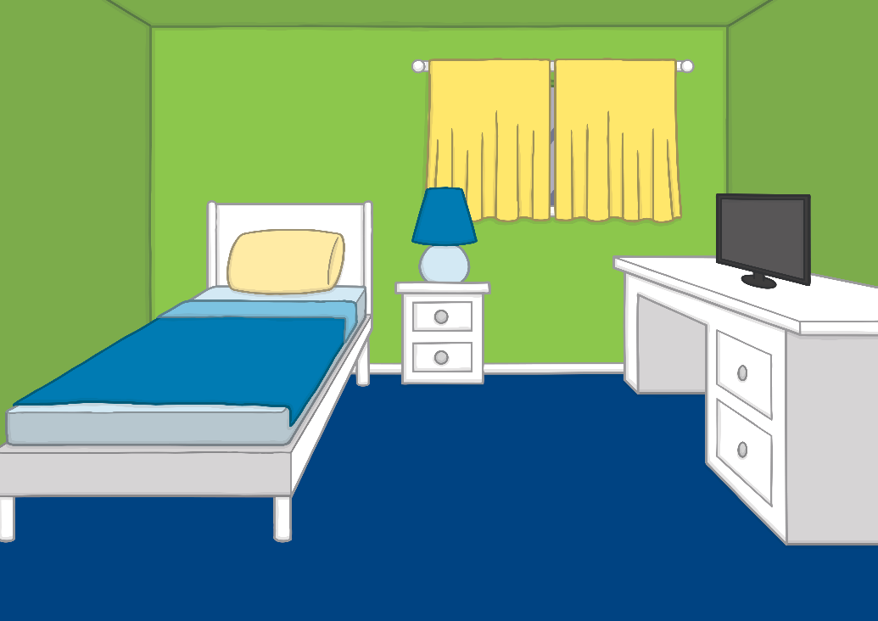
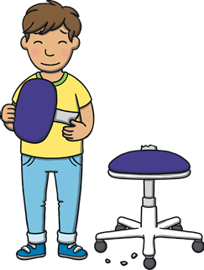
Apply
Now, we need a pair.

Slide 15
Apply
“We love our new chairs and desks!” said Kit and Sam.
“They are very lovely,” said Mum. “Now you both have somewhere to go and do your homework too!” Mum smiled.

Slide 16
Today, we have learnt…
air

