Slide 2
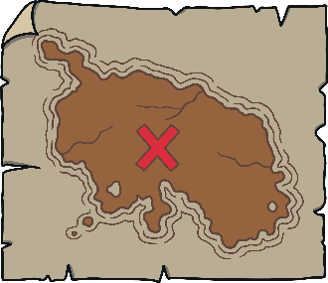
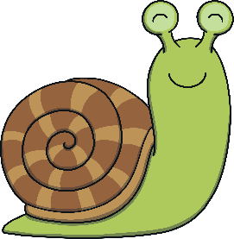
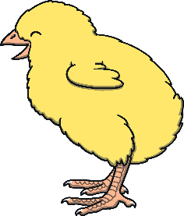
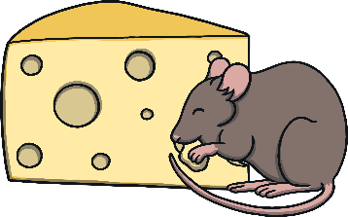
Revisit and Review
Let’s practise Sam’s Sounds and Tricky Words!
j
zz
ow
er
oo
ur
ar
ure
ear
air
oo
or
v
ch
ng
z
oi
igh
y
qu
x
th
ai
ee
oa
w
th
sh
they
here
was
he
she
we
me
be
you
my

Slide 3
Foxes Name and Letter Match
Revisit and Review
Can you match the vixen to their cub? Can you say the name and sound the letter makes?

Slide 4
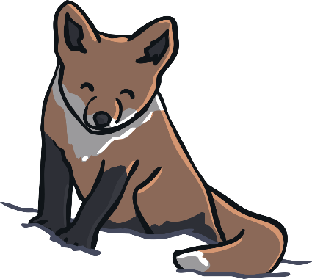
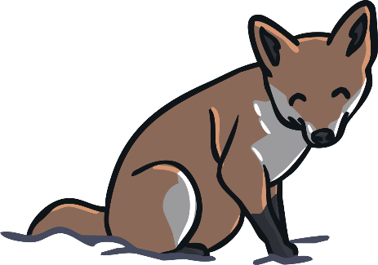
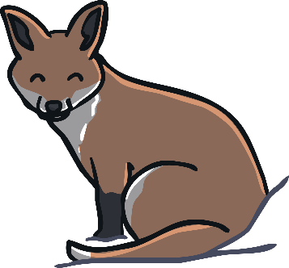
Revisit and Review
L
Y
F
E
Q
K
t
y
s
a
k
k
i
j
f
c
g
f
h
g
e
e
q
r
l
d
t
f
o
l

Slide 5
Today, we are recapping…
Teach
y
z
qu
ch

Slide 6
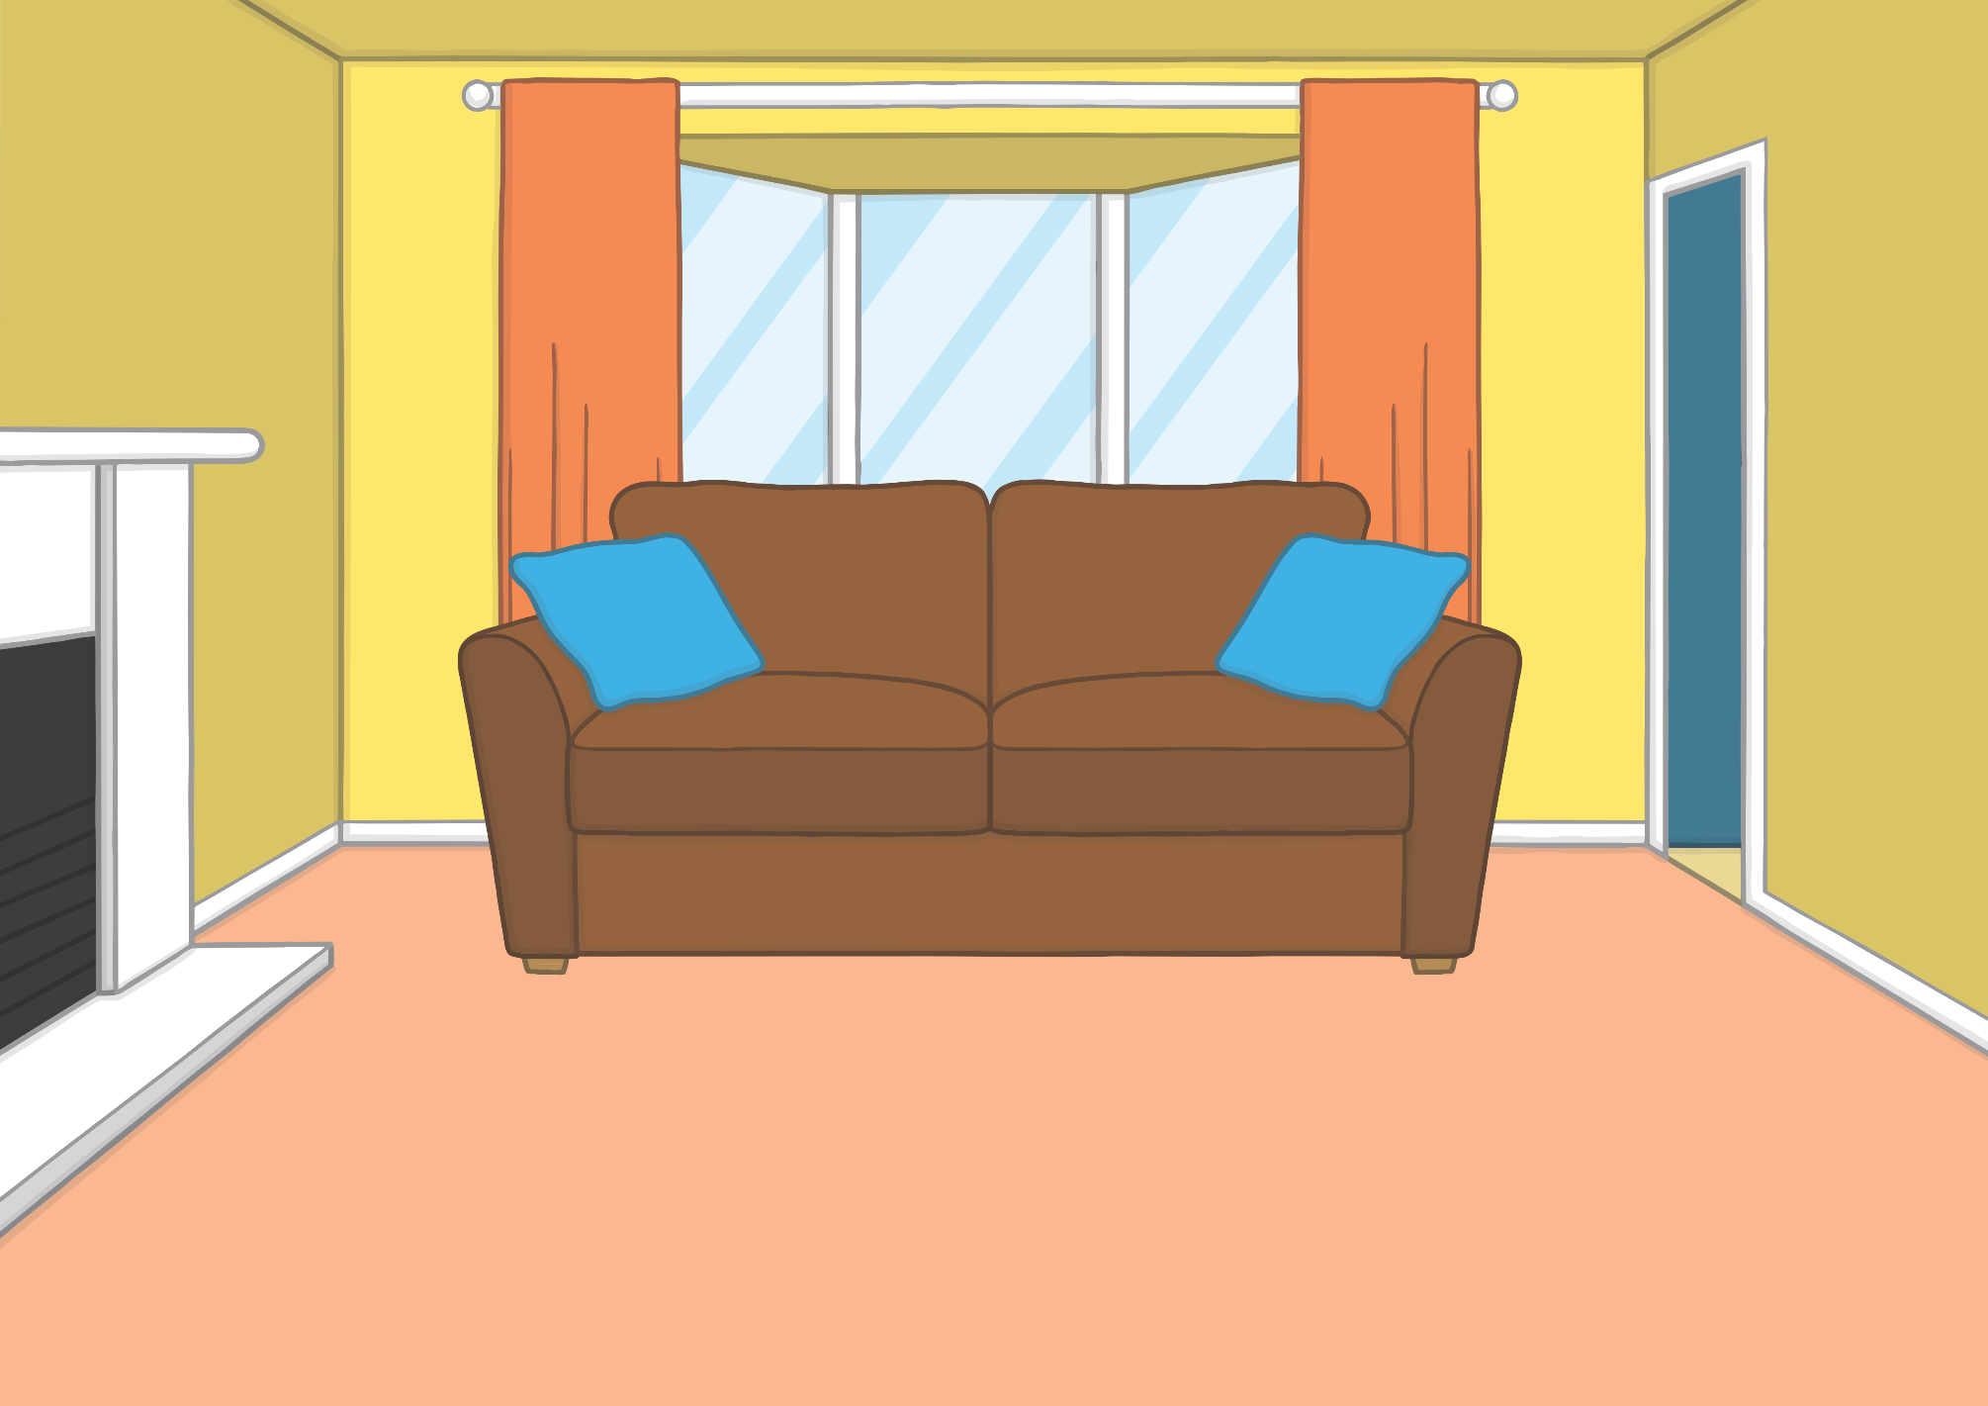
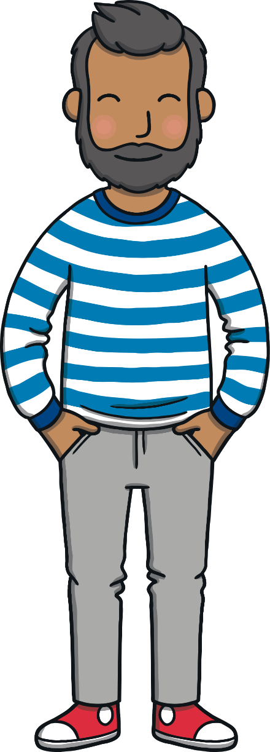
Teach
Kit and Sam were excited, they were going to the river to sail the boats they had each got for their birthday.

Slide 7
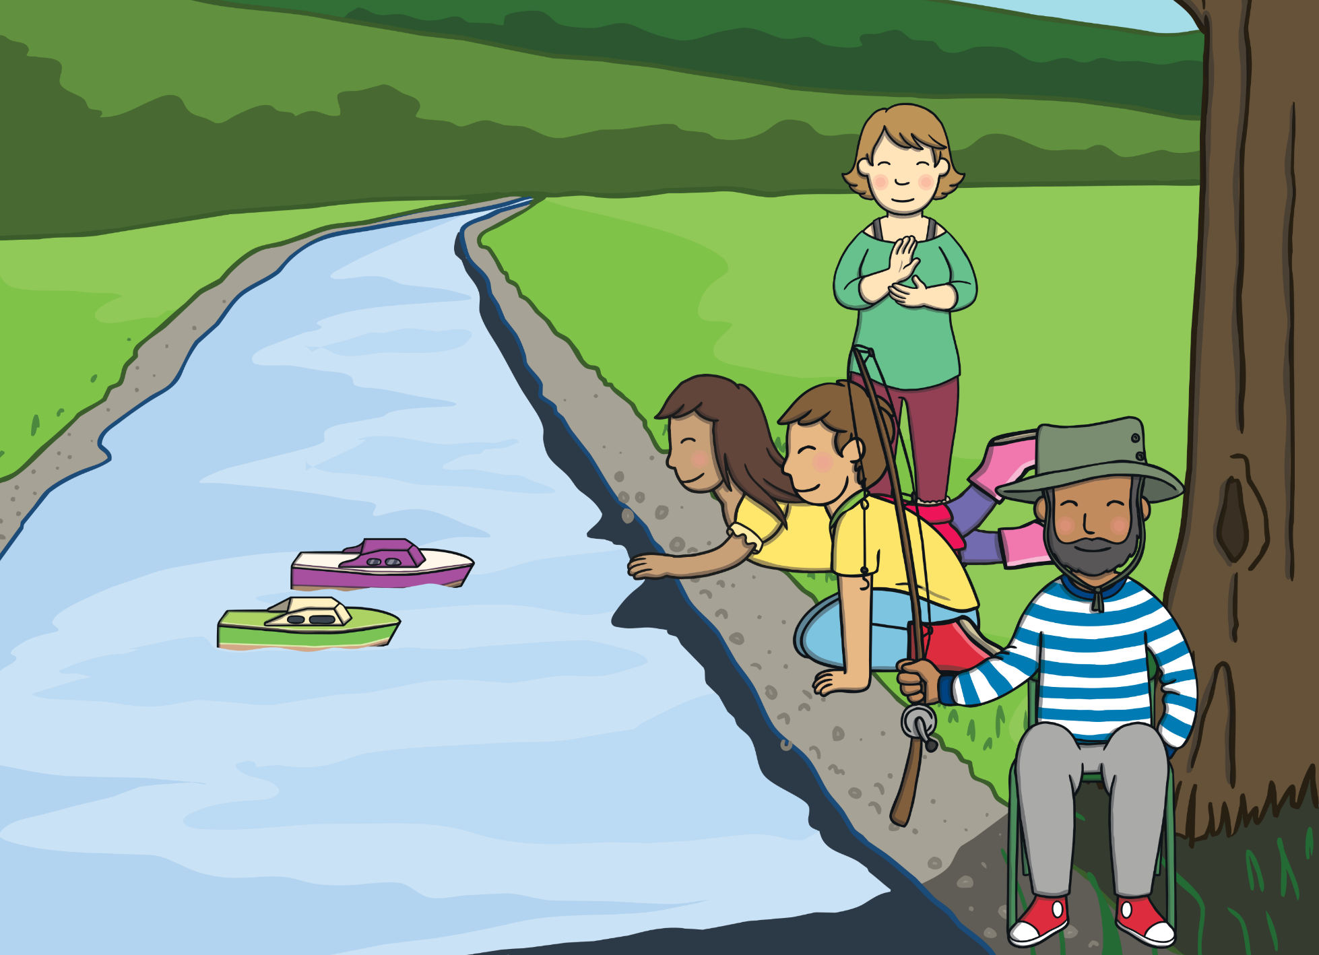
Teach
When they arrived at the river, Kit and Sam carefully put their boats down in the edge of the water and watched them sail slowly.

Slide 8
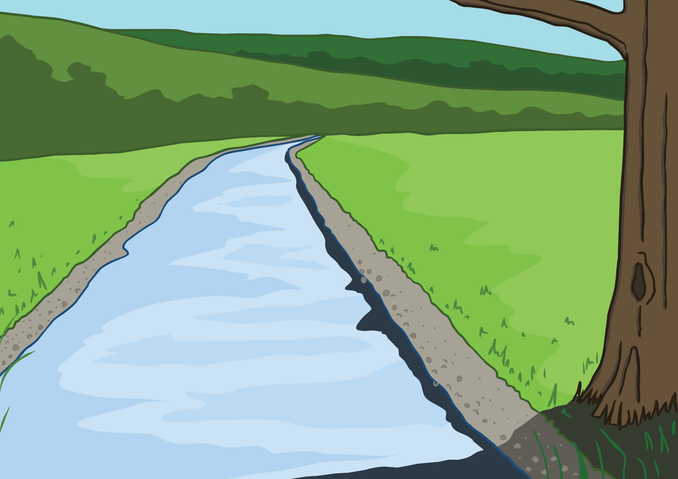
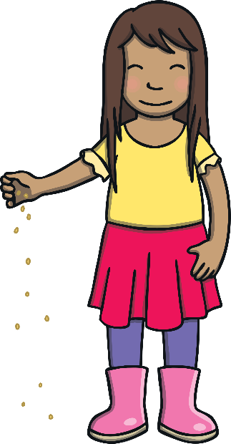
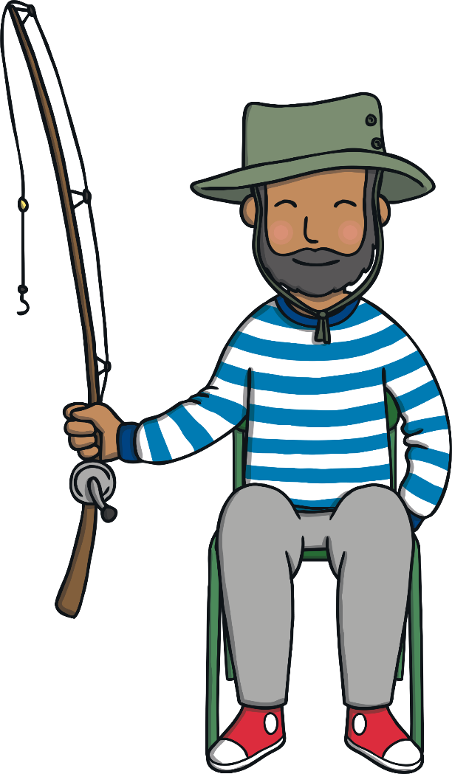
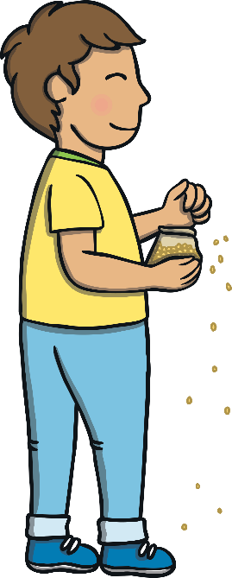
Teach
Kit and Sam had lots of fun watching their boats floating around on the water. Some ducks came to join them, Kit and Sam gave them some corn to eat.

Slide 9
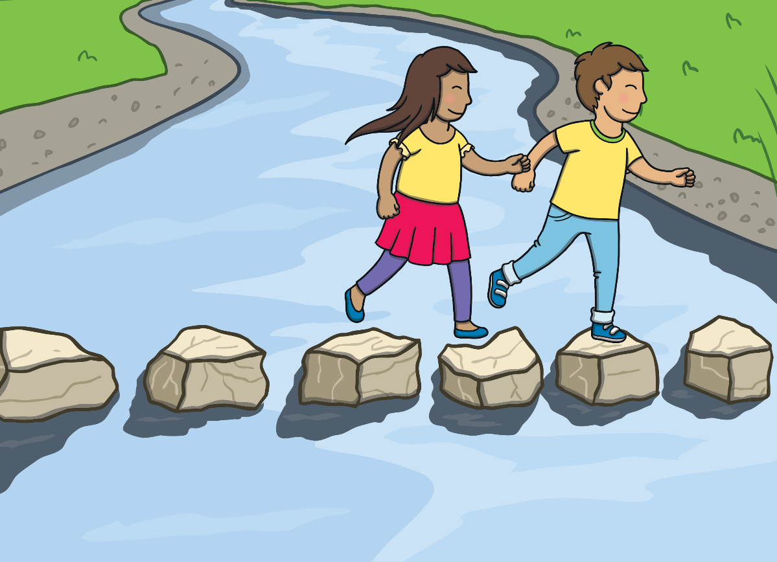
Stepping Stones
Practise
Kit and Sam have found some stepping stones across the river. Can you say the sounds as they hop across to help them blend the words?

Slide 10
Practise
ch
i
ck
Show

Slide 11
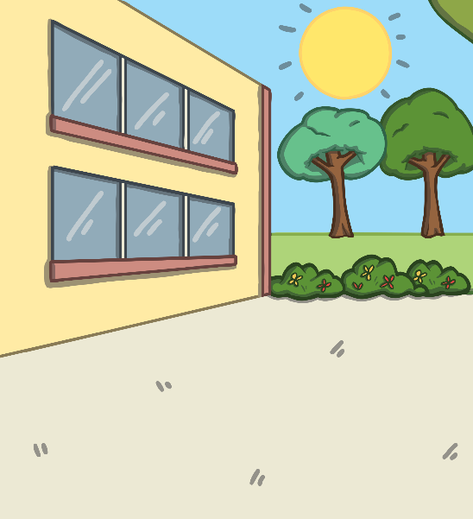
Practise
y
ar
d
Show

Slide 12
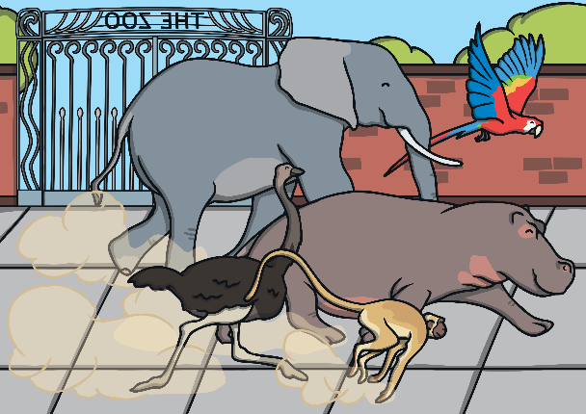
Practise
z
oo
Show

Slide 13
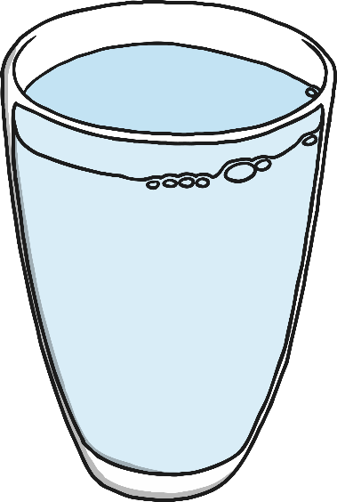
Practise
l
i
qu
i
d
Show

Slide 14
Practise
ch
i
p
Show

Slide 15
Practise
ch
air
Show

Slide 16
Practise
qu
n
ee
Show

Slide 17
Apply
As Kit and Sam were playing, they realised that their boats had sailed out into the river and were sailing away. “Quick!” they shouted.
“Wait there,” said Mum, “I will get them.” Then, she waded out into the water.

Slide 18
Apply
Sentence Time
What happened to Mum when she went to get the boats? Read the sentence to find out..
X
Click ‘Sound Buttons On/Off’ to select whether you want to show sound buttons under the caption.
Click me for Kit’s teaching tips!

Slide 19
Apply
She fell in and got a fish in her zip.
Sound Buttons On/Off
Show

Slide 20
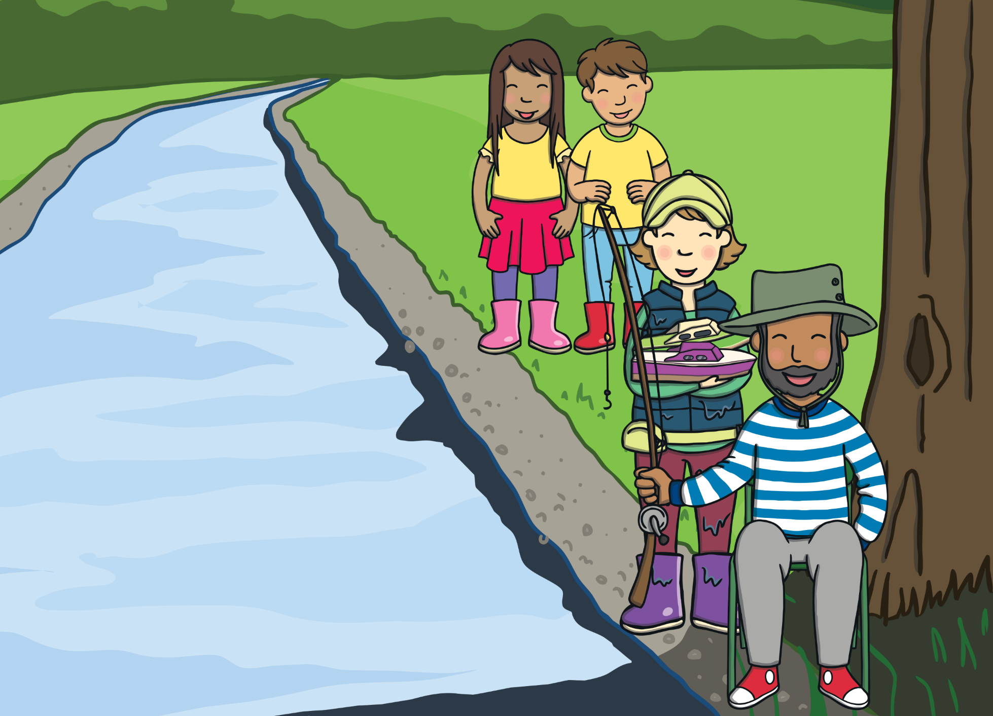
Apply
“You caught a fish!” laughed Sam.
“At least I got the boats,” said Mum, as she got back out of the water.
“I know what you can have for tea, Mum...” said Kit, “fish and ships!” Everyone laughed.

Slide 21
Today, we have recapped…
y
z
qu
ch

