Slide 2
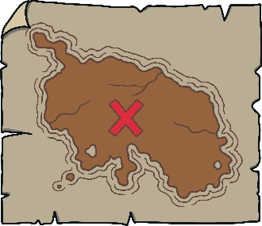
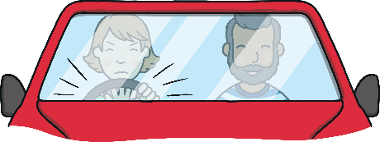
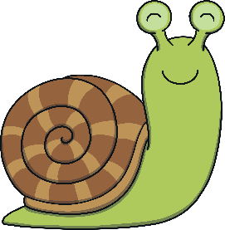
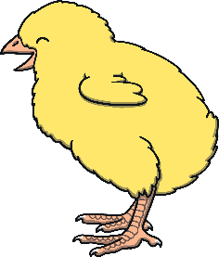
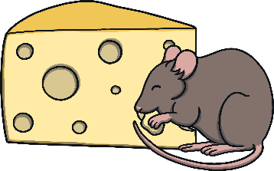
Revisit and Review
Let’s practise Sam’s Sounds and Tricky Words!
j
zz
ow
er
oo
ur
ar
ure
ear
air
oo
or
v
ch
ng
z
oi
igh
y
qu
x
th
ai
ee
oa
w
th
sh
they
was
he
she
we
me
be
you
my

Slide 3
Tool Name and Letter Match
Revisit and Review
Can you match the hammer to the correct nail? Can you say the name and sound the letter makes?

Slide 4
Revisit and Review
Y
B
T
C
G
R
y
d
f
e
v
p
t
z
g
b
l
k
o
r
g
t
t
q
o
k
e
m
c
h

Slide 5
Teach
This week, we meet our next tricky word – here.
Tricky words are words that can’t be sounded out. We just have to learn them off by heart!

Slide 6
Tricky Word Snowflakes
Teach
Shout out the tricky words on the snowflakes as they fall – watch out for tricky word here!
X
Remember, tricky words from this level are shown in red in the story and decodable or familiar words are in purple. Digraphs and trigraphs are underlined.
Click me for Kit’s teaching tips!

Slide 7
Teach
my
my
my
you
my
you
you
they
they
you
they
here
here
here
they
here

Slide 8
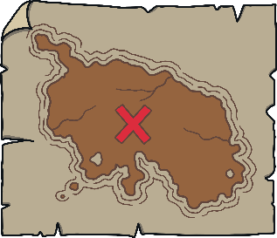
Today, we are recapping…
Teach
j
v
w
x

Slide 9
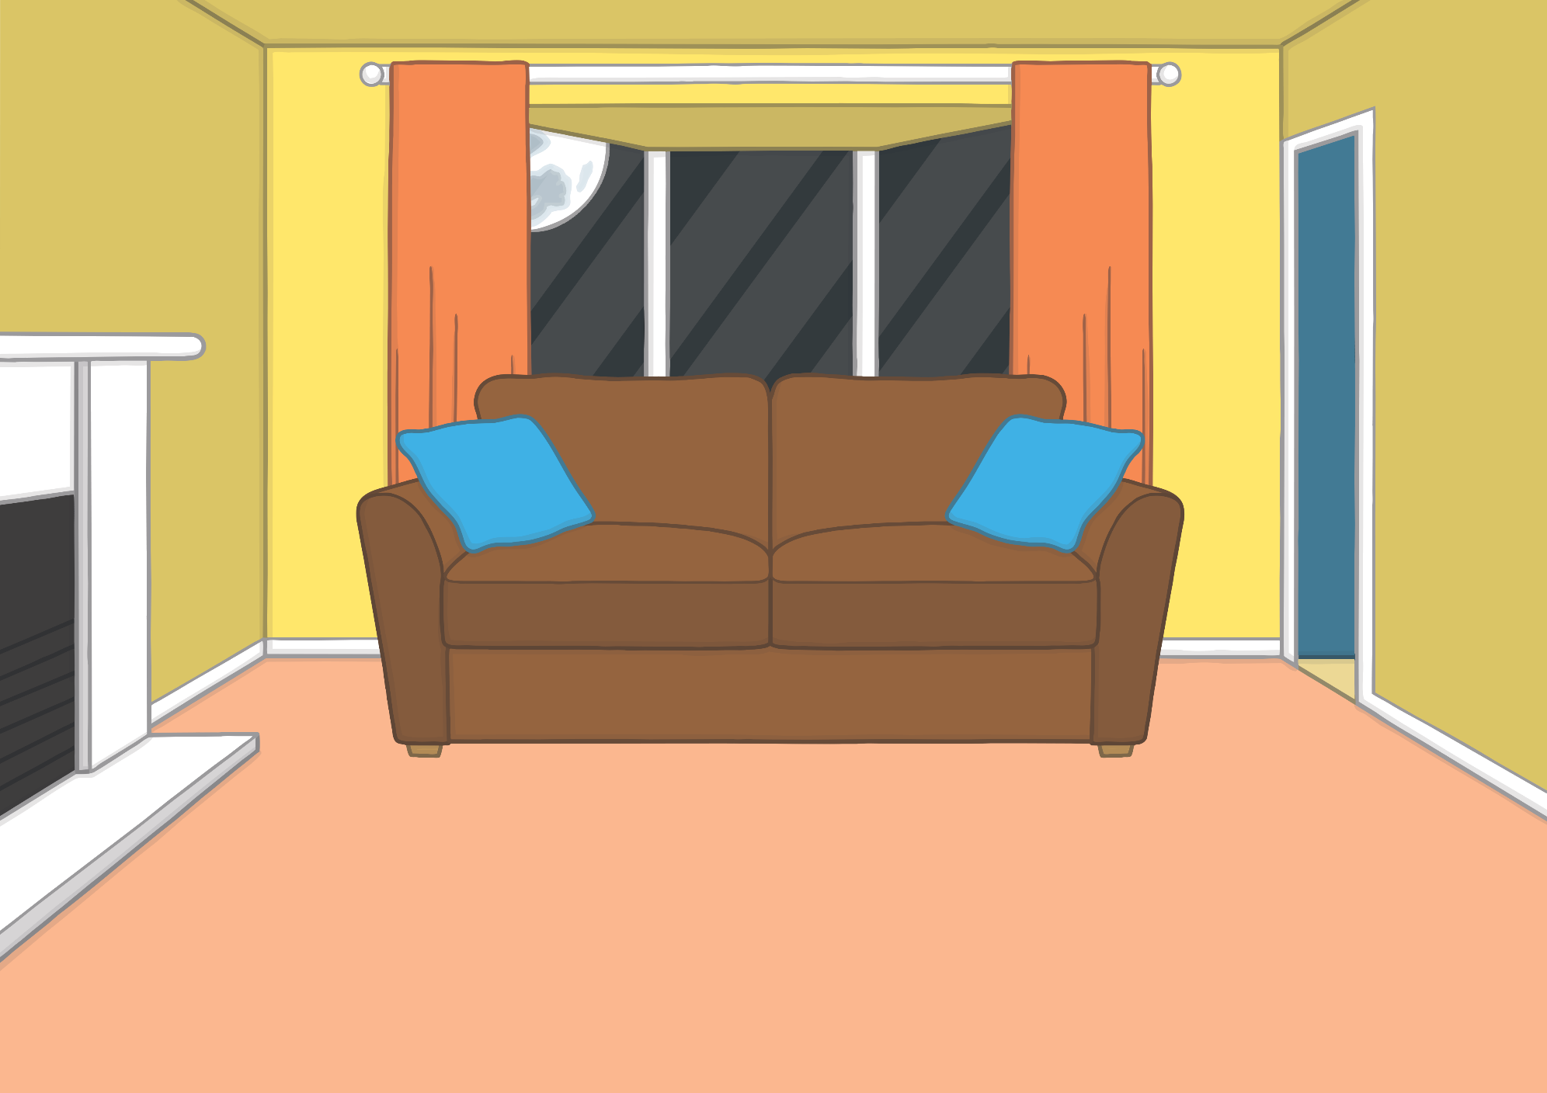
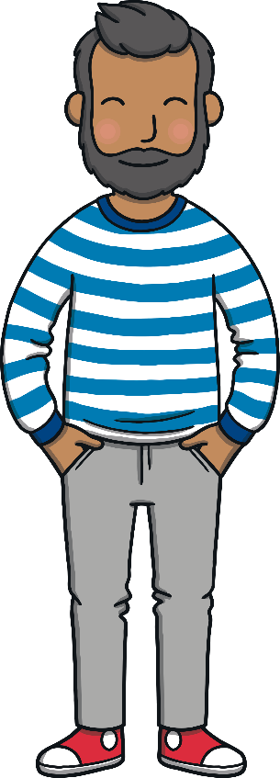
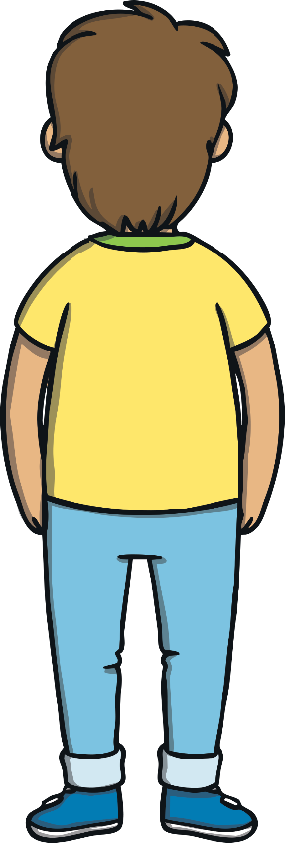
Teach
“It’s going dark already!” said Kit one day.
“That’s because it is winter,” said Mum. “The days are shorter in winter.” The family decided to go for a night time walk in the dark woods with Ben.

Slide 10
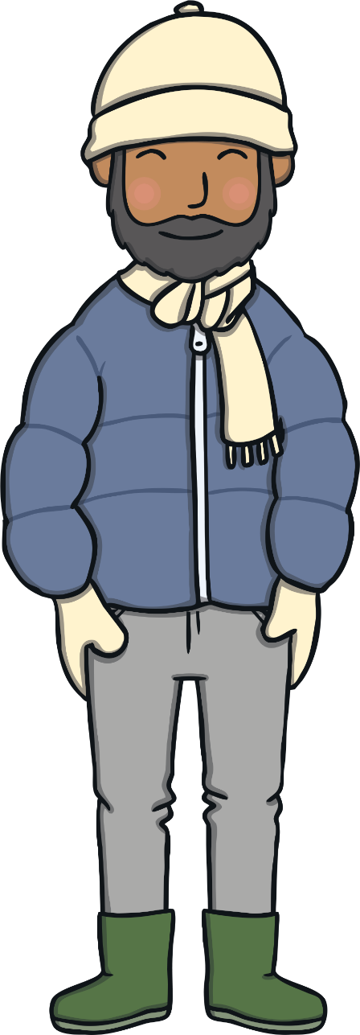
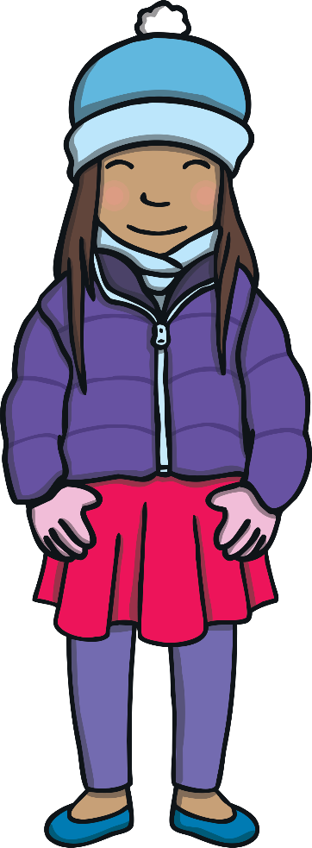
Teach
Everyone wrapped up warm and set off into the dark. “I am glad I brought a torch,” said Sam, as her beam of light showed the right way to go. The fallen leaves from autumn were still on the path, covered in glistening frost.

Slide 11
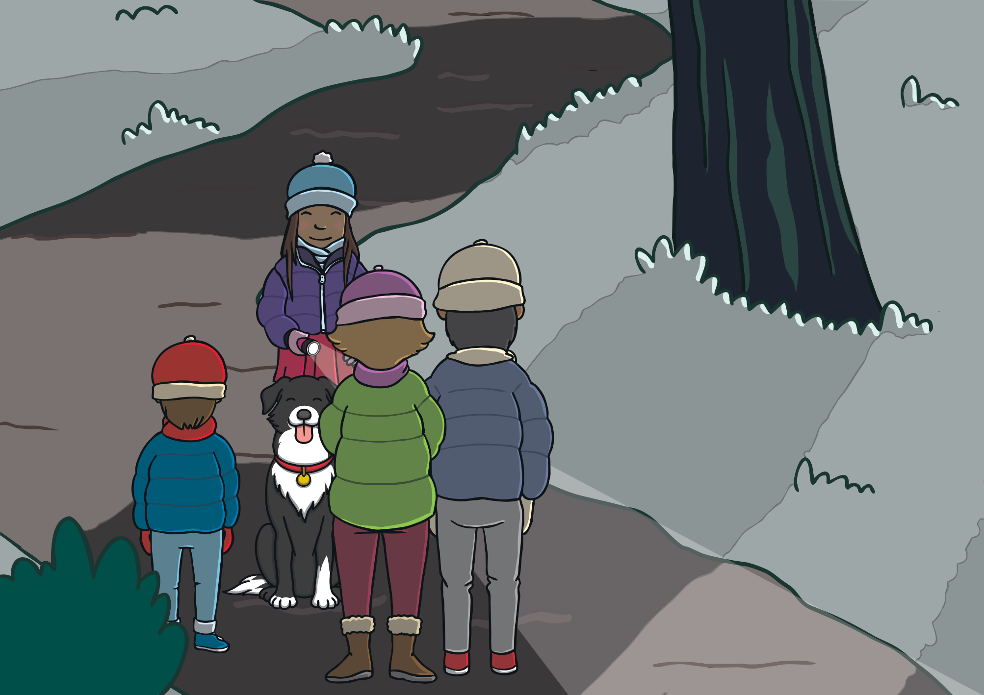
Teach
The path took them this way and that, under an arch and then down a hill. “I don’t think I’ve been here in the woods at night before,” said Kit, “everything looks so different.”

Slide 12
Frosty Leaves
Practise
Kit and Sam notice that the frosty leaves have sounds on them. Can you help them to read the words in the frost?

Slide 13
Practise
v
a
n
Show

Slide 14
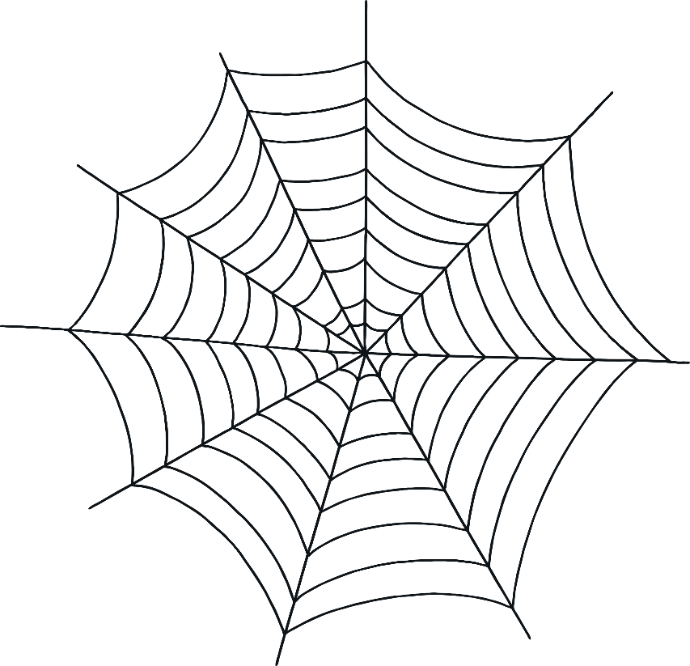
Practise
c
o
b
w
e
b
Show

Slide 15
Practise
t
a
x
i
Show

Slide 16
Practise
w
i
sh
Show

Slide 17
Practise
v
e
t
Show

Slide 18
Practise
b
o
x
er
Show

Slide 19
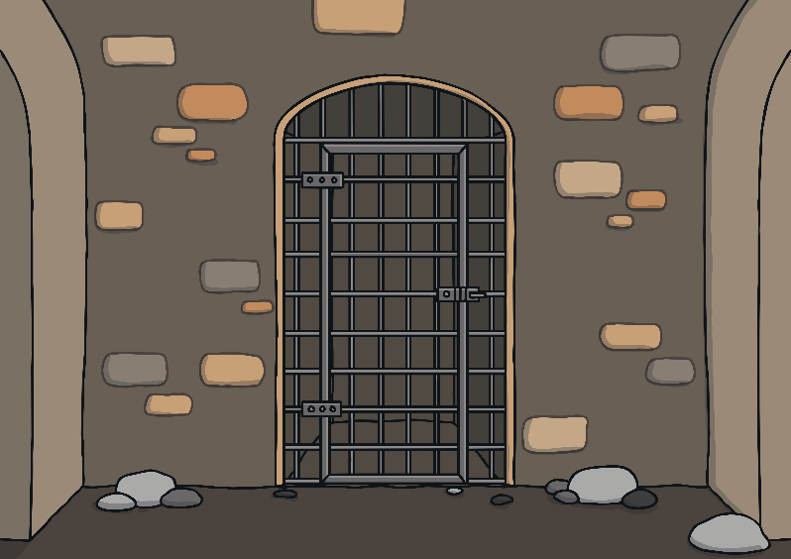
Practise
j
ai
l
Show

Slide 20
Practise
w
ow
Show

Slide 21
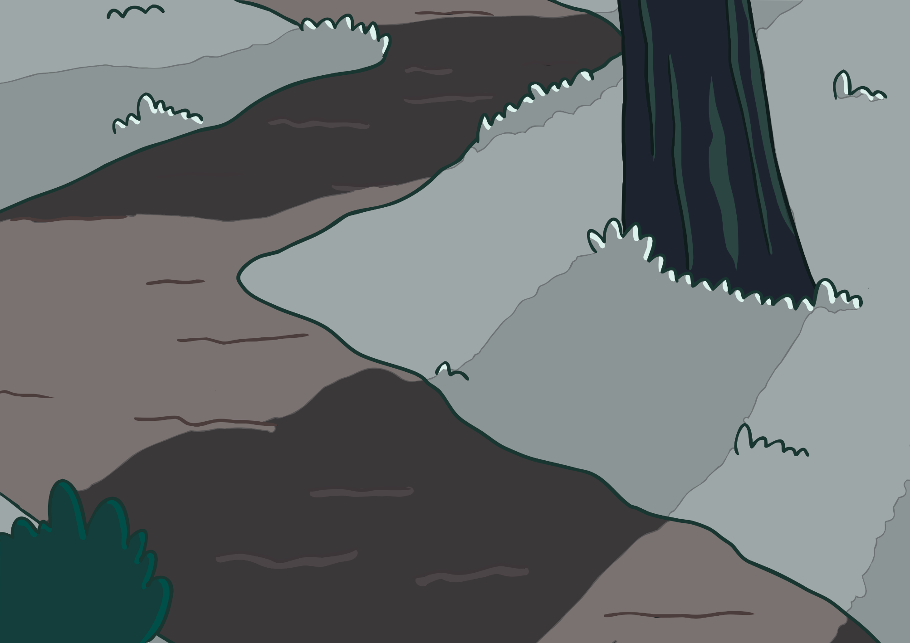
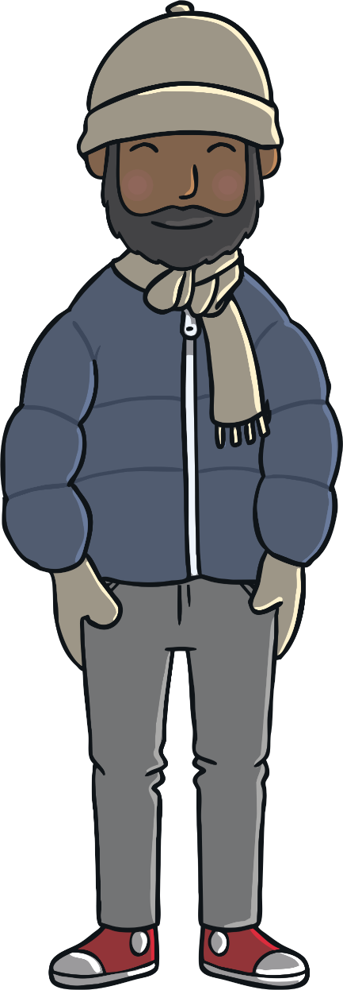
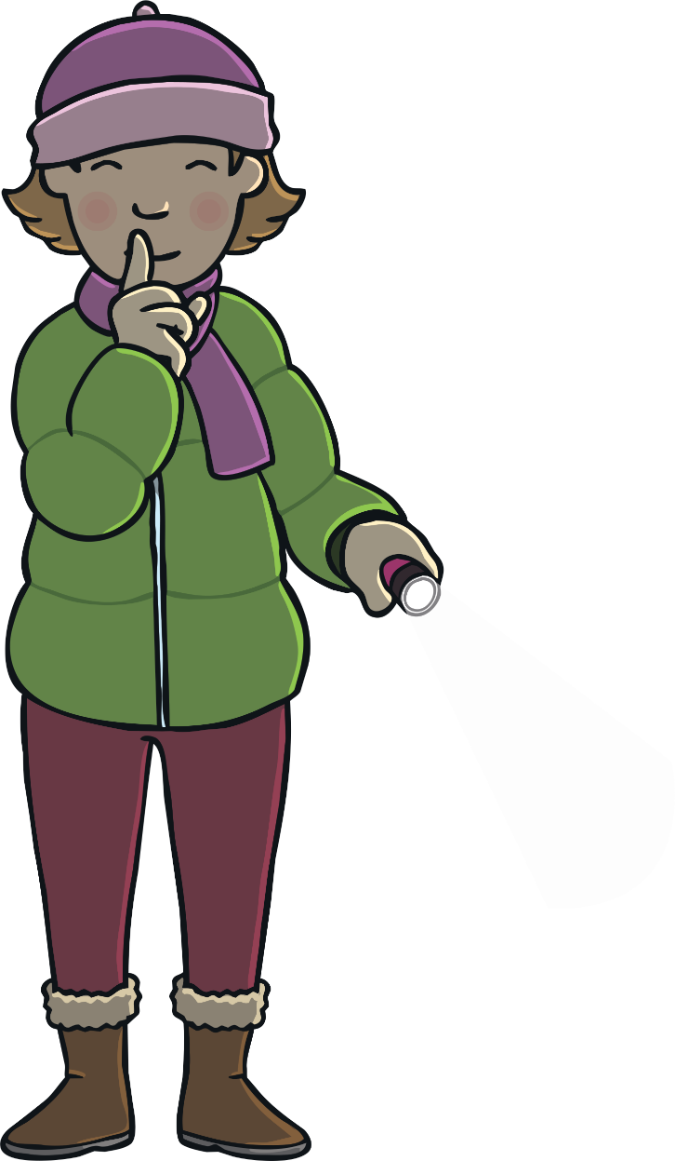
Apply
All of a sudden, Mum stopped, put her finger to her lips and said “Shh!” Everyone stopped, even Ben. Mum gently took the torch from Sam’s hand and shone it to the side of the path.

Slide 22
Apply
Sentence Time
What could Mum see in the woods? Read the sentence to find out.
X
Click ‘Sound Buttons On/Off’ to select whether you want to show sound buttons under the caption.
Click me for Kit’s teaching tips!

Slide 23
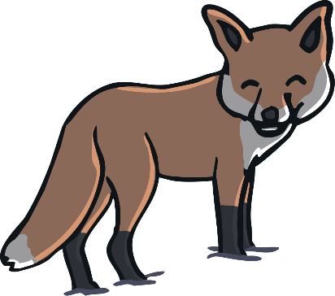
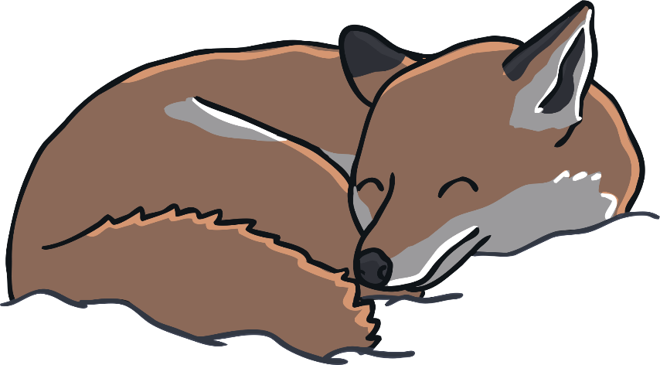
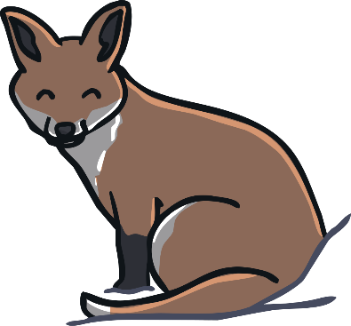
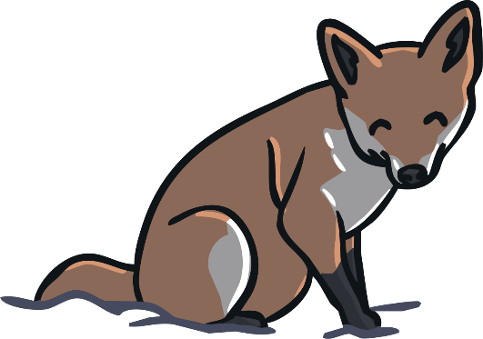
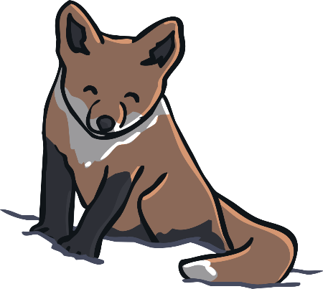
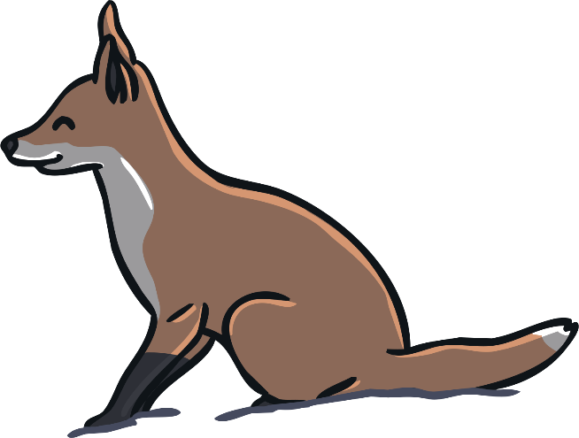
Apply
It was a vixen and her six cubs.
Sound Buttons On/Off
Show

Slide 24
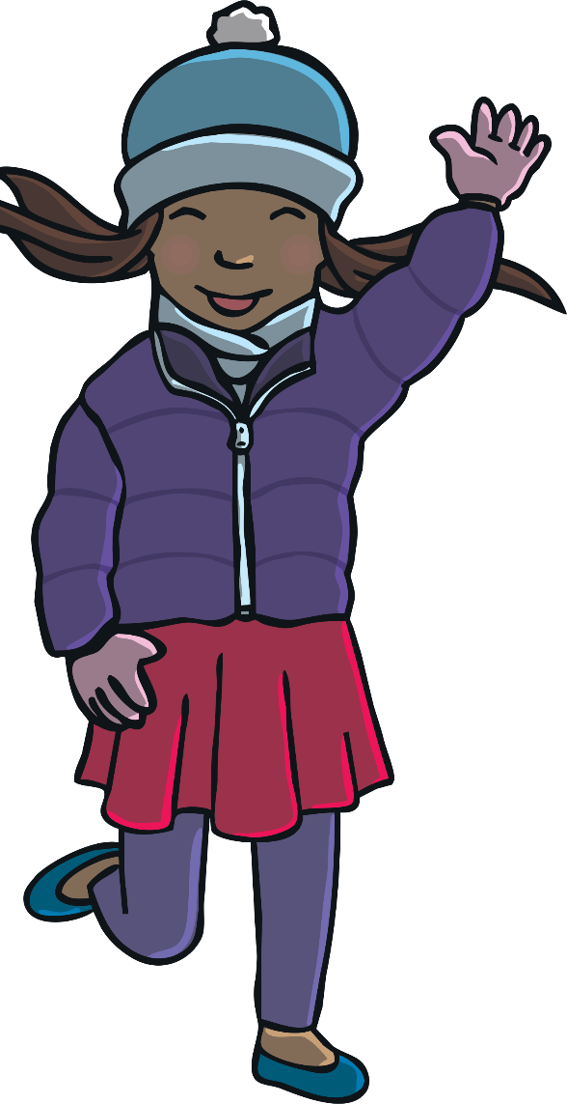
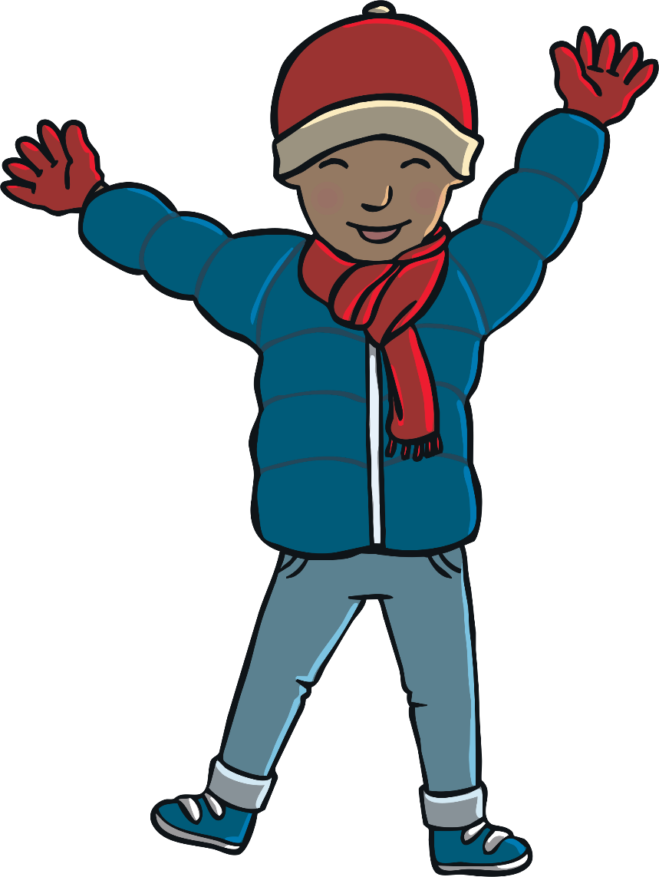
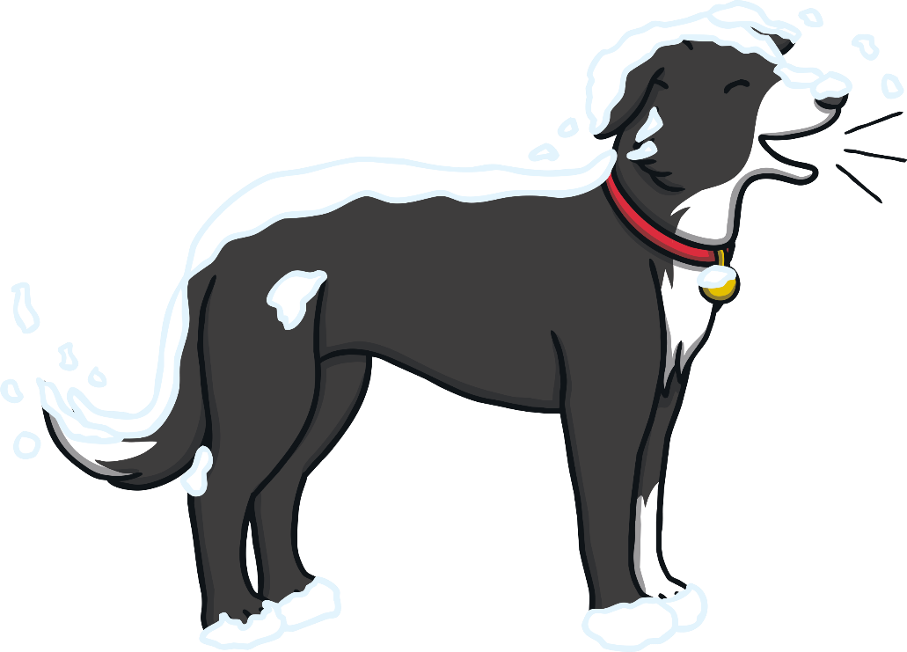
Apply
“Woof!”
“Wow!” Kit and Sam whispered, as they watched the fox lead her cubs back into their den.
“Foxes are nocturnal,” said Dad quietly. “That means we only usually see them at night.”
“I’m glad we came out in the dark then!” said Kit.

Slide 25
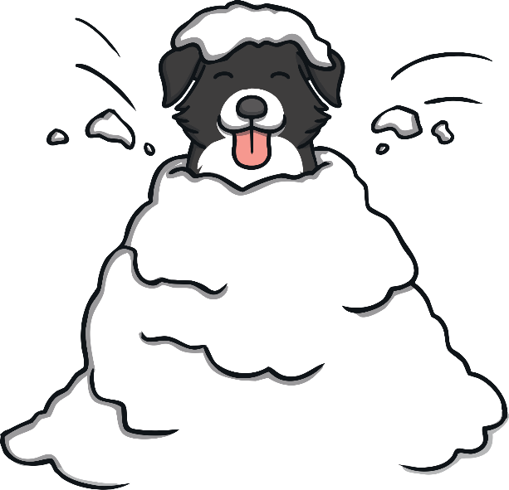
Today, we have recapped…
j
v
w
x

