Slide 2
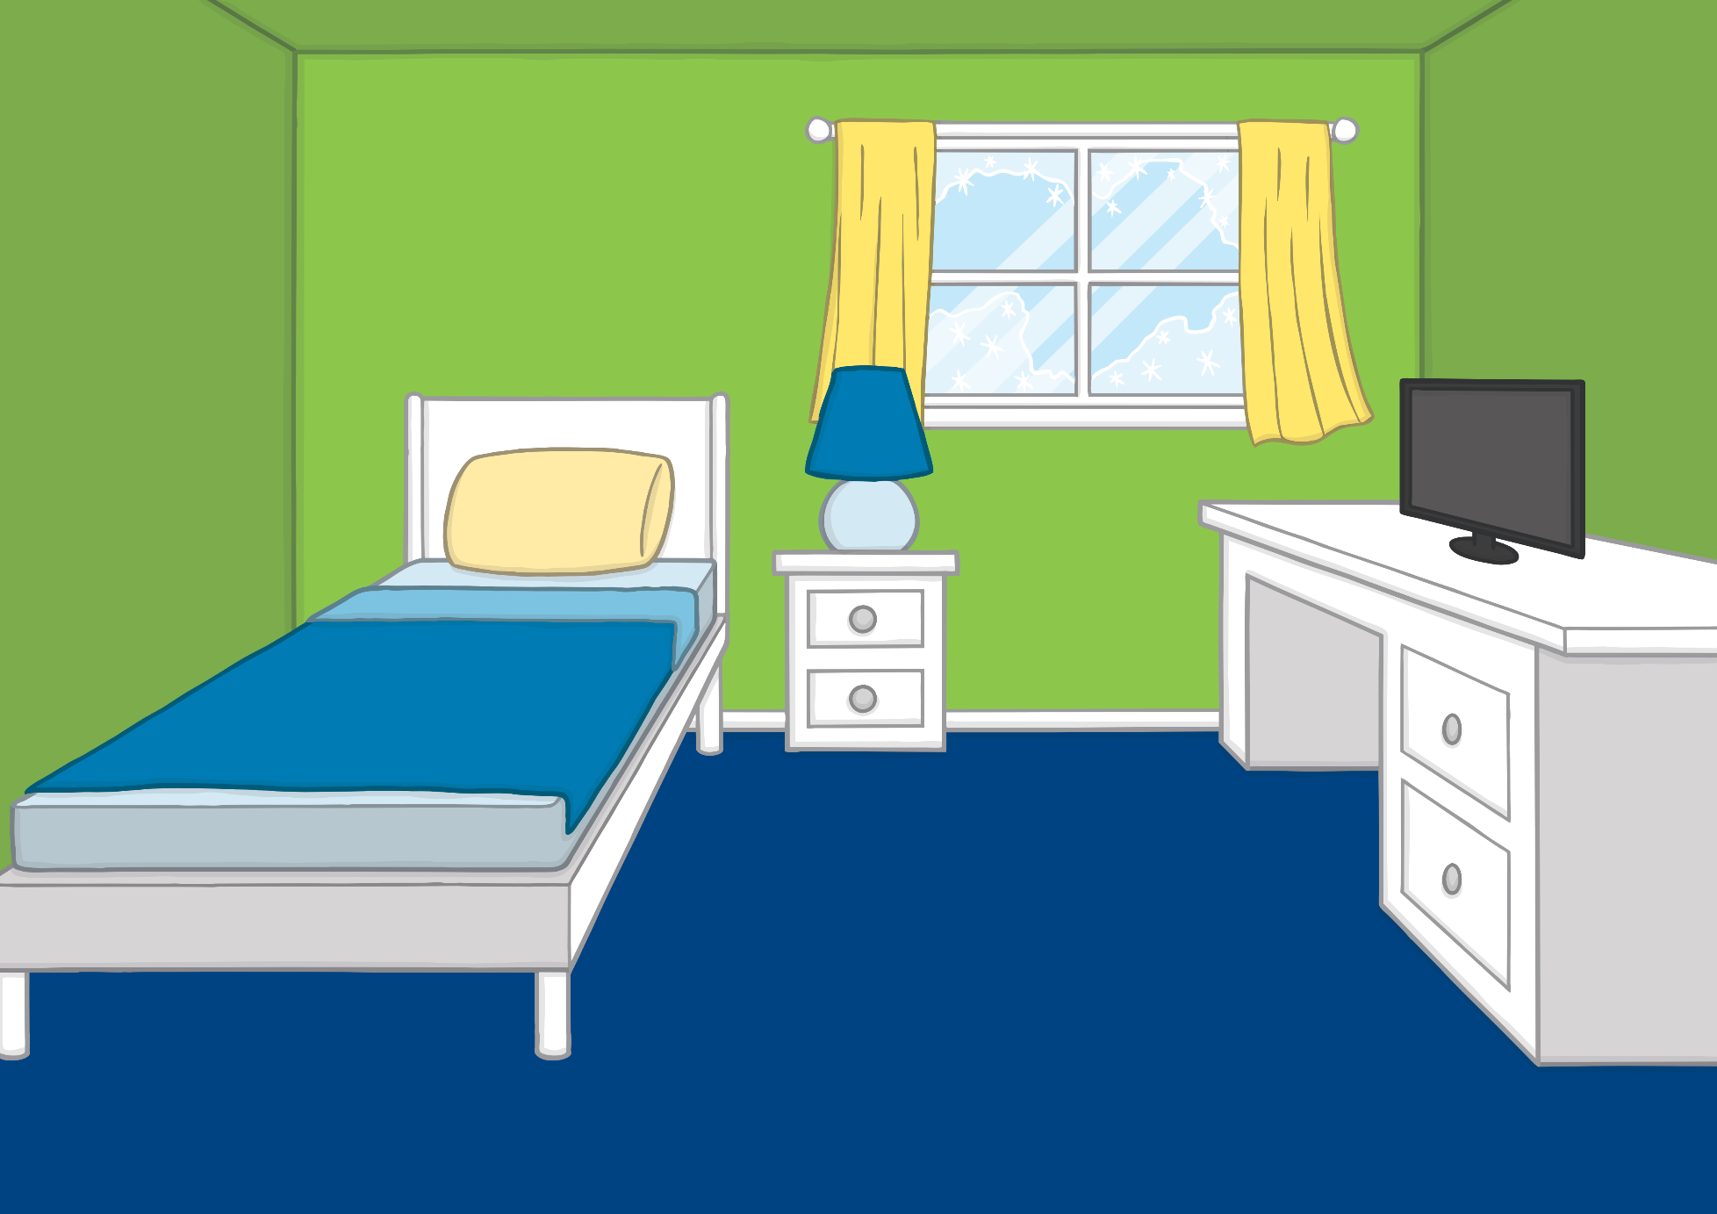
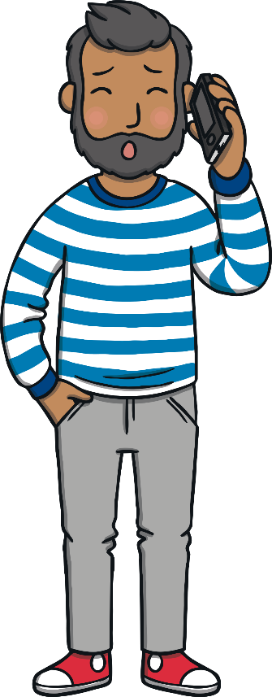
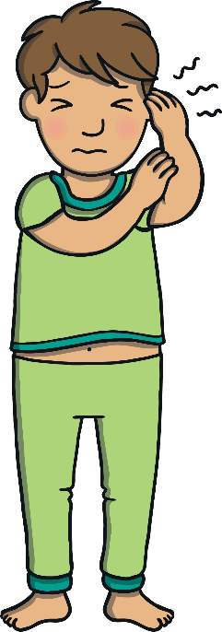
Teach
One day, Kit woke up with a sore ear. “Ouch!” said Kit. “My ear hurts!”
“You need to see the doctor,” said Dad. Dad rang for an appointment straight away.

Slide 3
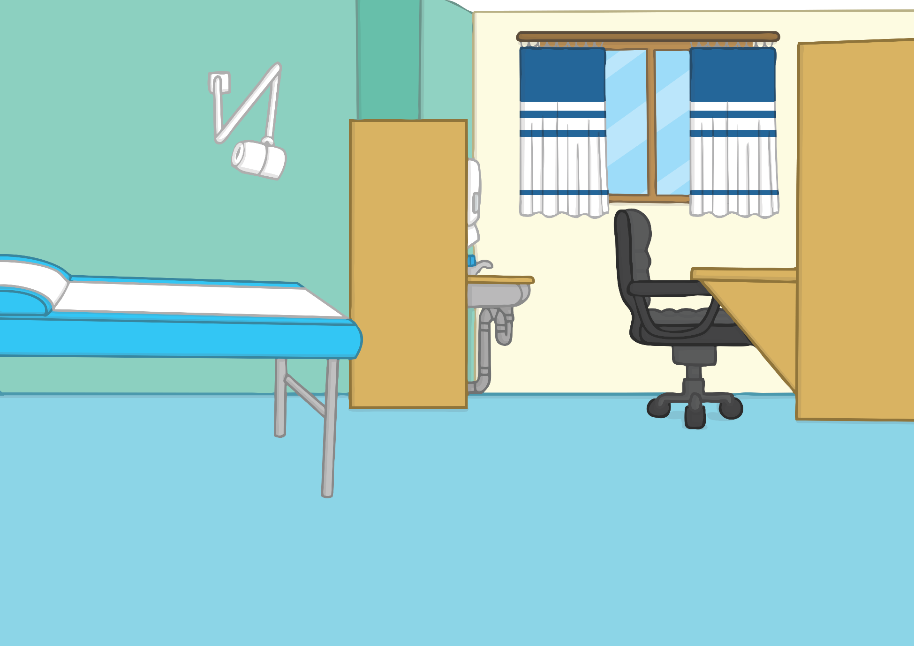
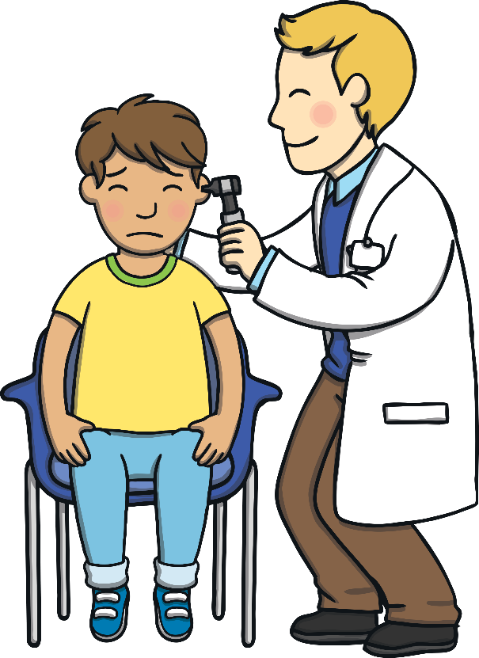
Teach
The doctor looked into Kit’s ears with a special tool. “Hmmm,” said Doctor Benjamin. “You certainly have a poorly ear.” The doctor gave Kit some medicine. “Make sure you take it three times a day,” he said.

Slide 4
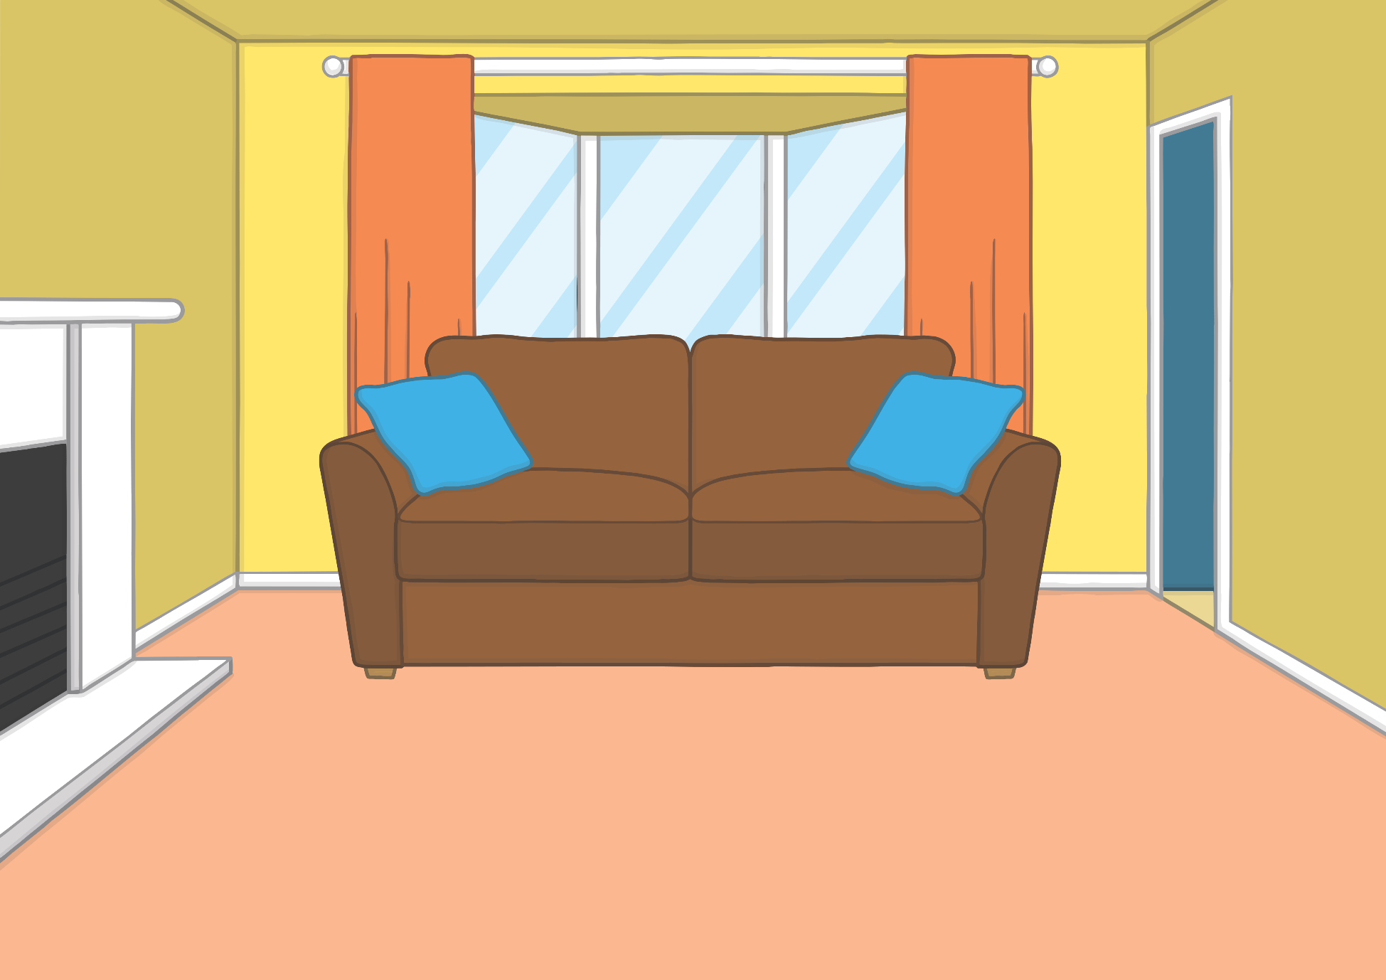
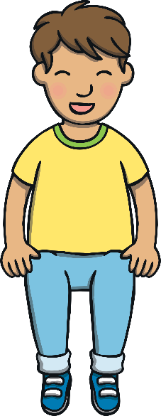
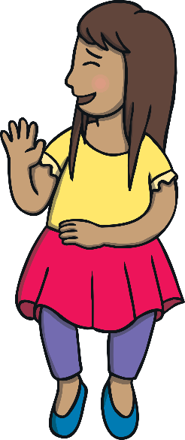
Teach
Kit told Sam all about the doctor and his medicine when he got home. The medicine tasted of bananas, which Kit really liked, and his sore ear was better very soon!

Slide 5
e
a
r
Teach
e, a and r are a team. They say ear.

Slide 6
Teach
Teach
Action
Cup your hand around your ear.
Say ‘ear’.

Slide 7
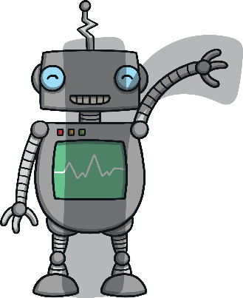
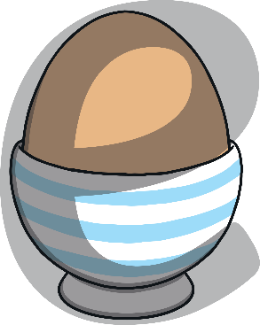
Teach
Teach
Write the Letters
Around the egg and under the cup.
Around the apple, up the stalk and down the leaf.
Down the robot's body, up and over its arm.
e
a
r
Play

Slide 8
Practise
hear
Check

Slide 9
Practise
ear
Check

Slide 10
Practise
tear
Check

Slide 11
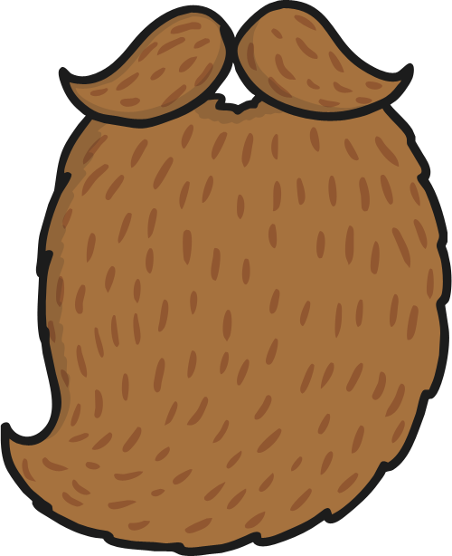
Practise
beard
Check

Slide 12
Practise
f-ear
Check

Slide 13
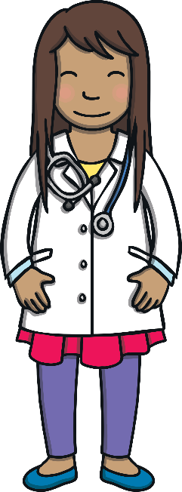
Apply
Sam was really glad that Kit was feeling better. They decided to play doctors together. Sam checked Kit over. Then, she decided to test Kit’s hearing by moving further and further away from him.

Slide 14
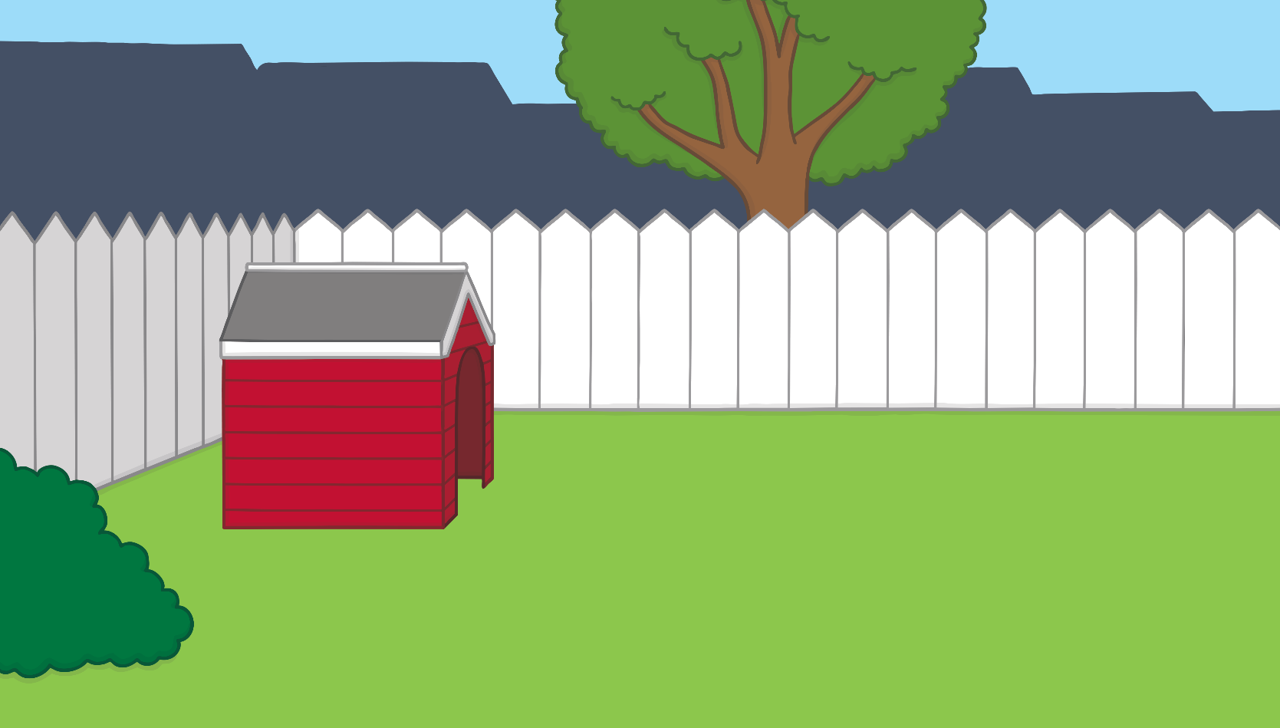
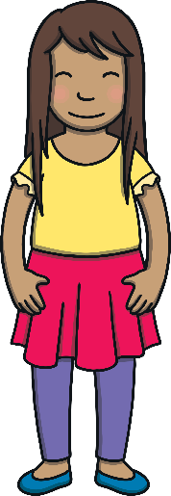
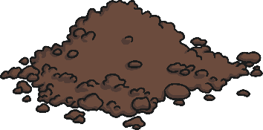
Apply
Yes
Can you hear me near this soil?

Slide 15
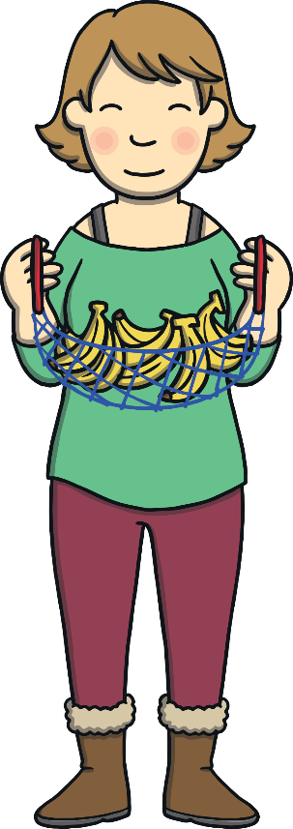
Apply
“You passed the test! You don’t need any more medicine, my dear,” said Doctor Sam.
“I’m glad I’m better now,” said Kit, “but I’m sad that all the medicine has gone - I love bananas!”

Slide 16
Today, we have learnt...
ear

