Slide 2
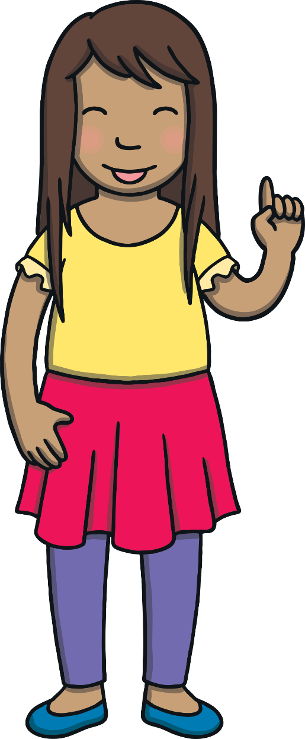
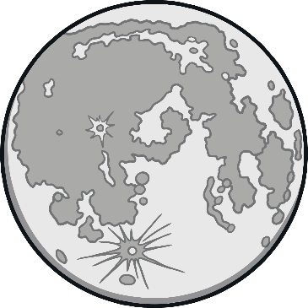
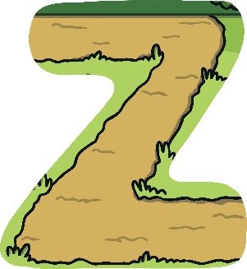
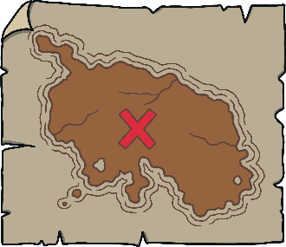
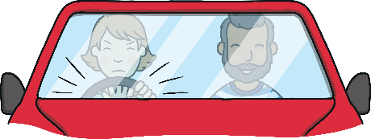
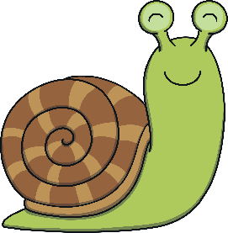
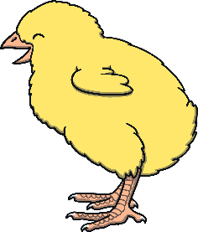
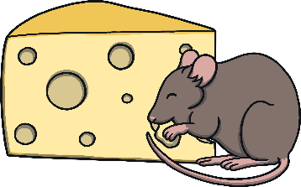
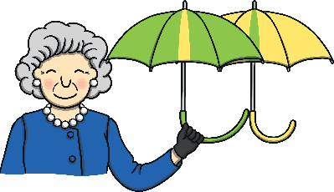
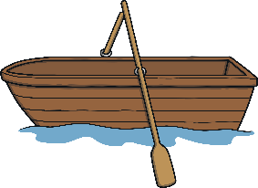
Revisit and Review
Let’s practise Sam’s Sounds and Tricky Words!
j
zz
ow
er
oo
ur
ar
ure
ear
air
oo
or
v
ch
ng
z
oi
igh
y
qu
x
th
ai
ee
oa
w
th
sh
they
was
he
she
we
me
be
you
here
my

Slide 3
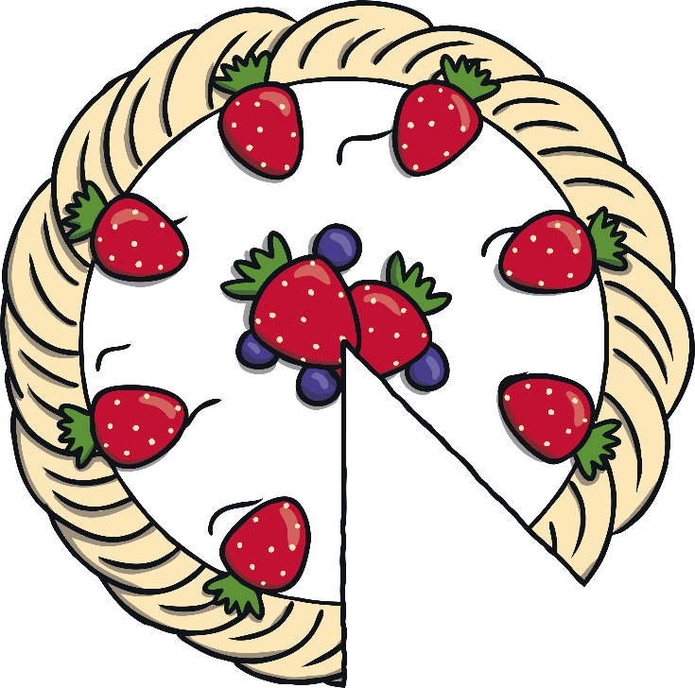
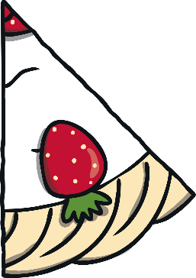
Cake Name and Letter Match
Revisit and Review
Can you find the missing slice for the cake? Can you say the name and sound the letter makes?

Slide 4
Revisit and Review
I
S
D
F
H
N
g
m
y
q
j
u
m
f
b
t
s
c
k
o
r
e
j
w
h
d
i
n
n
t

Slide 5
Today, we are recapping…
Teach
ai
ee
igh
oa

Slide 6
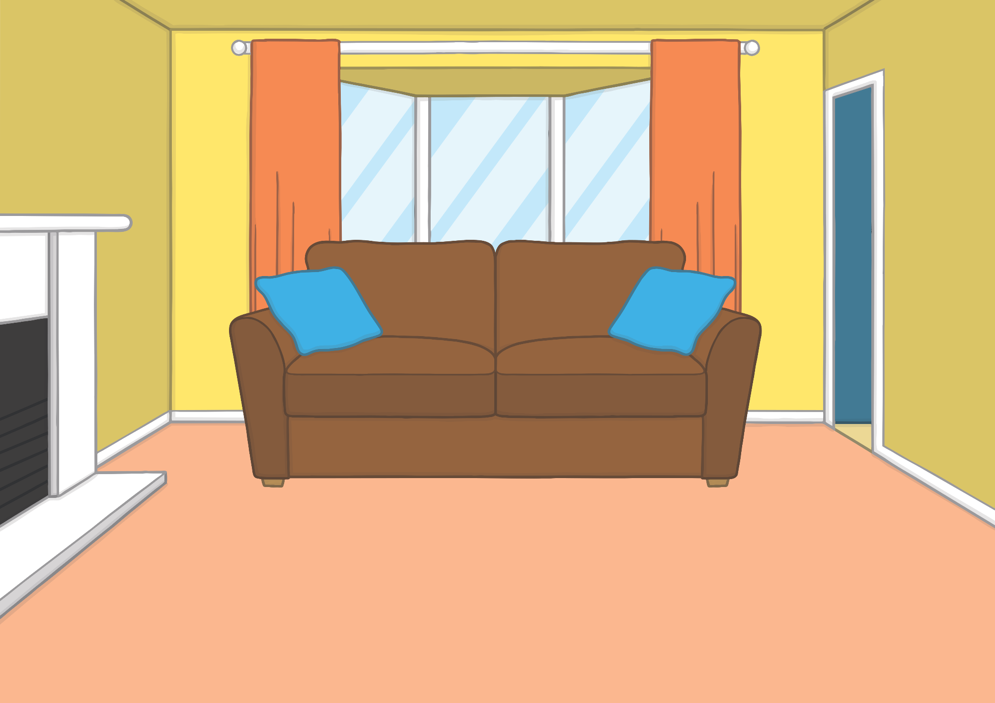
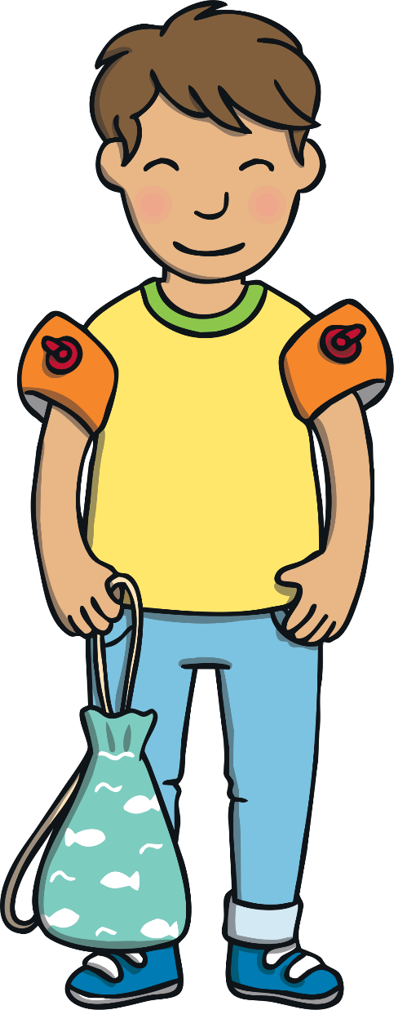
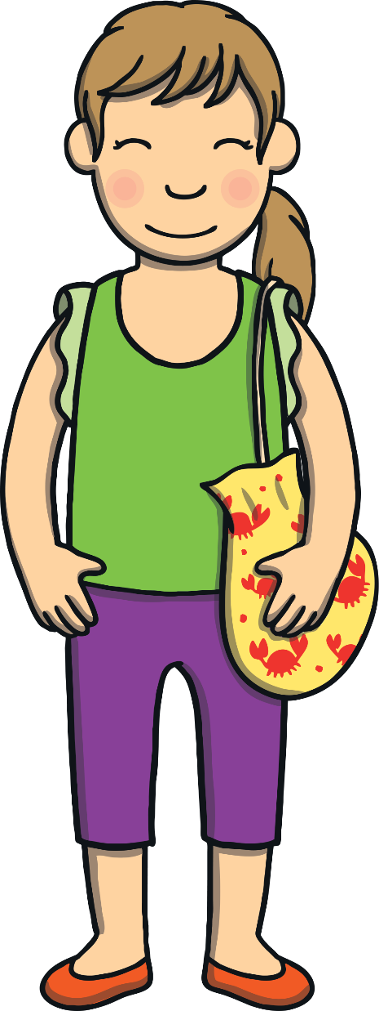
Teach
Today, Kit and Sam were going swimming with their friend Gabi. They each took a bag with swim gear and a towel inside. Kit had his arm bands on already!

Slide 7
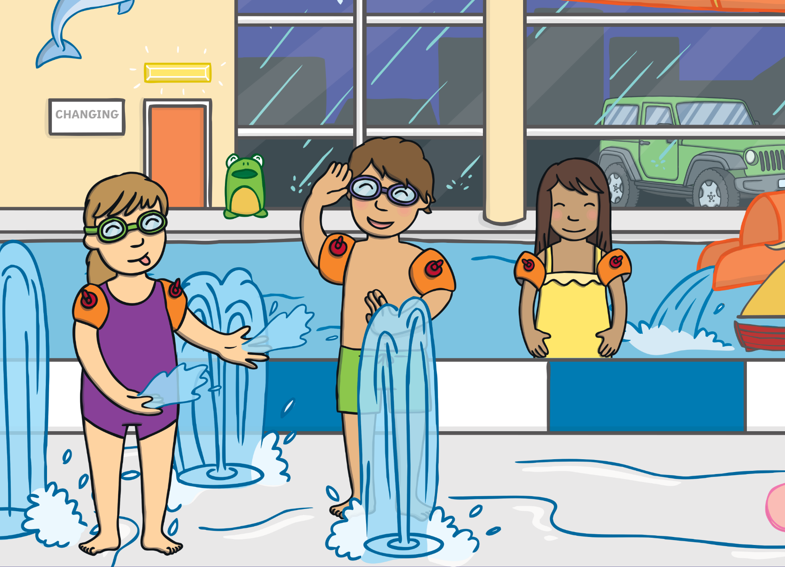
Teach
It was very exciting! There were slides, fountains and a huge swimming pool. Kit, Sam and Gabi went straight to the fountains and splashed about.

Slide 8
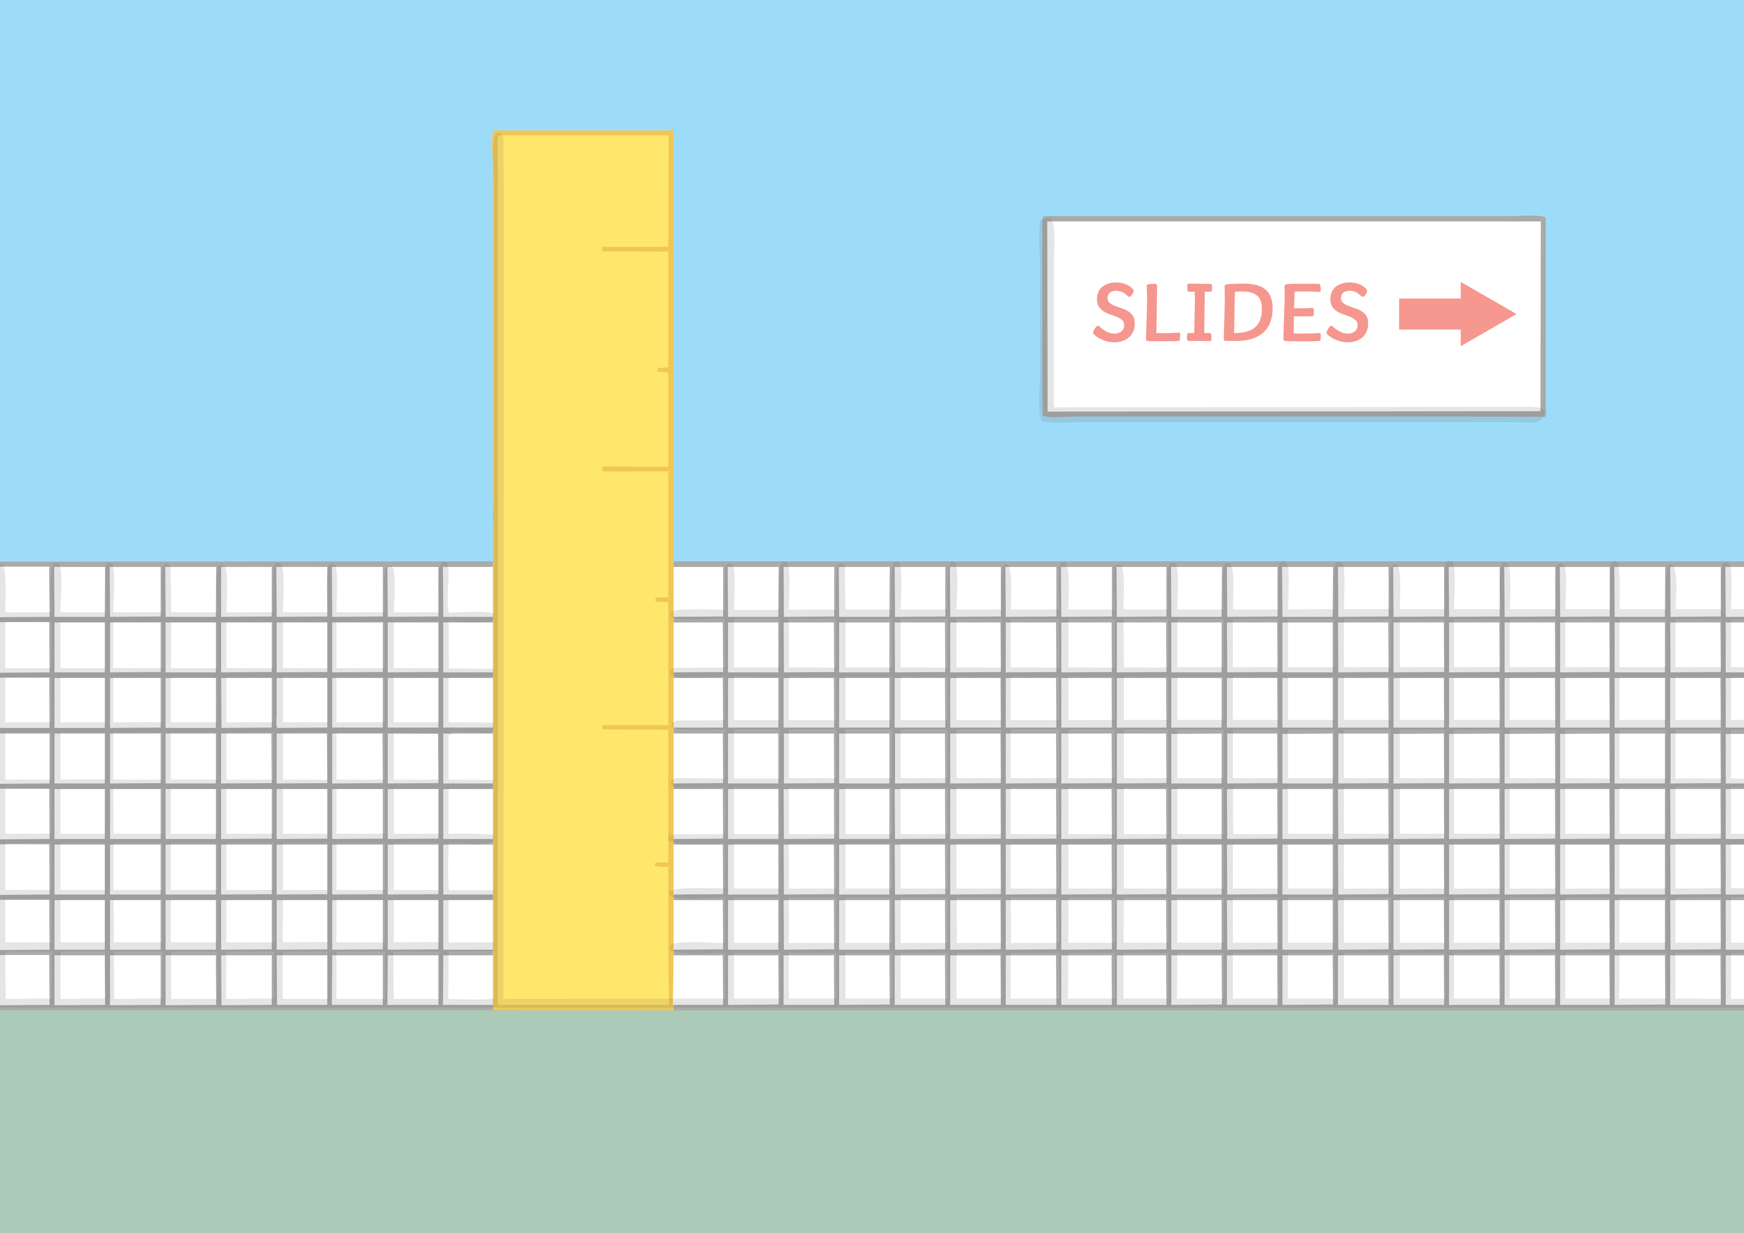
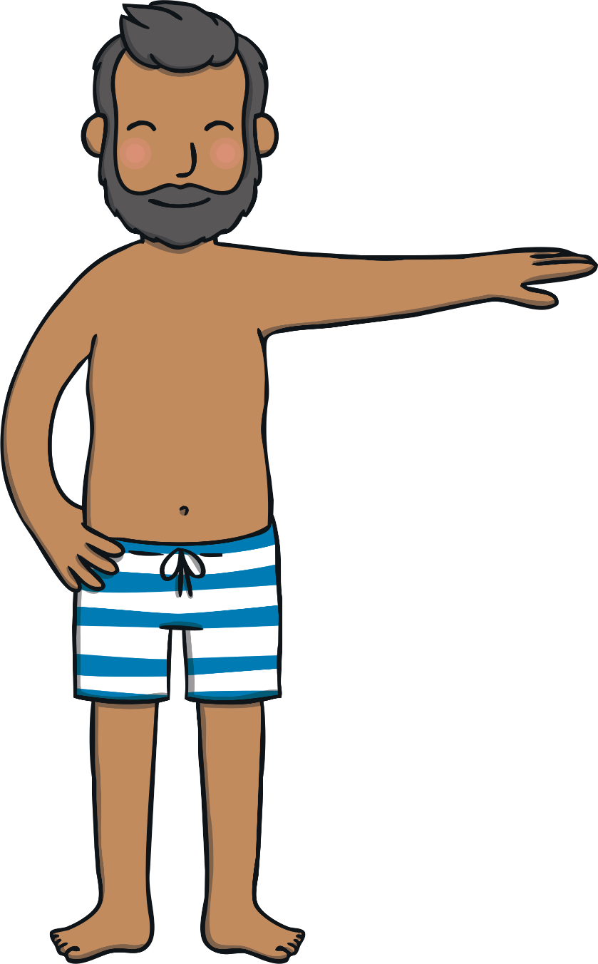
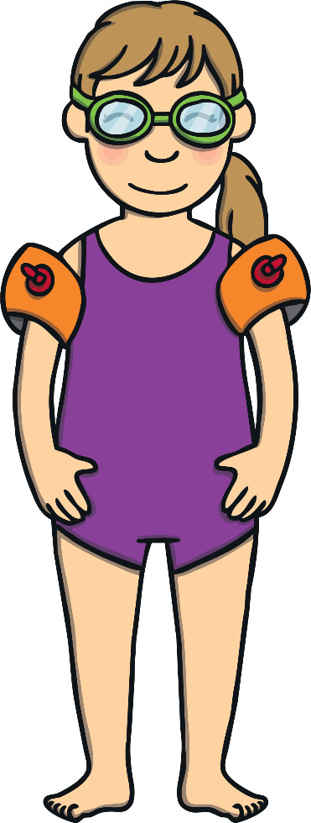
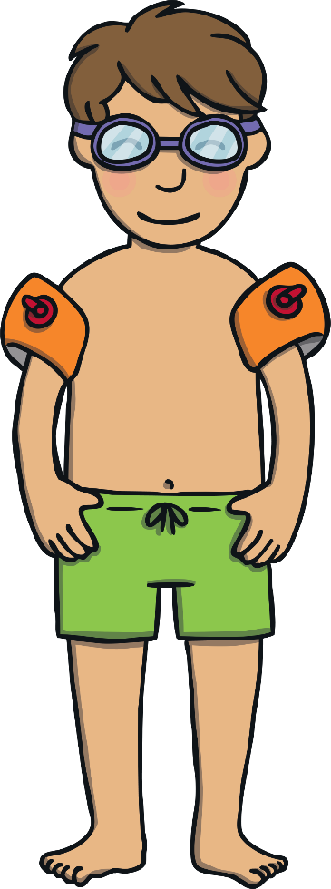
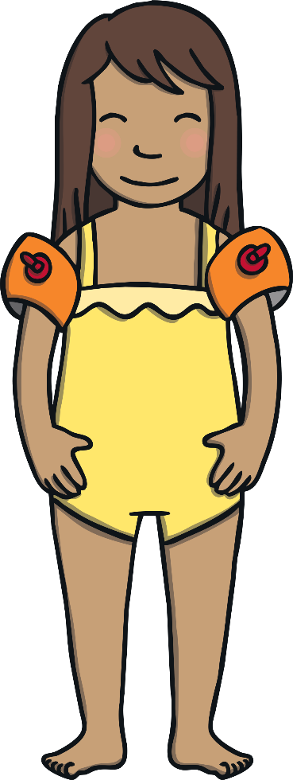
Teach
“Shall we go on the slide next?” asked Gabi.
“Yes!” replied Kit and Sam.
“Come here first,” said Dad. He checked that they were all tall enough.

Slide 9
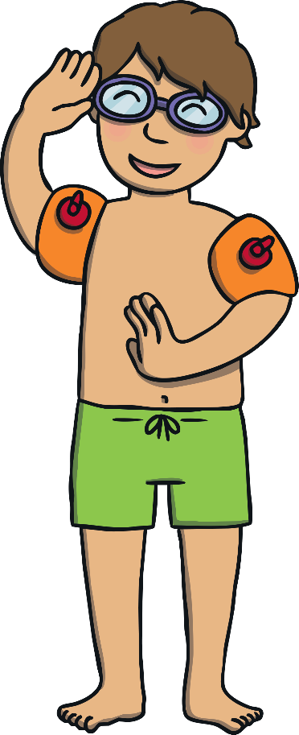
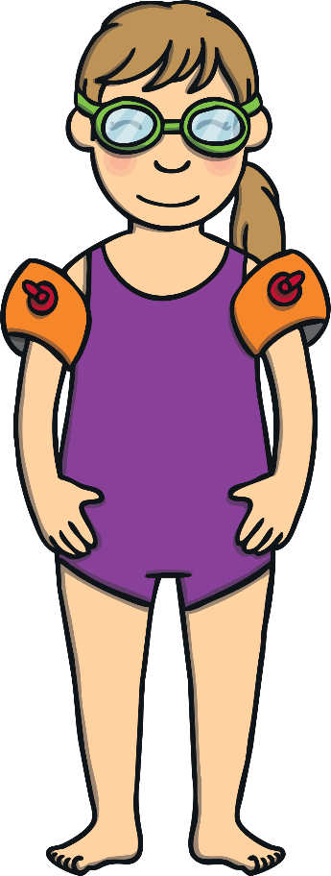
Decide the Slide
Practise
Kit, Sam and Gabi are deciding which slide to go on. Can you write down the name of each slide from the picture on the signs?

Slide 10
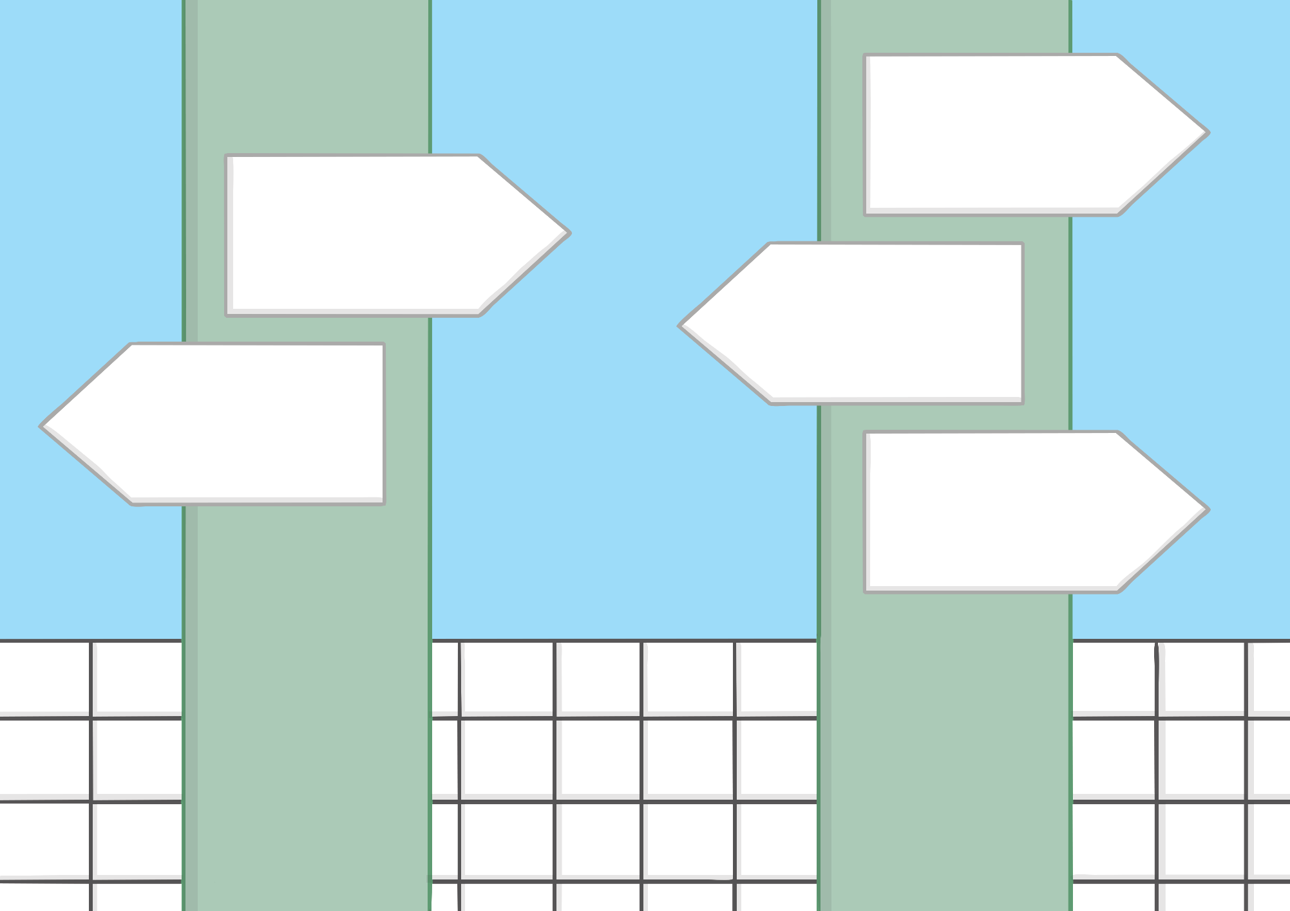
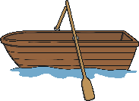
Practise
rain
night
sheep
boat
soap
Check

Slide 11
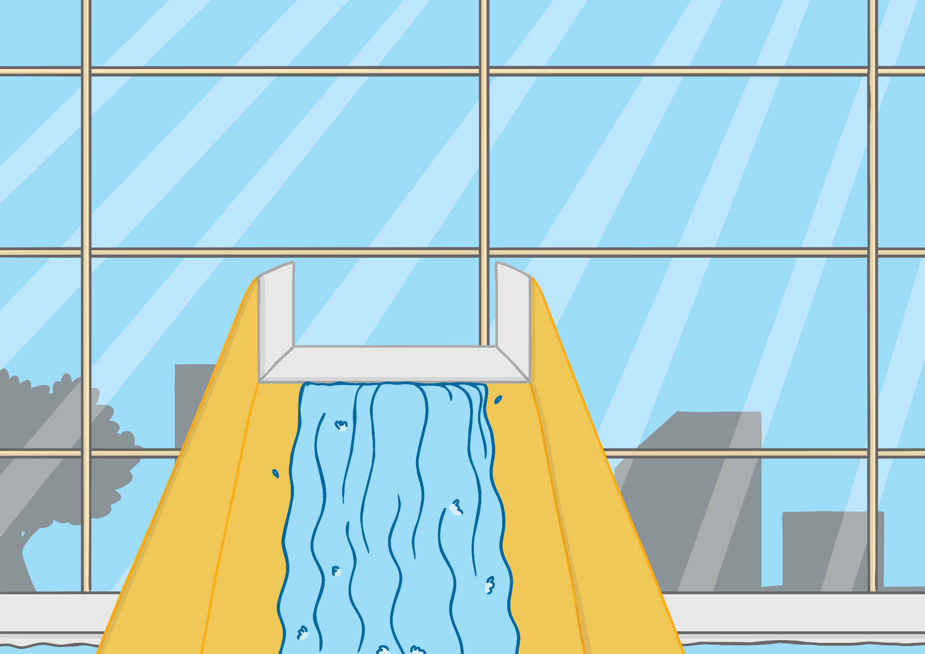
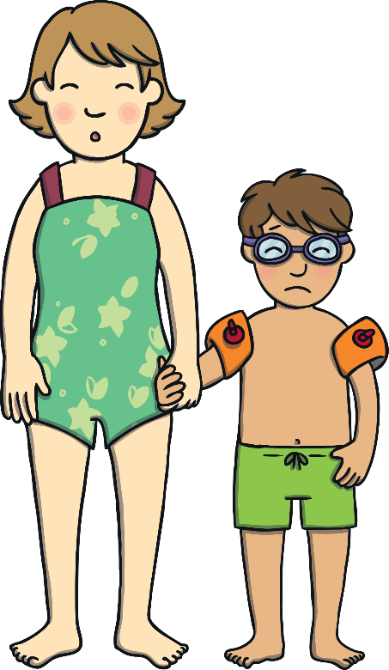
Apply
As they climbed up and up to the top of the slide, Kit got more and more quiet. When they reached the top, Kit whispered to Mum “I don’t like it up here.”

Slide 12
Apply
Sentence Time
Why didn’t Kit like it at the top of the slide? Write a caption or sentence to match the picture.
X
Click ‘Sound Buttons On/Off’ to select whether you want to show sound buttons under the caption.
Click me for Kit’s teaching tips!

Slide 13
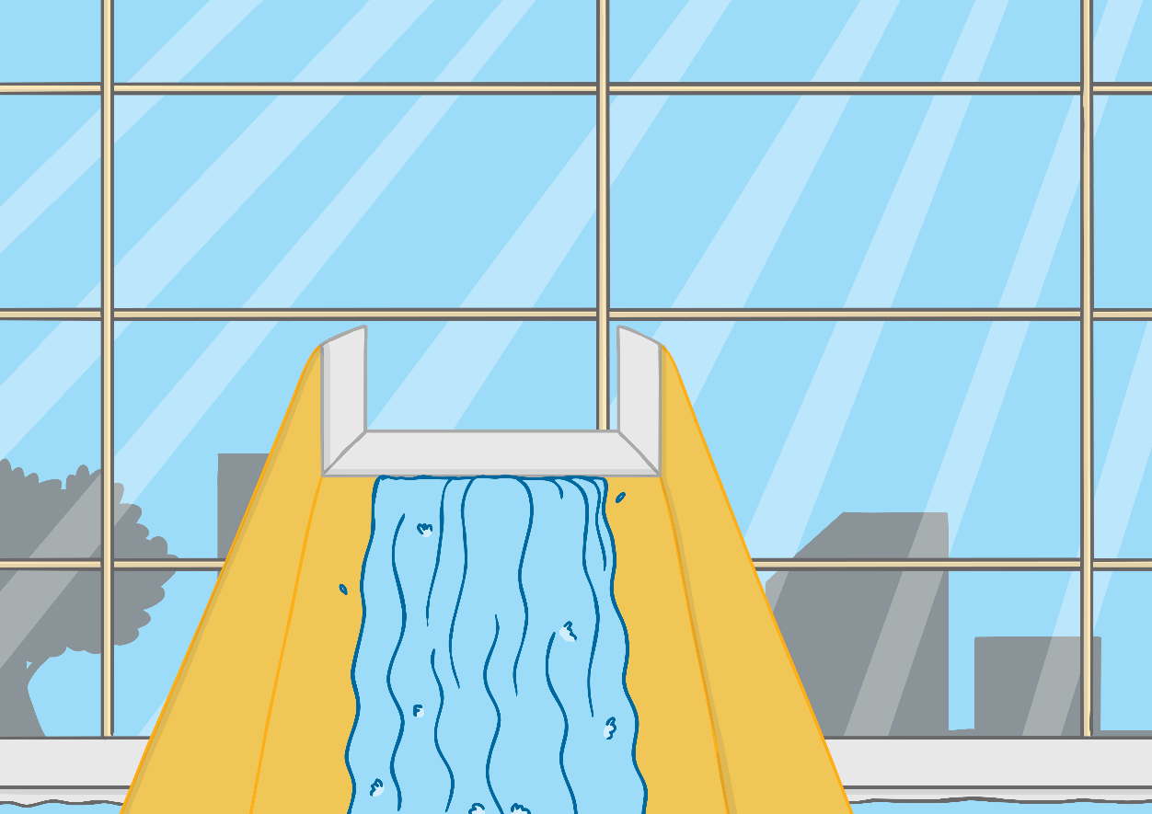
Apply
It was too high for Kit.
Sound Buttons On/Off
Show

Slide 14
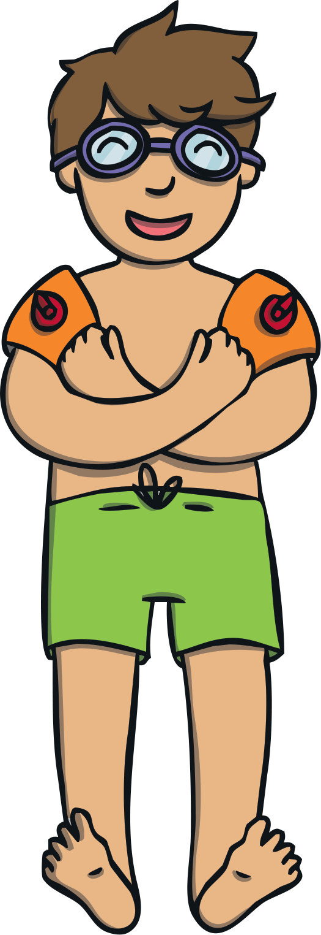
Apply
“You were very brave to go down the slide Kit, even though you didn’t like how high it was.” said Gabi.
“I loved it in the end!” said Kit. “Let’s go on again!” he said, and off they all went for another go. It wasn’t too high for Kit this time!

Slide 15
Today, we have recapped…
ai
ee
igh
oa

