Slide 2
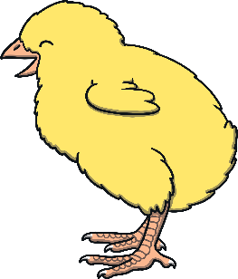
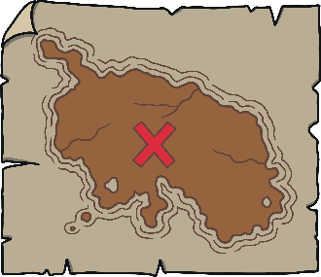
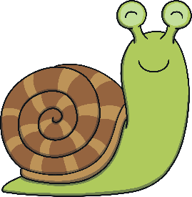
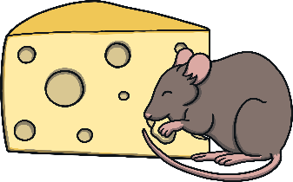
Revisit and Review
Let’s practise Sam’s Sounds and Tricky Words!
v
air
er
j
z
ch
y
ng
qu
ear
x
igh
ai
oo
ar
oa
th
oi
ee
w
ur
ure
ow
oo
or
th
sh
they
here
my
was
you
he
she
we
me
be

Slide 3
Duck Name and Letter Match
Revisit and Review
Can you match the duck to their duckling?
Can you say the name and sound the letter makes?

Slide 4
Revisit and Review
J
y
j
p
o

Slide 5
Revisit and Review
M
i
a
x
m

Slide 6
Revisit and Review
H
h
v
n
u

Slide 7
Revisit and Review
A
f
d
a
y

Slide 8
Revisit and Review
Z
e
r
b
z

Slide 9
Revisit and Review
X
x
s
k
t

Slide 10
Today, we are recapping…
Teach
sh
th
th
ng

Slide 11
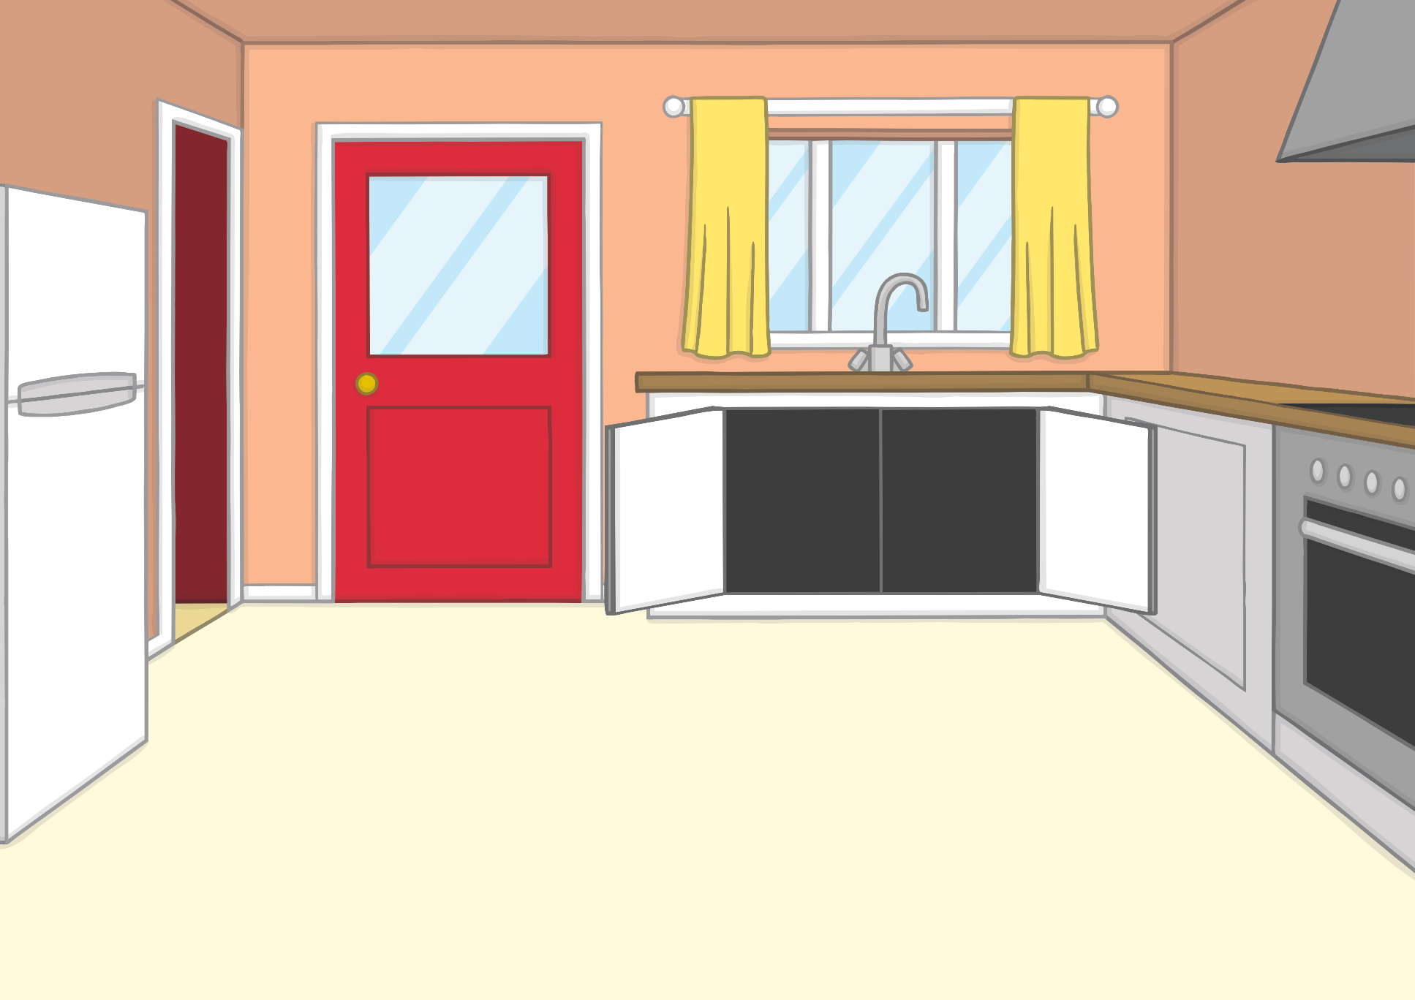
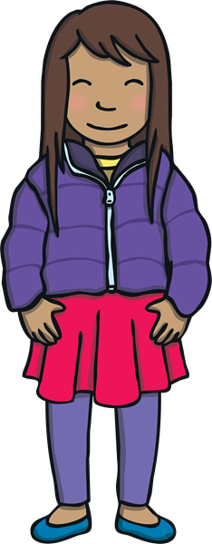
Teach
“We need to go to the big shop,” said Mum, as she looked in the food cupboards. Kit and Sam put on their coats and shoes while Mum got the carrier bags ready.

Slide 12
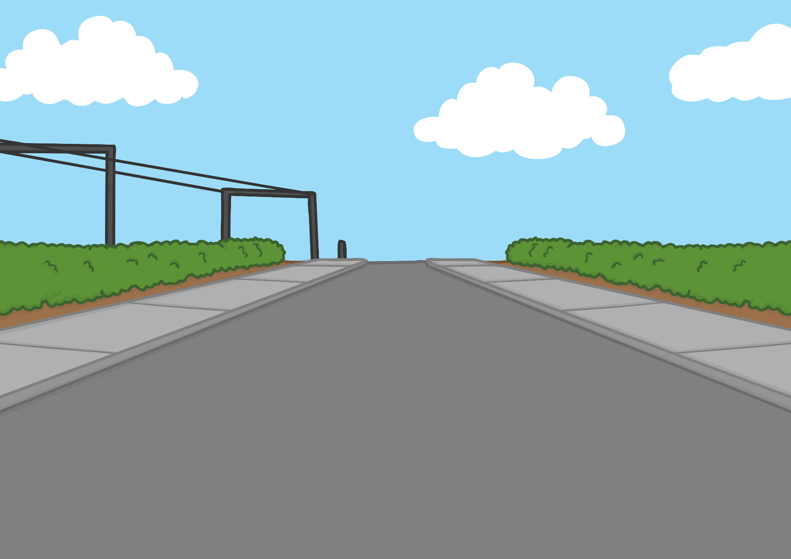
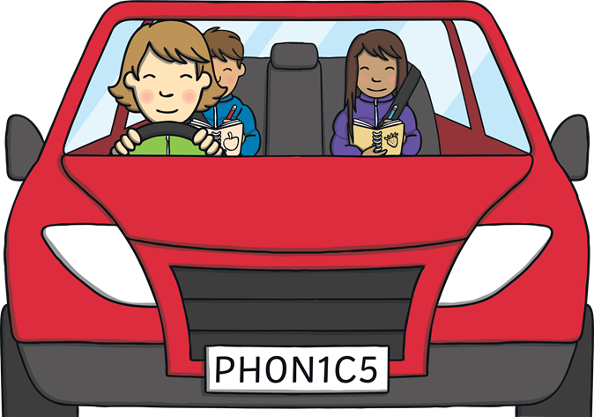
Teach
On the way, Kit and Sam drew pictures of the things they might need. “Can we have fish for tea?” said Sam. “Fish is my favourite!”
“Of course,” said Mum.

Slide 13
Shopping List
Practise
Kit and Sam have drawn some pictures of what they need from the shop. Can you help to write a word to match?

Slide 14
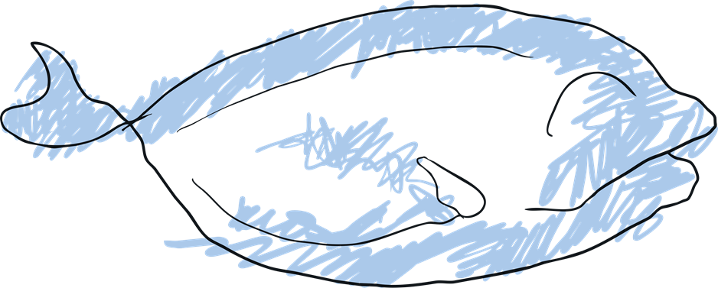
Practise
fish
Show Suggestion

Slide 15
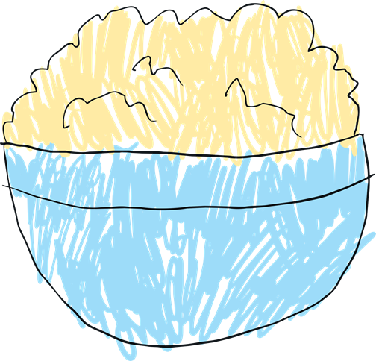
Practise
mash
Show Suggestion

Slide 16
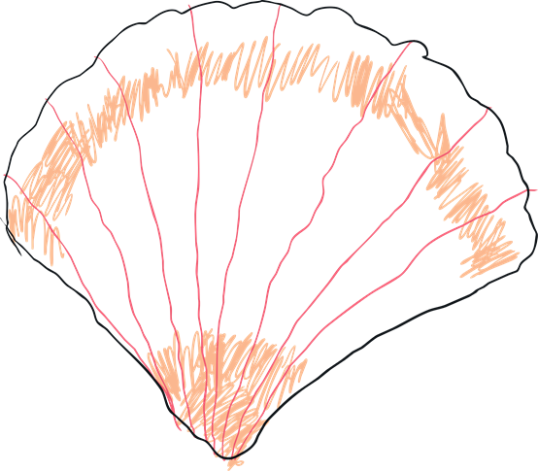
Practise
shell
Show Suggestion

Slide 17
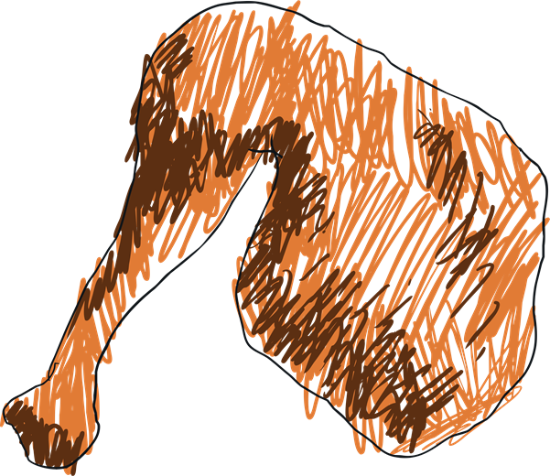
Practise
chicken thigh
Show Suggestion

Slide 18
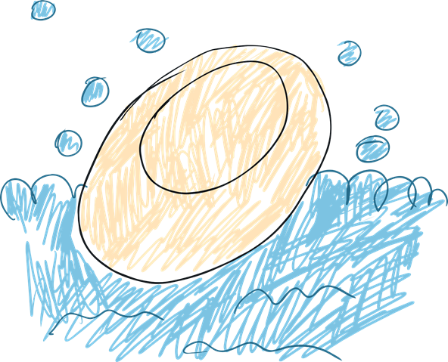
Practise
bath soap
Show Suggestion

Slide 19
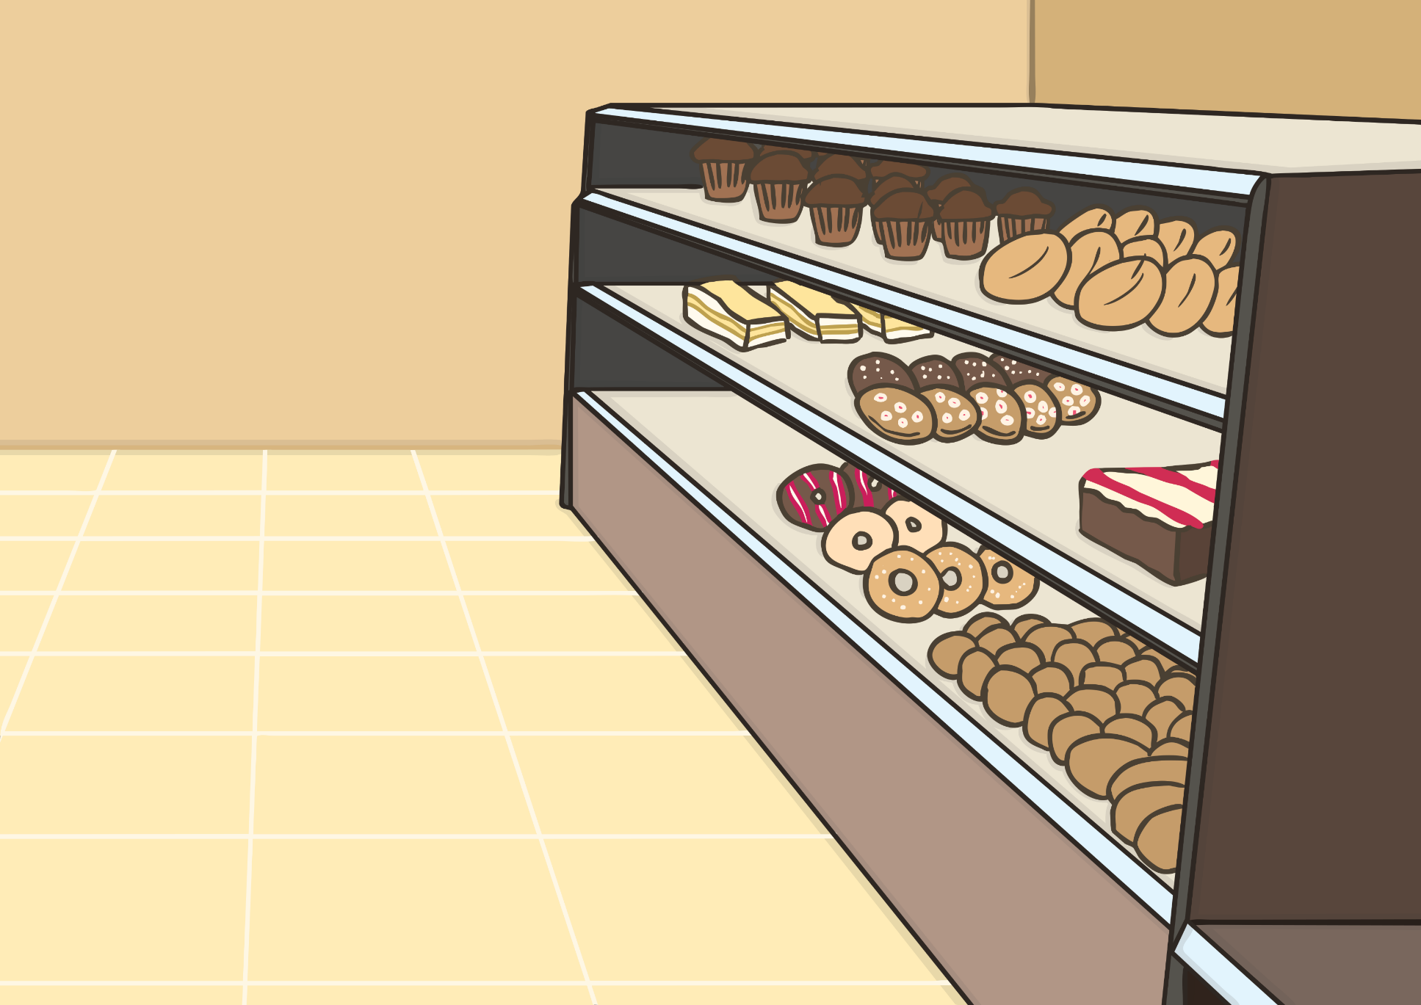
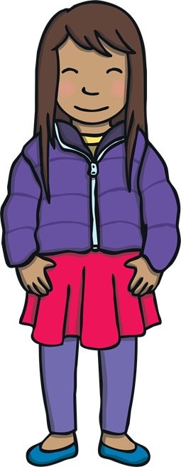
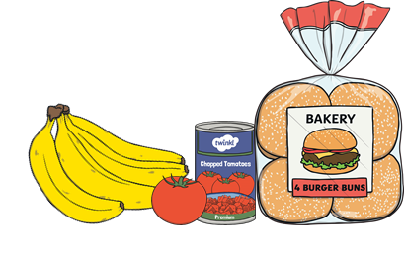
Apply
Kit and Sam helped Mum to get everything they needed and put it carefully in the trolley. They even got a special long cake for dessert.

Slide 20
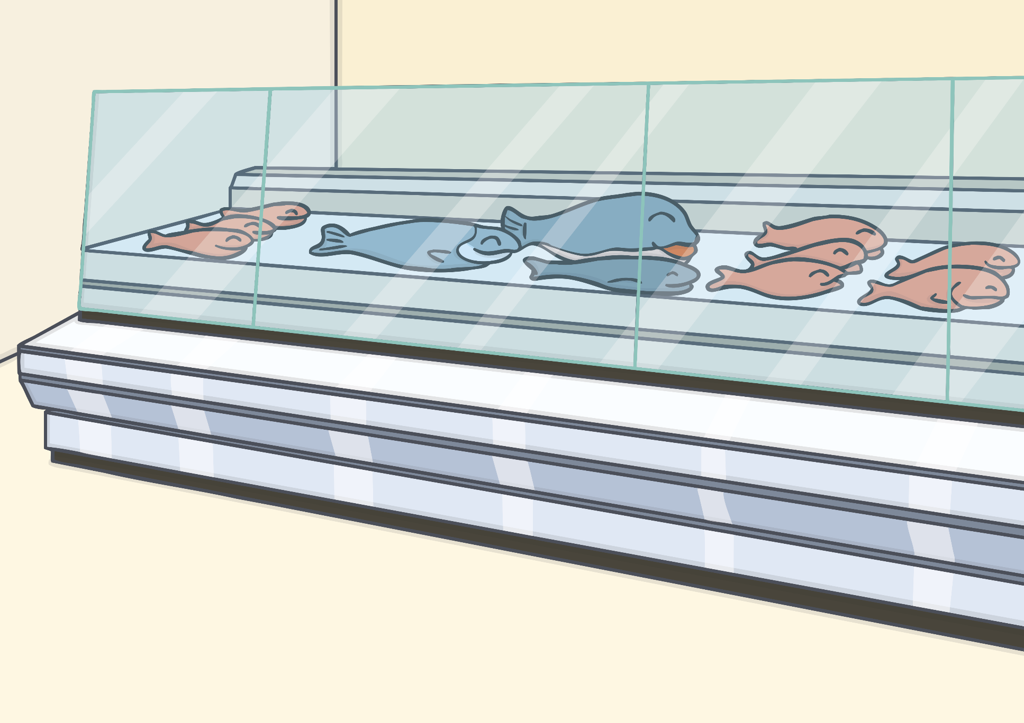
Apply
“We still haven’t found the fish,” said Sam, disappointedly. “Hang on,” said Mum, “here it is!” As they turned into the aisle, Kit and Sam saw a huge stall with lots of different fish!

Slide 21
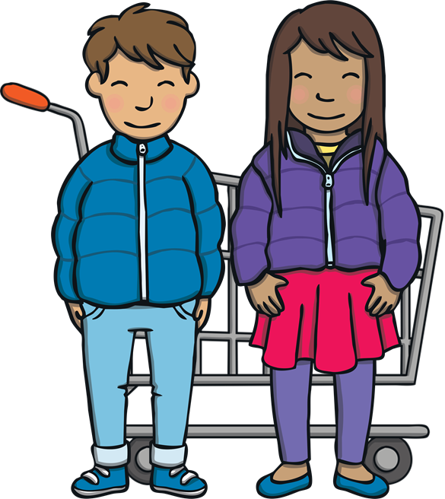
Caption Time
Apply
What did Kit and Sam think was best about the shop? Write a caption to match the picture.
X
Click ‘Sound Buttons On/Off’ to select whether you want to show sound buttons under the sentence.
Click me for Kit’s teaching tips!

Slide 22
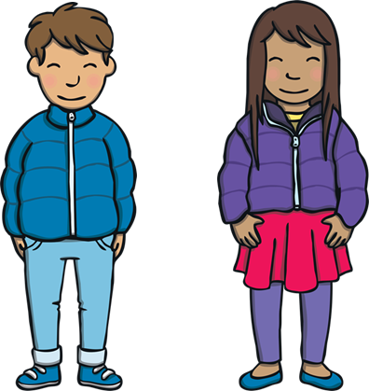
Apply
Here is a good shop for fish.
Sound Buttons On/Off
Show

Slide 23
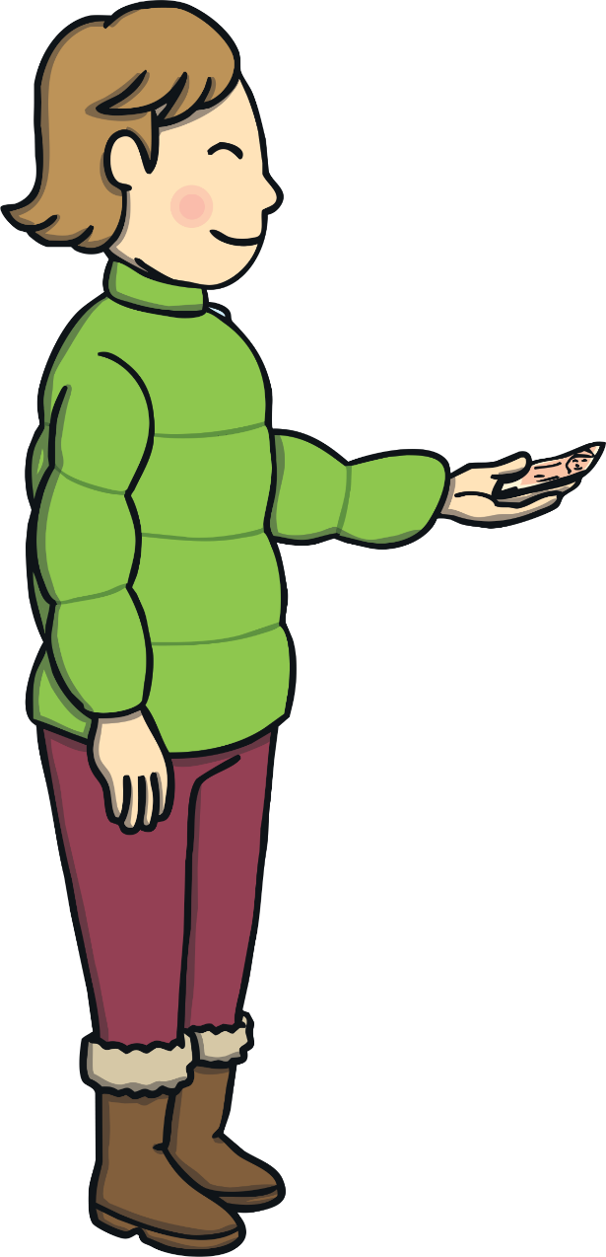
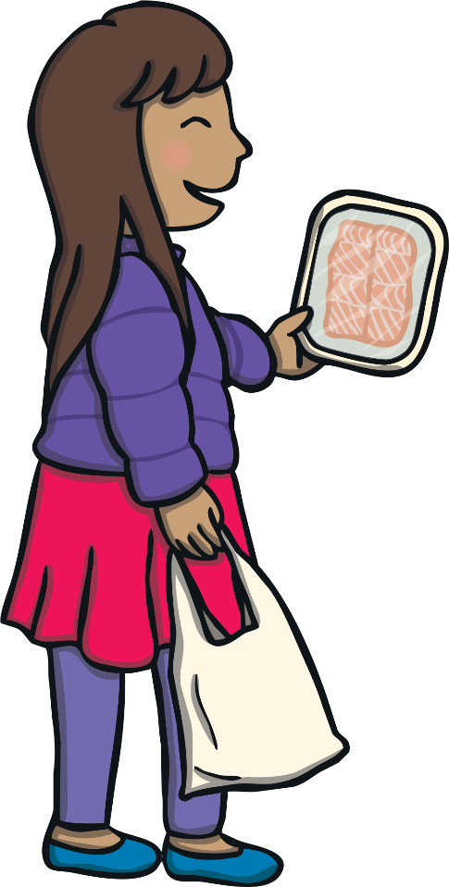
Apply
Mum got out her cash and paid at the till. Kit and Sam helped to put the shopping into Mum’s carrier bags. “I can’t wait for tea!” said Sam.
“I am glad we found the fish,” said Kit, “but I’m glad we found the cake too!”

Slide 24
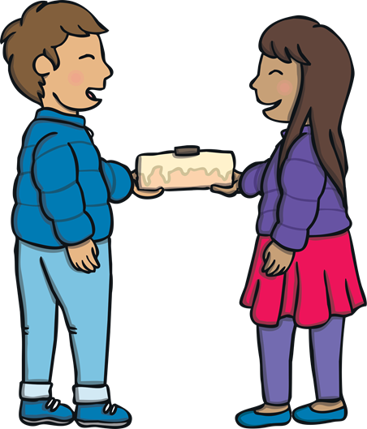
Today, we have recapped…
sh th th ng

